Slide 1
Up Close Owl
Using charcoal to create visual texture and variation in value

Slide 2
Art Class Rules - How to have FUN!
All Classroom rules apply.
Relax and get ready to have fun!
Raise your hand and ask for help if you start to feel frustrated, we are here to help.
KEEP IT POSITIVE when talking about your work and your classmate’s work, everyone’s art is different.
Stand back and take a look - you might think differently about your work if you use the 5 ft rule!
Sometimes less is more (especially when it comes to paint) so dont overdo it.
Enjoy yourself and be proud of your finished work. There are no mistakes in art, just chances to try new things.

Slide 3
Perspective
When you see something far away what do you notice?
When you see something close up, does what you notice change?
Are your eyes drawn to something specific that you didn’t notice before?
Are you drawn in by a textural detail...or maybe a stand out color?
Notes:
These questions are rhetorical – get them thinking about close up vs. distance…
Remind them to ask themselves these questions as you show them up close vs. full photo pictures

Slide 4
Flying Owl…
What do you notice?

Slide 5
What do you see now?
Notes:
Do you notice more details?
What stands out – his feathers, his eyes or beak?
Can you imagine a different setting?

Slide 6
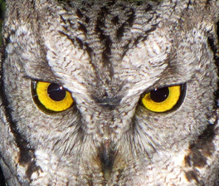
What does your imagination say about this owl?
Do you think it is day….or night?
Is the owl sitting in a hallow tree…or flying?

Slide 7
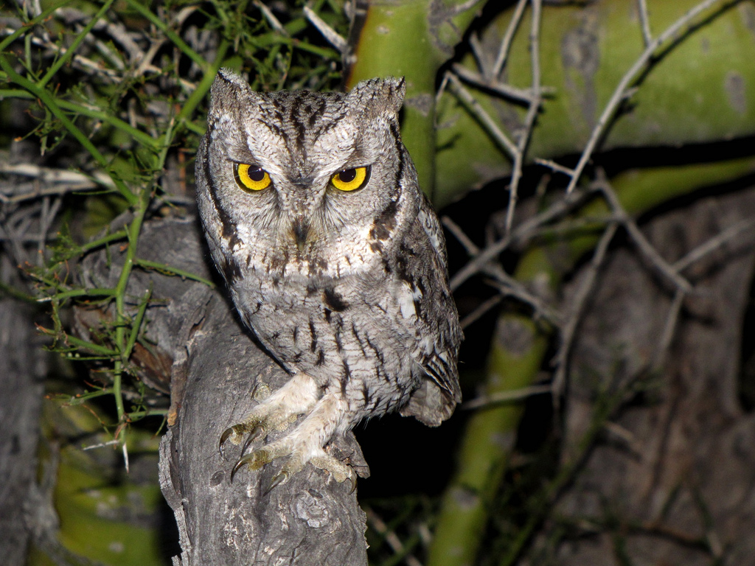
What do you see now?
Notes:
This is the same owl from a distance…

Slide 8
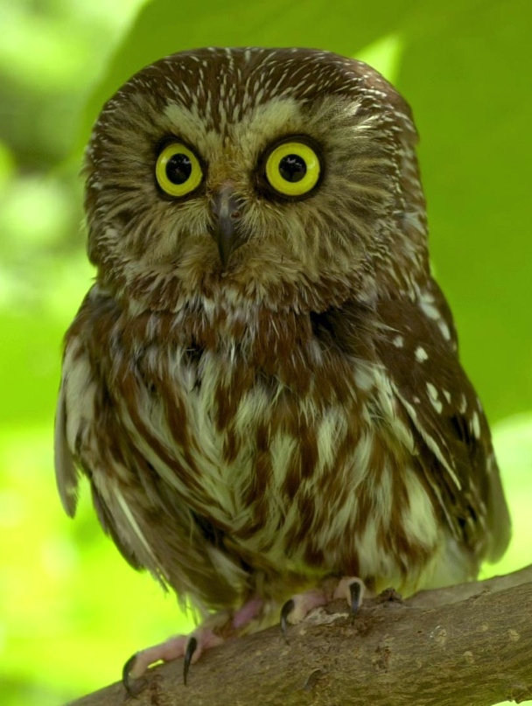

Slide 9
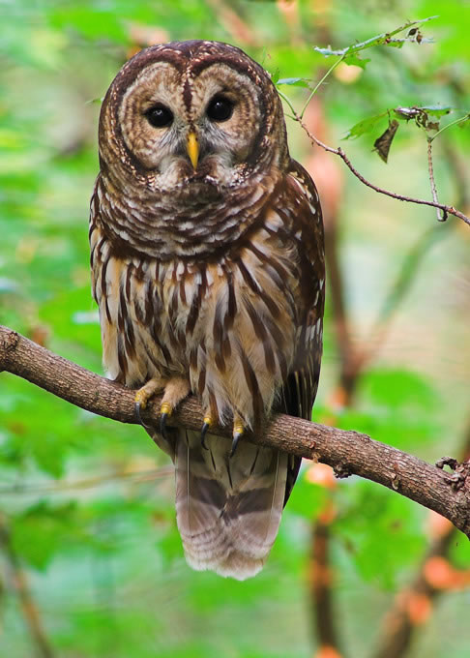
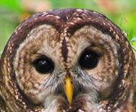

Slide 10
Vocabulary
Texture — the way something feels
Visual texture — the way something looks like it would feel, duplicated in a 2D medium
Value — the degree of lightness or darkness

Slide 11
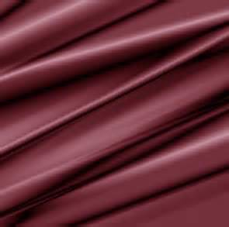
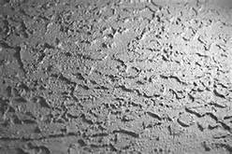
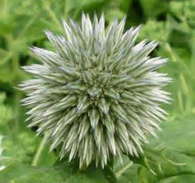
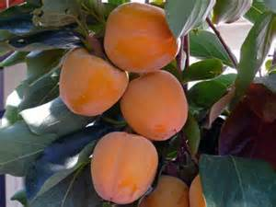
Visual texture in images
Notes:
These textures may mimic actual textures or be can imagined textures
The Mimics drapes or folds in a satiny fabric
Simulates a rough, rocky surface
Something sharp
Something soft and smooth

Slide 12
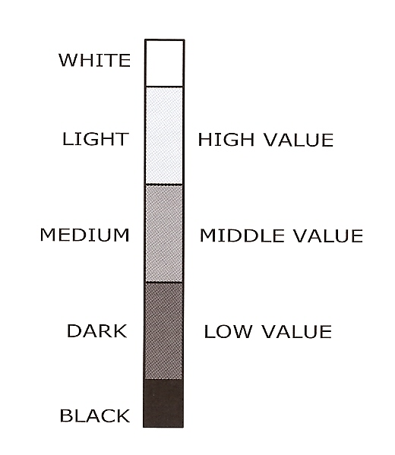
Value
The function of Value is to tell us how light or how dark a given color is. White is at the top, representing pure light. Between these are a number of divisions of gray, regularly graded between black and white.
On a Value Scale, you start the scale at 0 (Black) work up the scale to 10 (White)

Slide 13
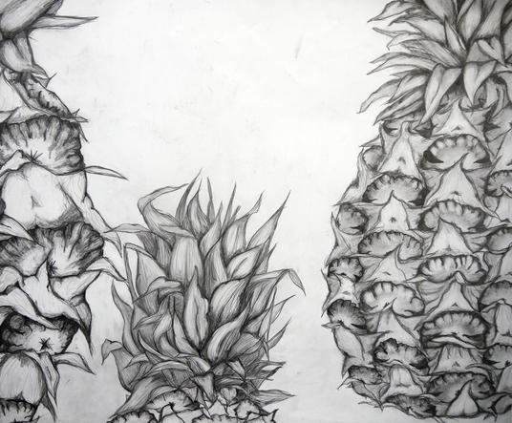
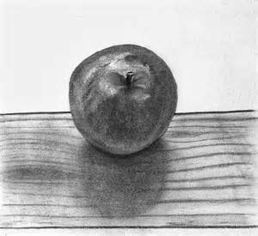
Creating visual texture with charcoal as a medium
Notes:
What types of texture do you see in these different images?
Where the charcoal is blended do you see softness?
Where the charcoal is not blended do you see sharp edges or fine lines?

Slide 14
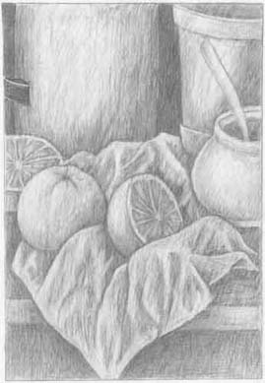
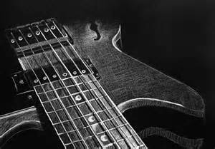
Value - dark to light – using charcoal
Notes:
Changing value can create shadows, depth or lightness
It can add texture be making this appear sharper or softer…

Slide 15
Instructions
Use the charcoal to sketch a basic outline of the owls head, go VERY lightly, you can make lines darker later but you cannot erase them like a pencil.
Sketch a rough outline for eyes – add beak and ears if you’d like. Go close up to the owls face, you can even go off the page.
Add visual texture to the owl
Create lines for feathers - soft and har
Enhance areas, add texture and depth
Use thick lines and thin lines to vary the texture and value
Leave some areas totally white to add highlights.
If you’d like, use a tissue to blend the charcoal where you want to add softness or lighten the value
To make your work really pop, select a bright colored pastel and color in the eyes and beak and even parts of the background.
Notes:
To make your work really pop, select an area or two (usually the eyes, background or beak) to add color to using chalk pastels.

