Slide 1
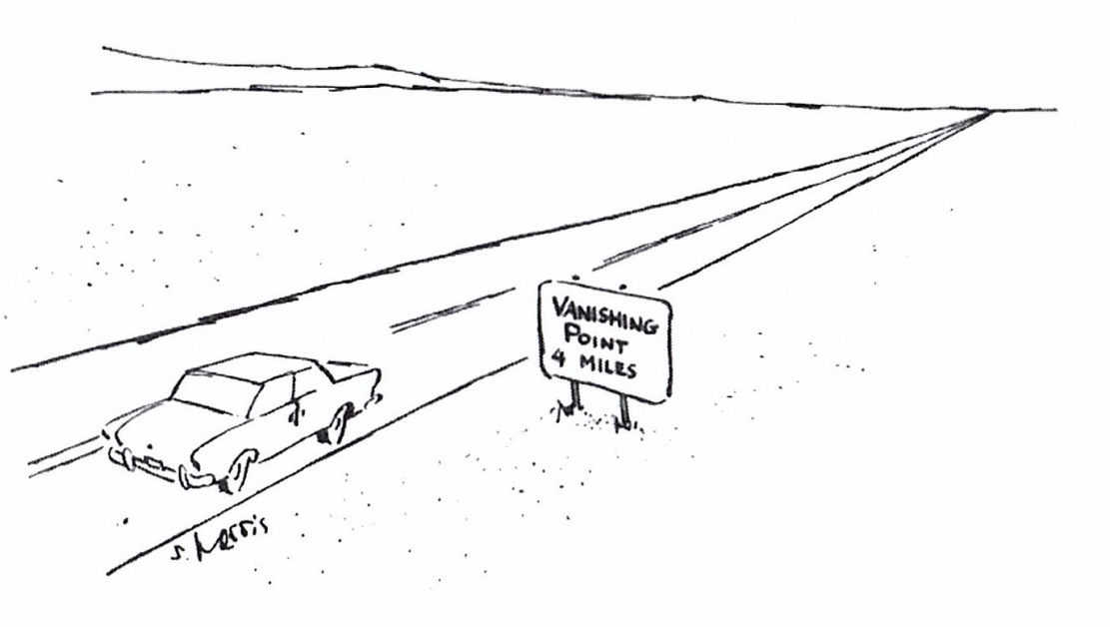
Artist Techniques for Creating the
Illusion of
Depth and Space
Linear
Perspective
&
Atmospheric
Perspective
Creekside Art Docent February 2019

Slide 2
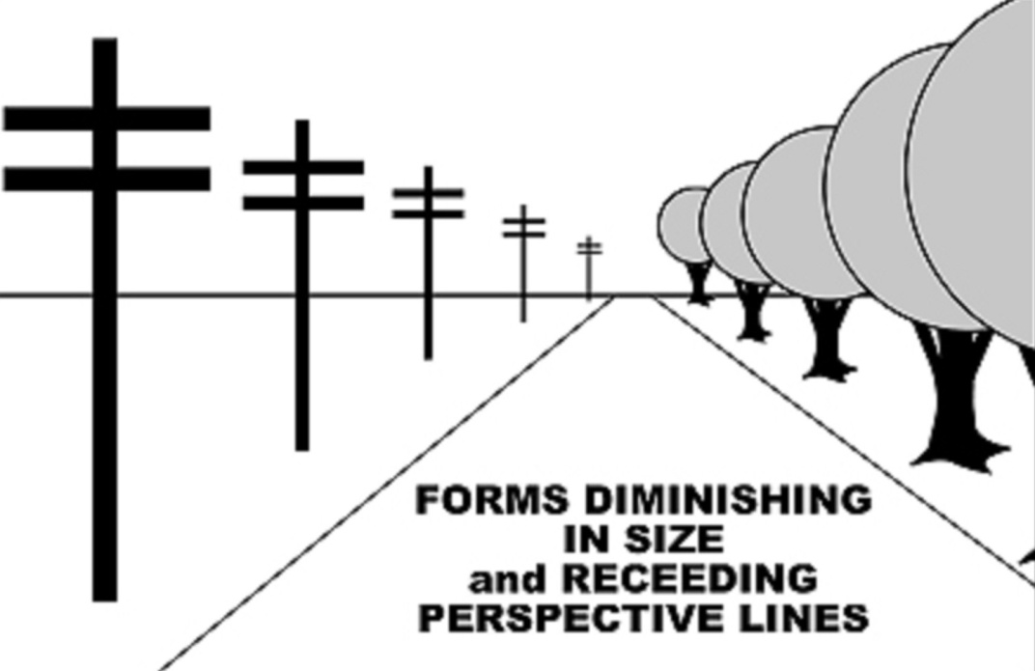
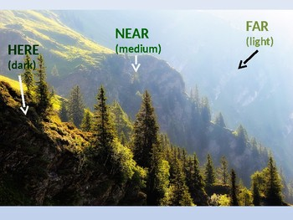
Today's Art Project:
We are using the Single-point (or One-point) Linear Perspective technique to create a scene painted with water-color that creates the illusion of Depth and Space.
We will keep in mind:
As distance grows between the observer and an object, the apparent size is reduced.
Lines that are parallel in reality appear to converge or move toward each other as apparent distance increases.
Objects that are nearest in the scene are darkest.
Objects that are more distant are lighter due to the Earths atmosphere – the more distance, the more atmosphere, the lighter the object.

Slide 3
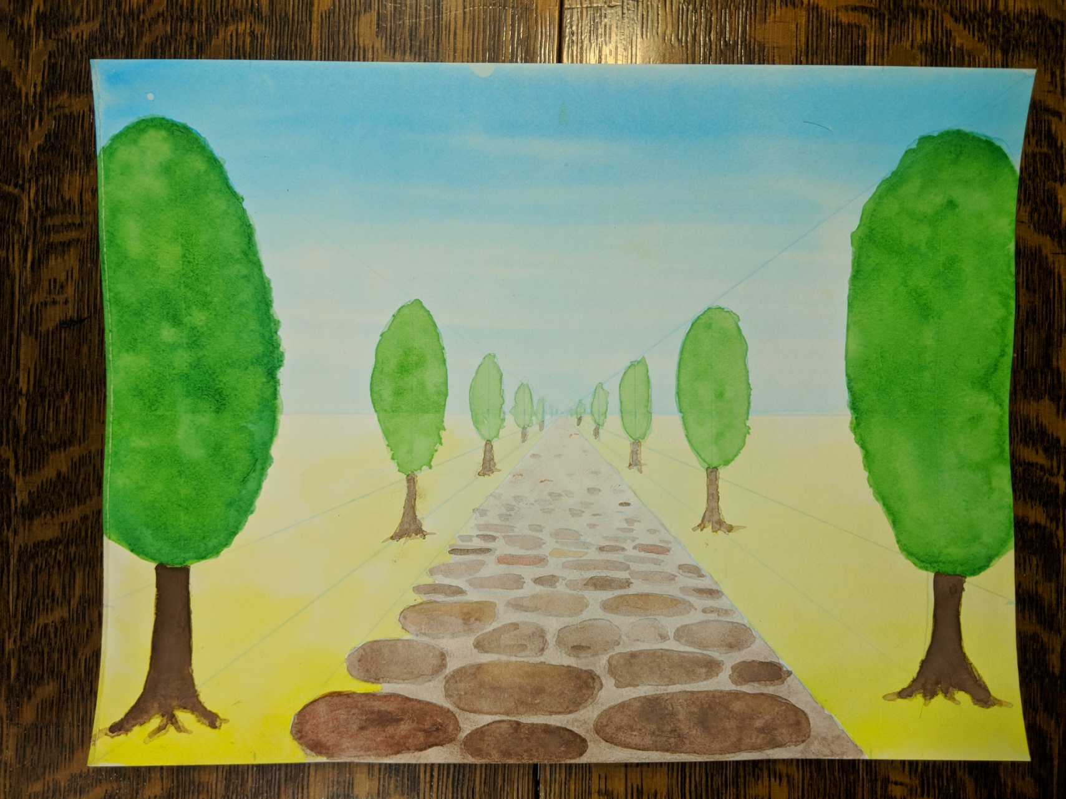
Today's Art Project:

Slide 4
Part 1 - Drawing:

Slide 5
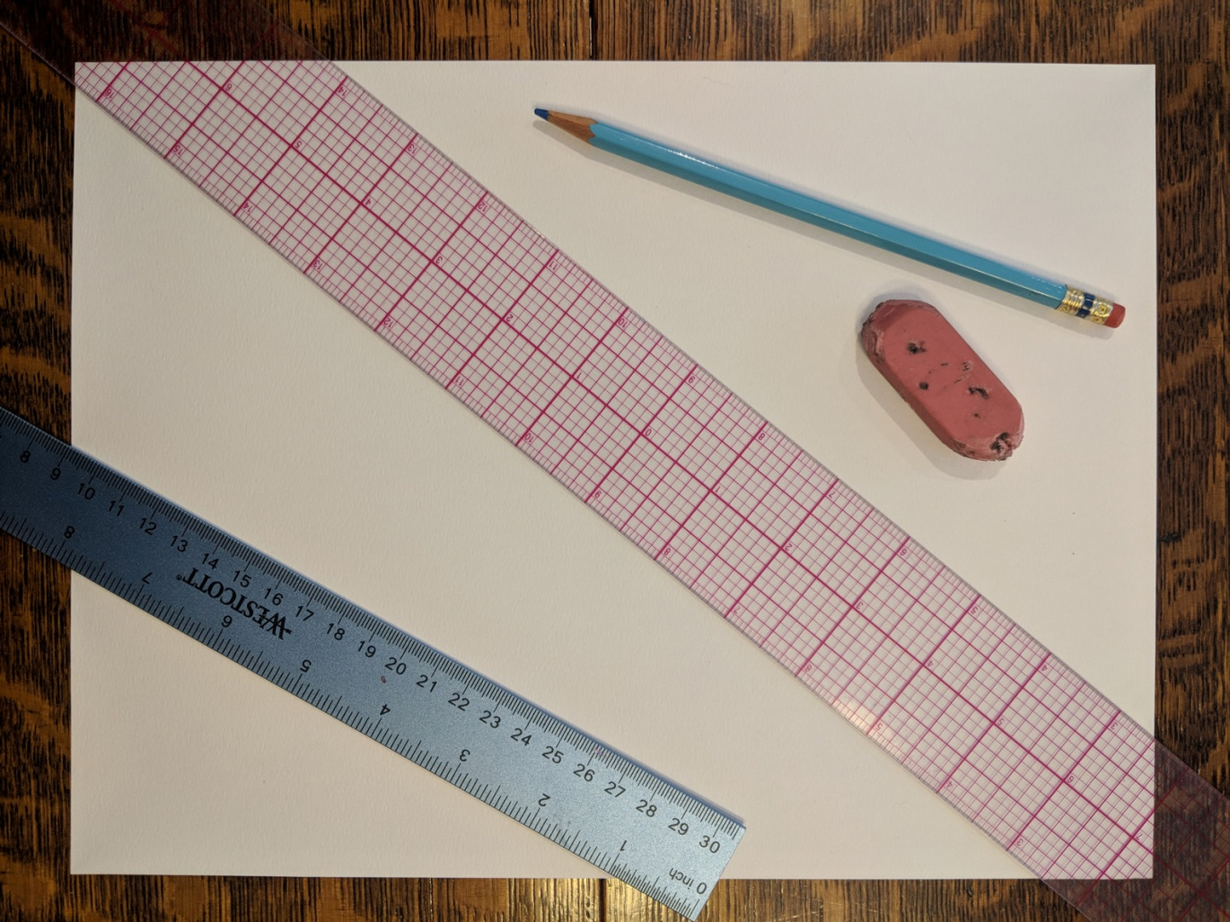
Drawing Supplies:
One 9x12 140# watercolor paper.
One non-reprographic blue color pencil.
18” clear straight edge.
12” ruler.
Large eraser.

Slide 6
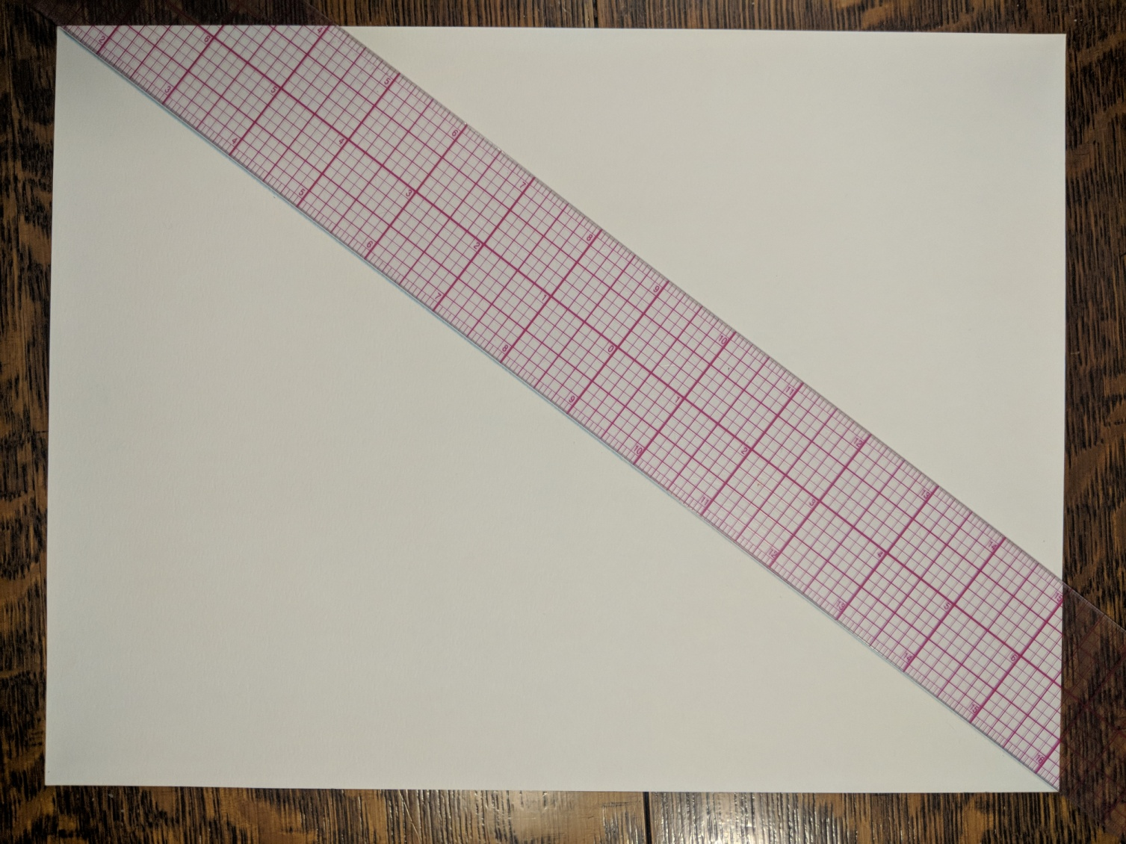
Draw Linear Perspective Lines:
Using straight edge, draw diagonals between opposite corners with blue pencil.
The point where they cross is called the VANISHING POINT.
Vanishing Point

Slide 7
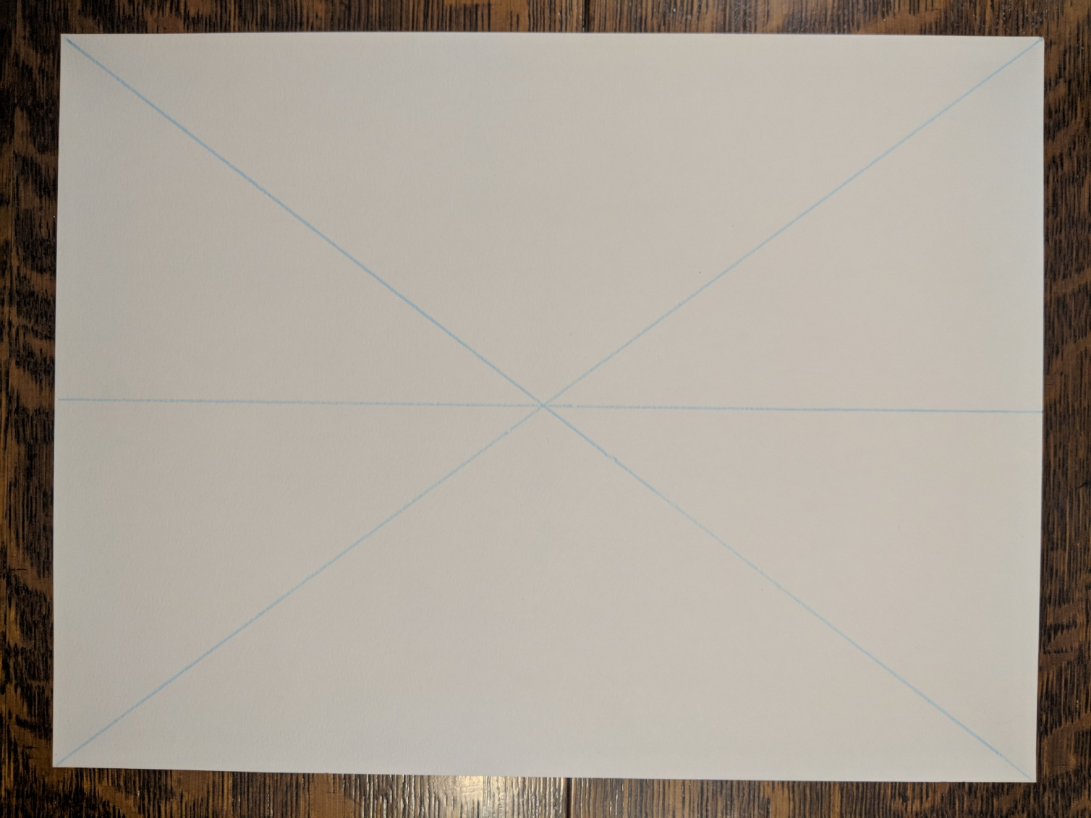
Draw Horizon Line:
Measure up on the left 4 ½” and make a small mark. Using straight edge, draw the HORIZON LINE through the small mark and center of the “X” made before.
Horizon Line
4 ½”

Slide 8
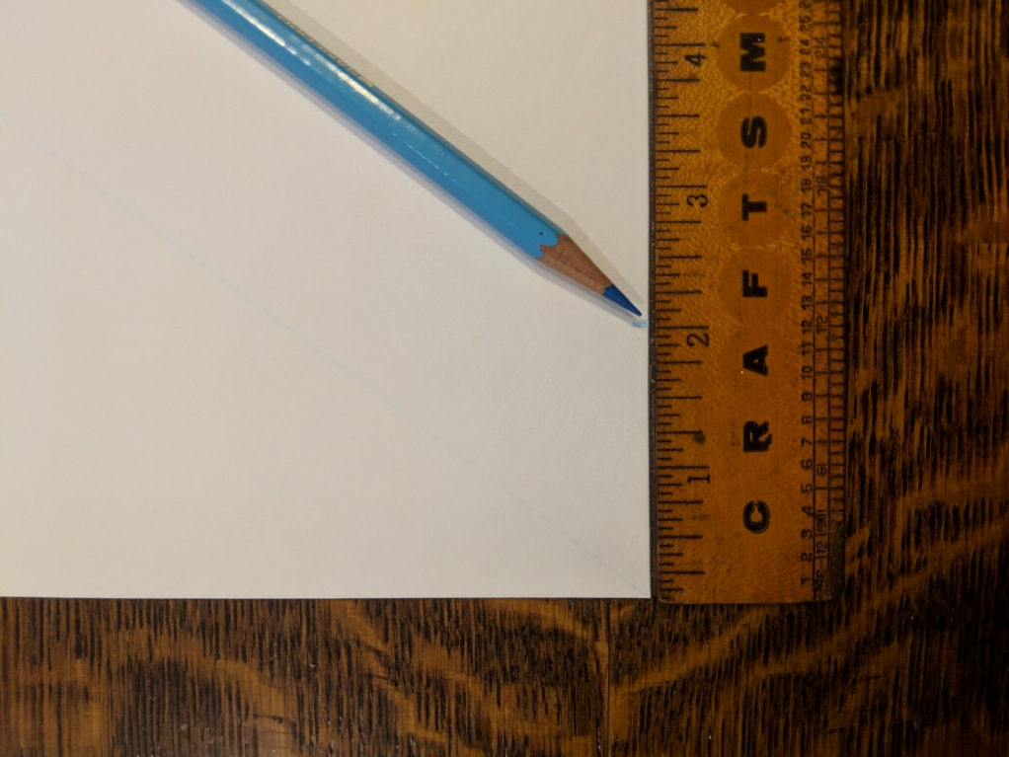
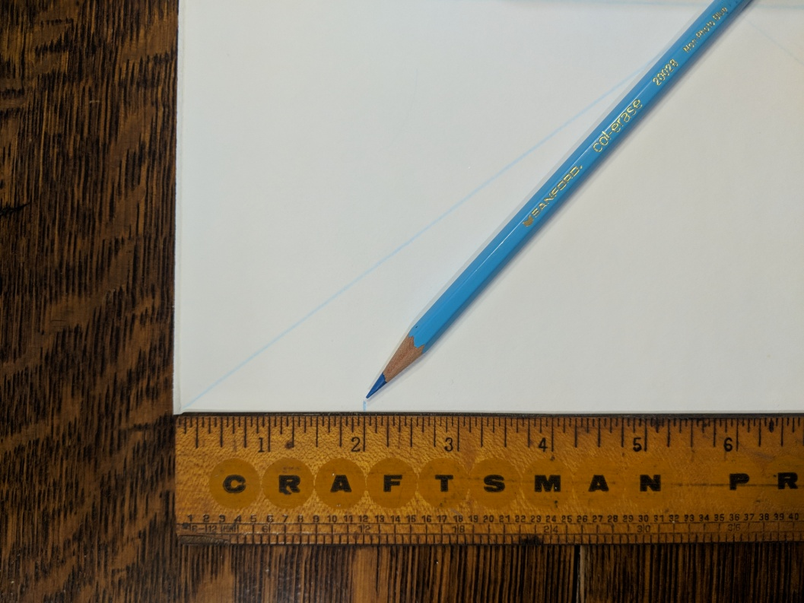
Add Perspective Lines:
Measure 2” UP and 2” IN from each bottom corner making SMALL marks.

Slide 9
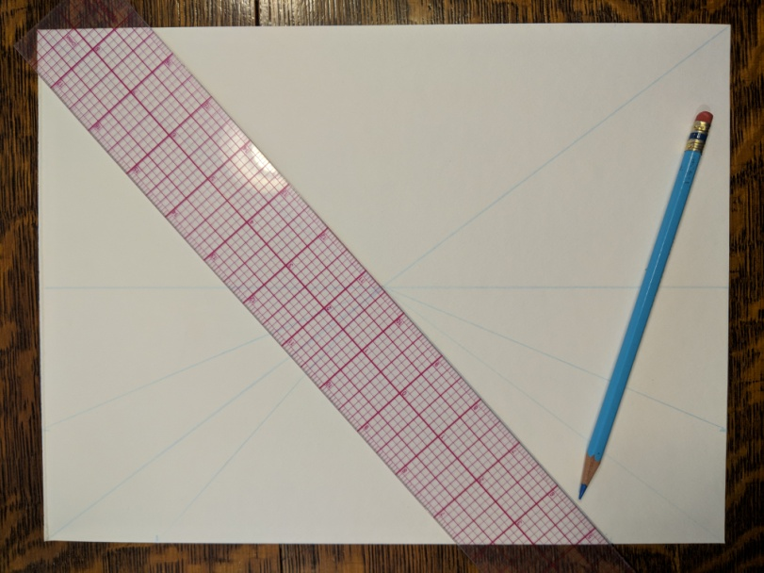
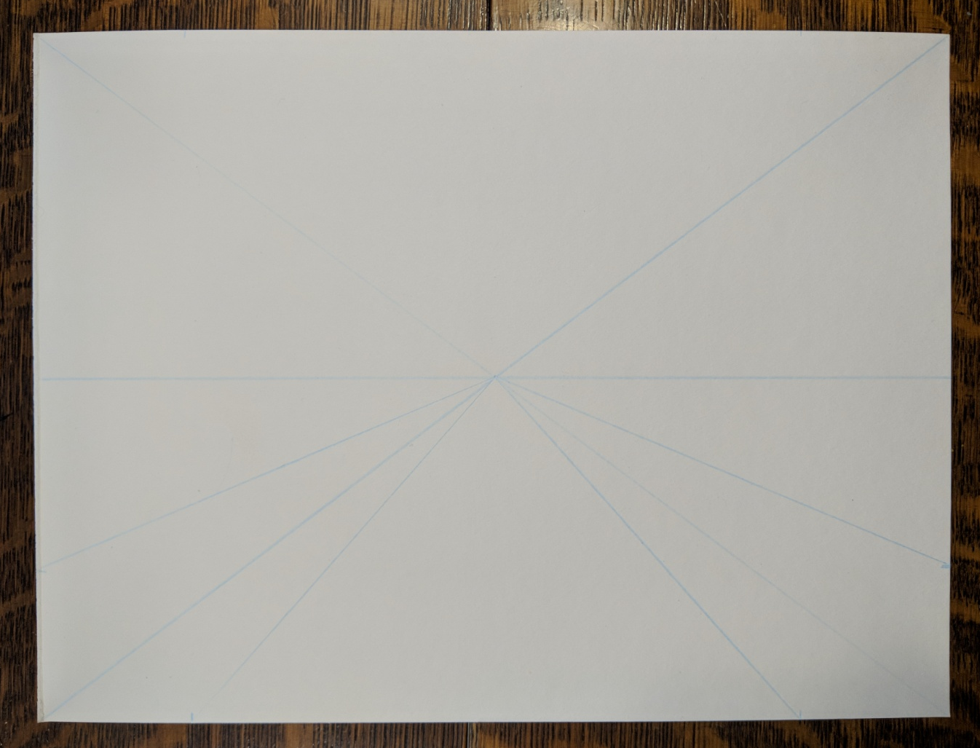
Add Perspective Lines:
Use straight edge to connect each small mark with the VANISHING POINT.

Slide 10
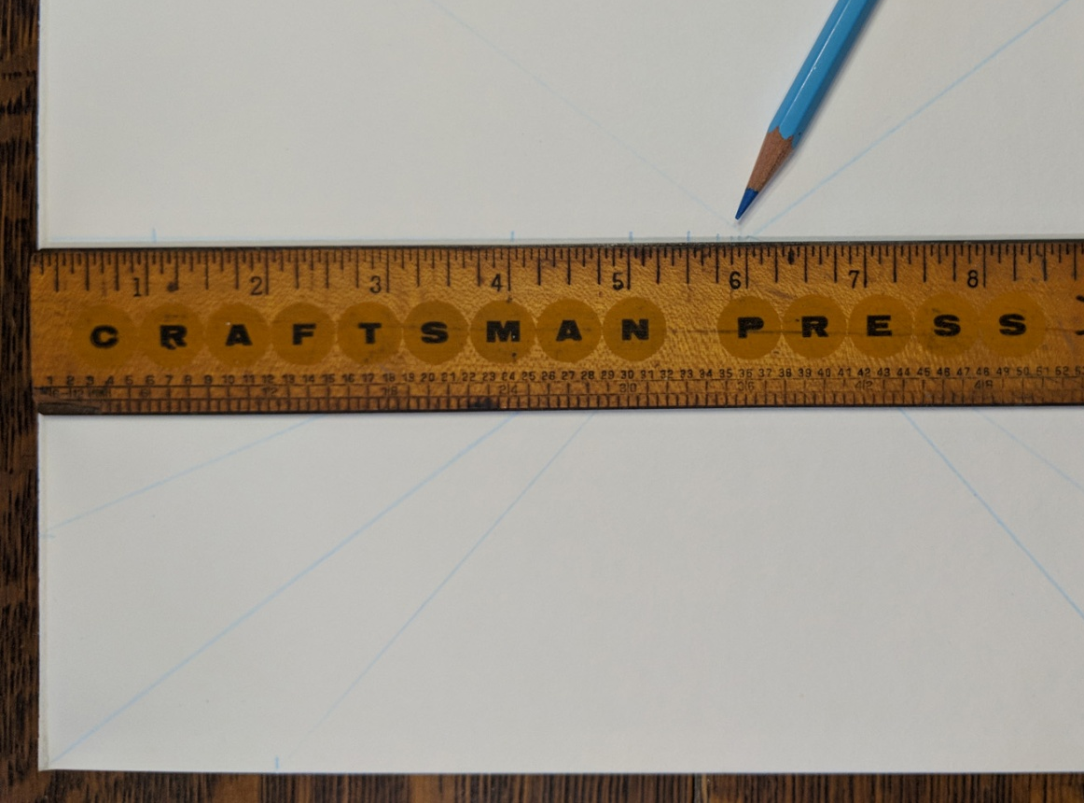
Measure Tree Spacings:
Measure along the HORIZON LINE from the LEFT side making SMALL marks at 1”, 4”, 5”, 5 ½”, 5 ¾”, and 5 7/8”. Repeat from RIGHT side.

Slide 11
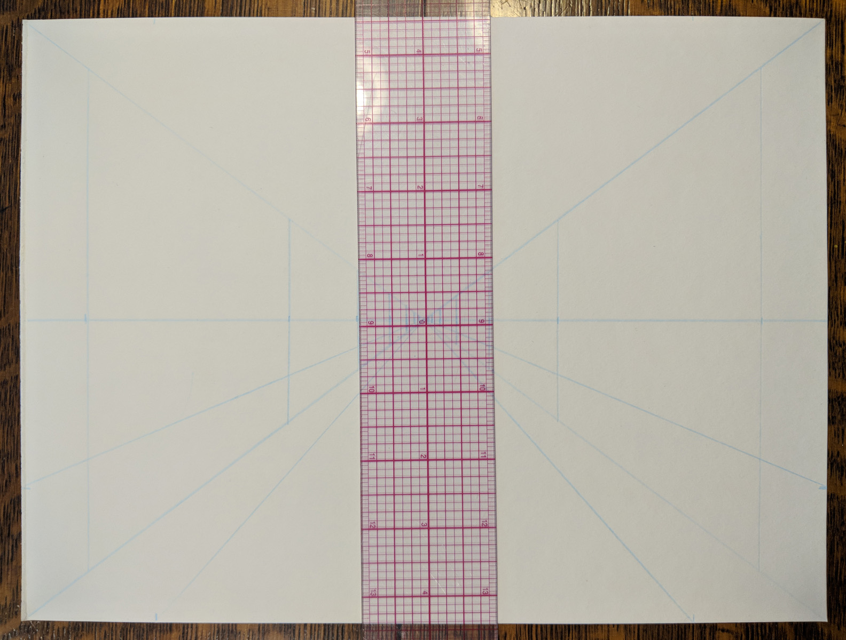
Draw Tree Sticks:
Draw VERTICAL sticks through each small mark – in between the PESPECTIVE LINES that made the original “X”. There should be 12.

Slide 12
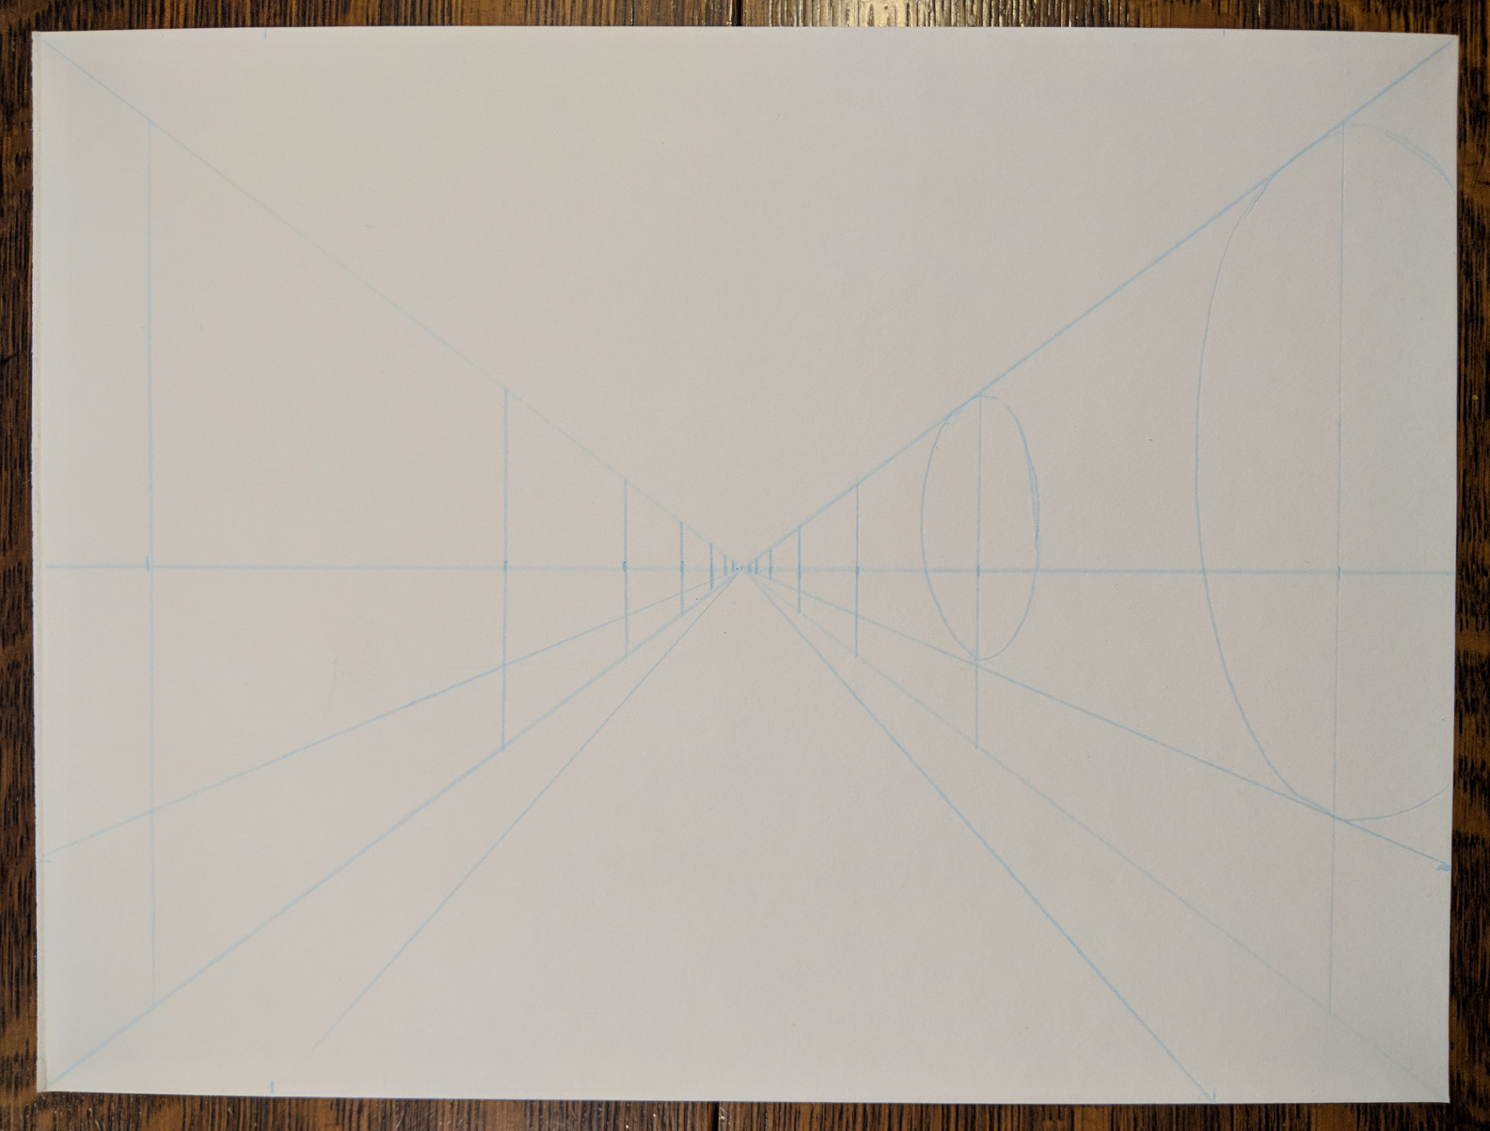
Draw Tree Canopies:
On the RIGHT side, draw basic ovals around the sticks between the top PERSPECTIVE LINE and the next one, just below the HORIZON LINE.
Horizon Line

Slide 13
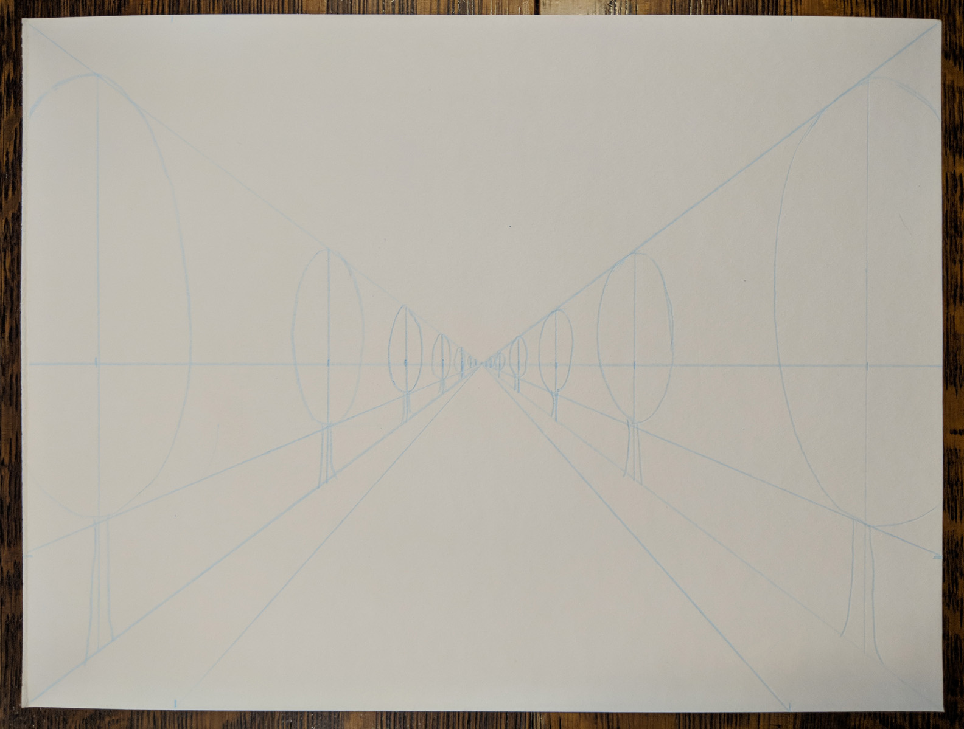
Finish Trees:
Repeat ovals on LEFT side. Then add the tree trunks, remembering that more distant objects are smaller than closer objects.

Slide 14
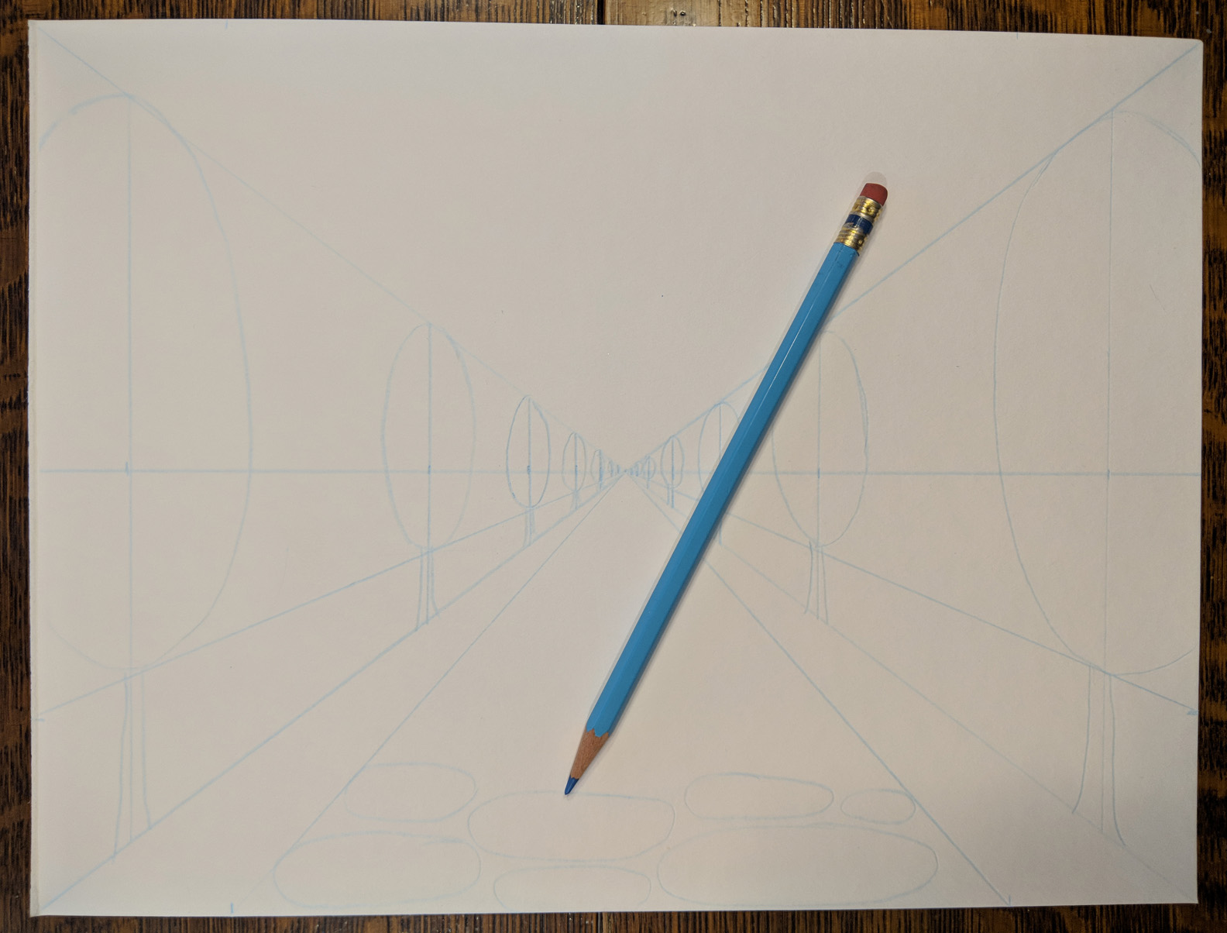
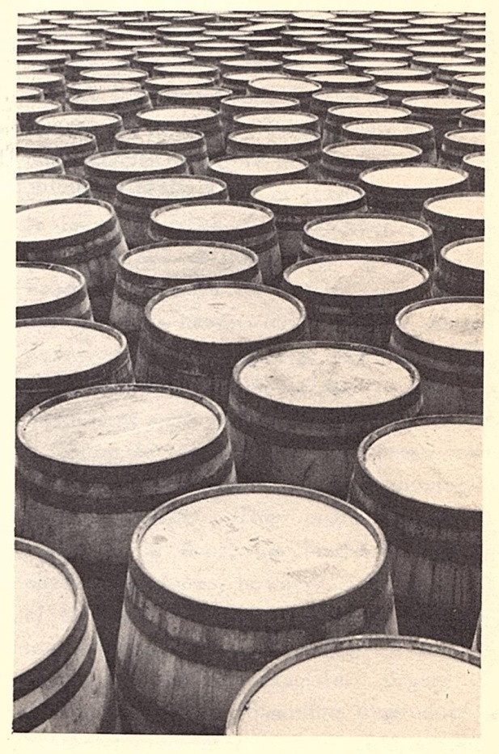
Draw Stepping Stones:
Draw rough oval stones, taking care to make the closer ones “fatter” and…

Slide 15
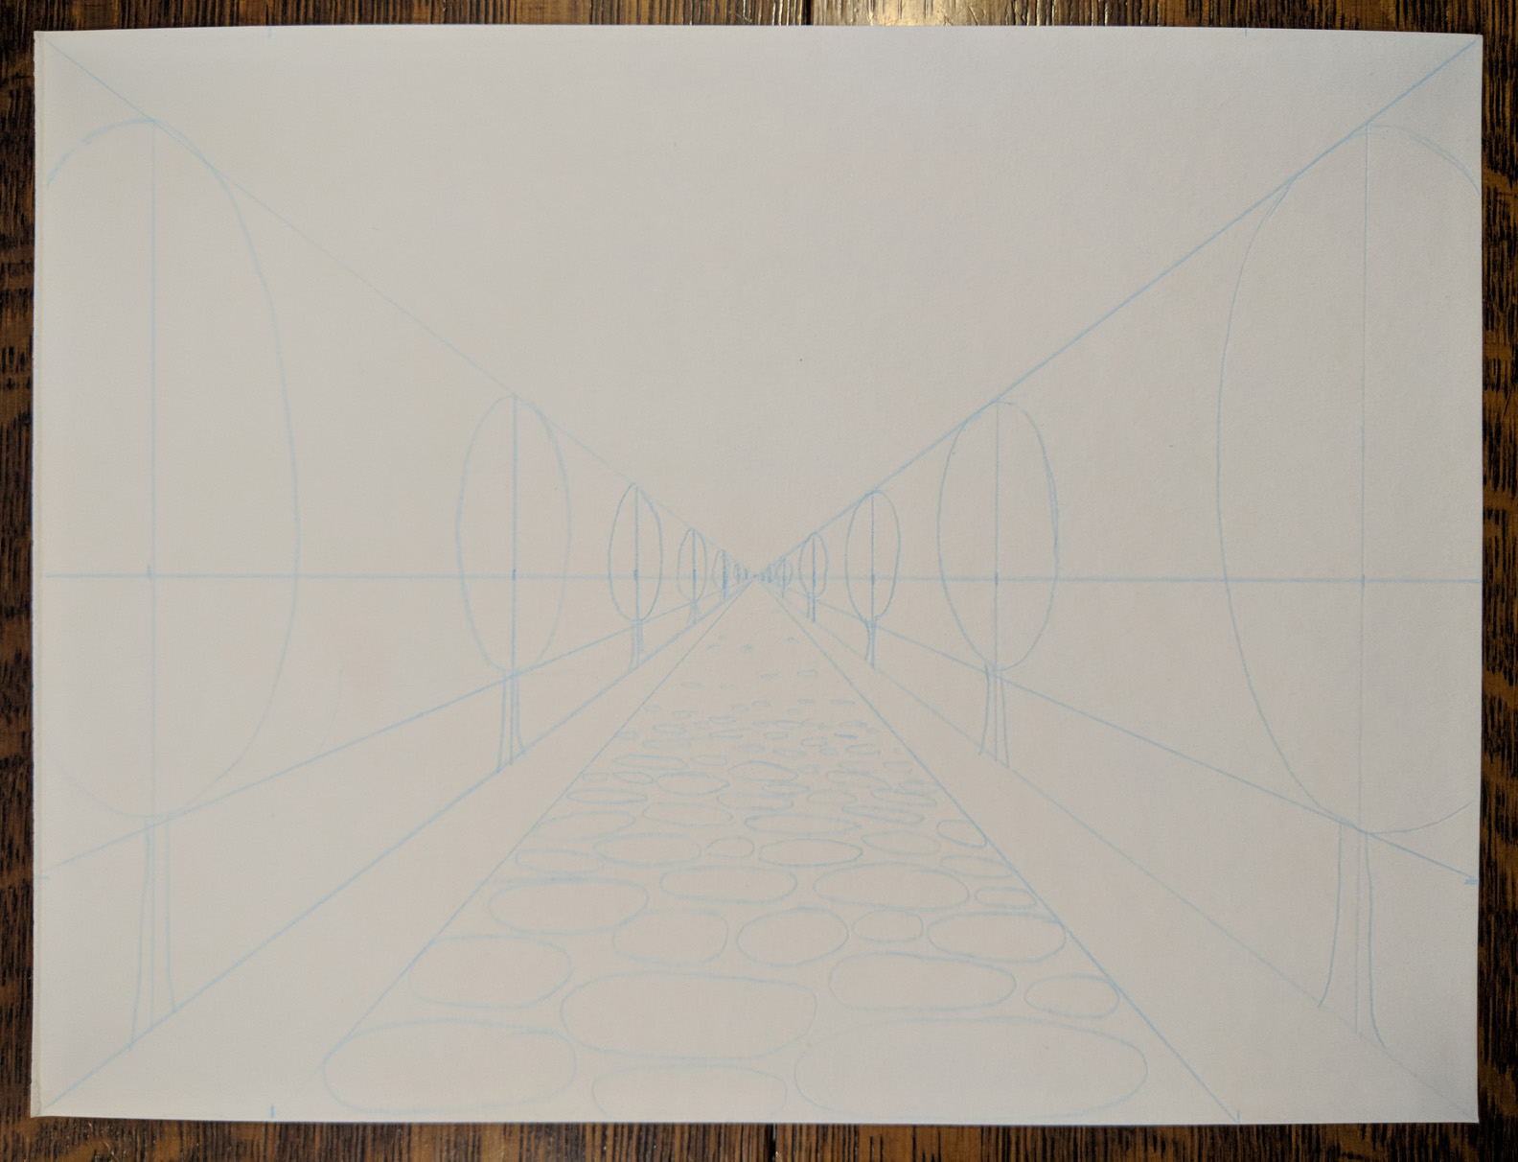
Draw Stepping Stones:
Continue to draw them “skinnier” and “skinnier” as they get further away.
Only fill in the path half way back.

Slide 16
Before we paint, we need to erase all our perspective blue lines!

Slide 17
Part 2 - Painting:

Slide 18
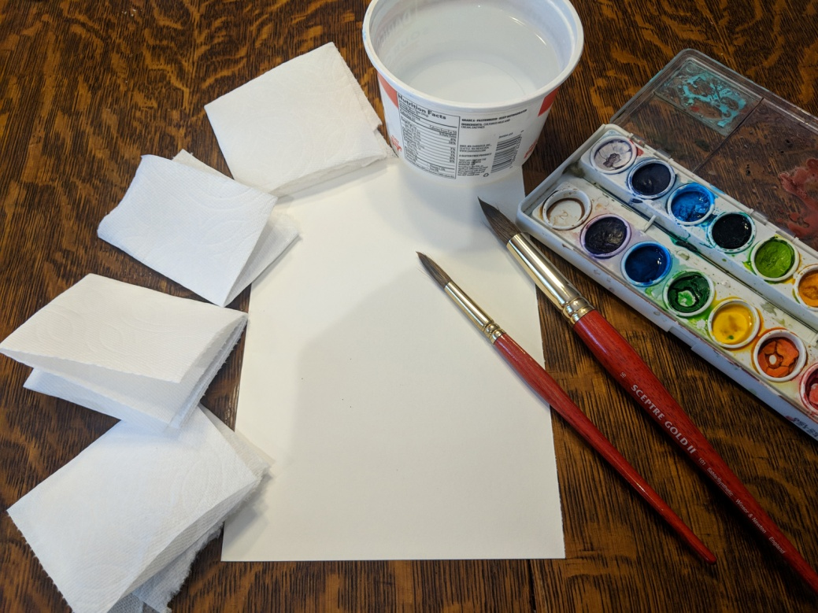
Painting Supplies
Your perspective line drawing
One half sheet watercolor paper for practicing fading.
Large and Medium sized watercolor brushes.
Four absorbent paper towel squares, folded a few times.
Water color set.
Small tub for water (keep water clean!)

Slide 19
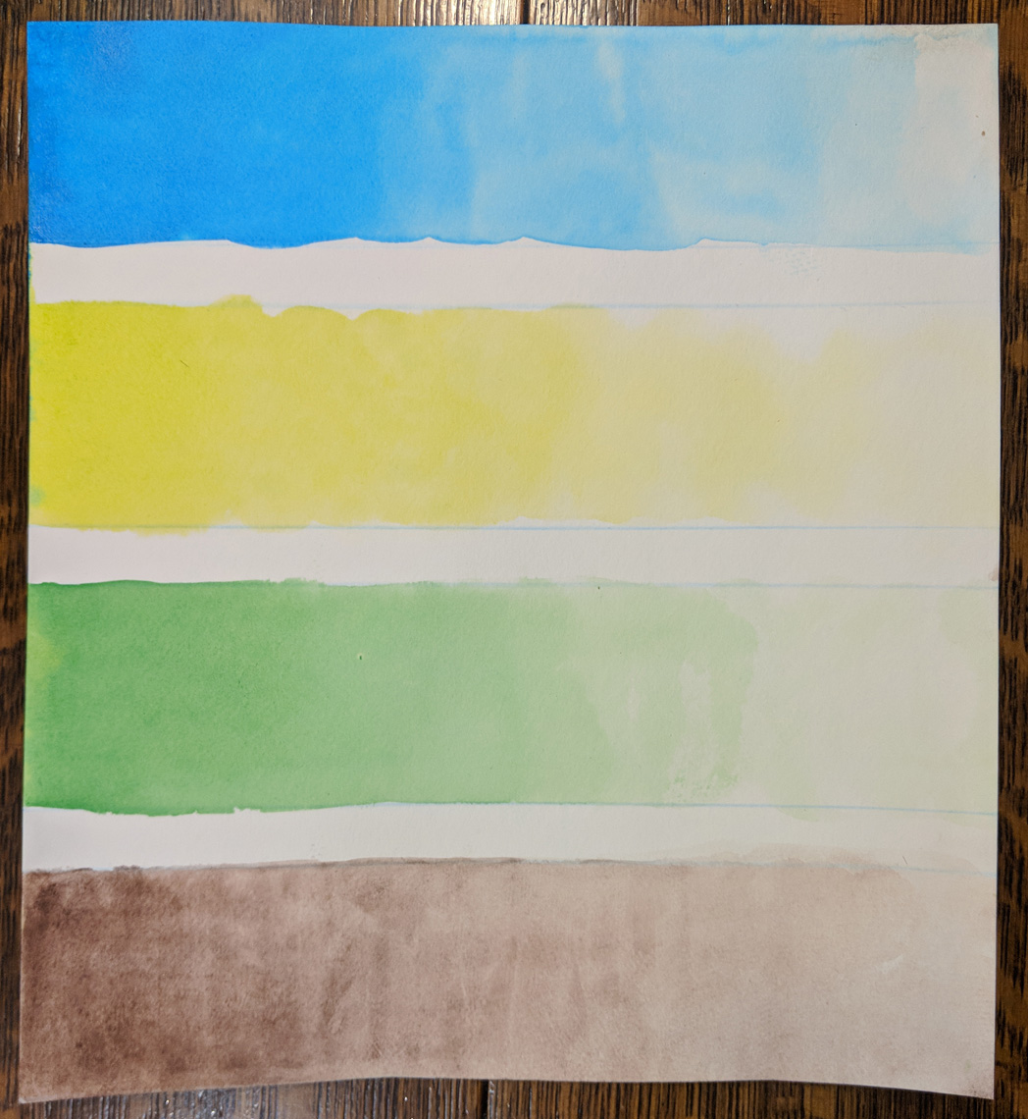
Practice Shading:
Quickly draw four stripes on the ½ sheet of water color paper.
One-by-one –
“Paint” each stripe with clean water.
Load brush with color.
Start at one end, applying color in a back-and-forth motion.
Use paper towel pad to soak up excess water and paint on the lightest end.
Gently blot other sections of the stripe as necessary to create an even gradient or shade.
Repeat for the next color.
NOTE: a second wash can be applied to darken color if required.

Slide 20
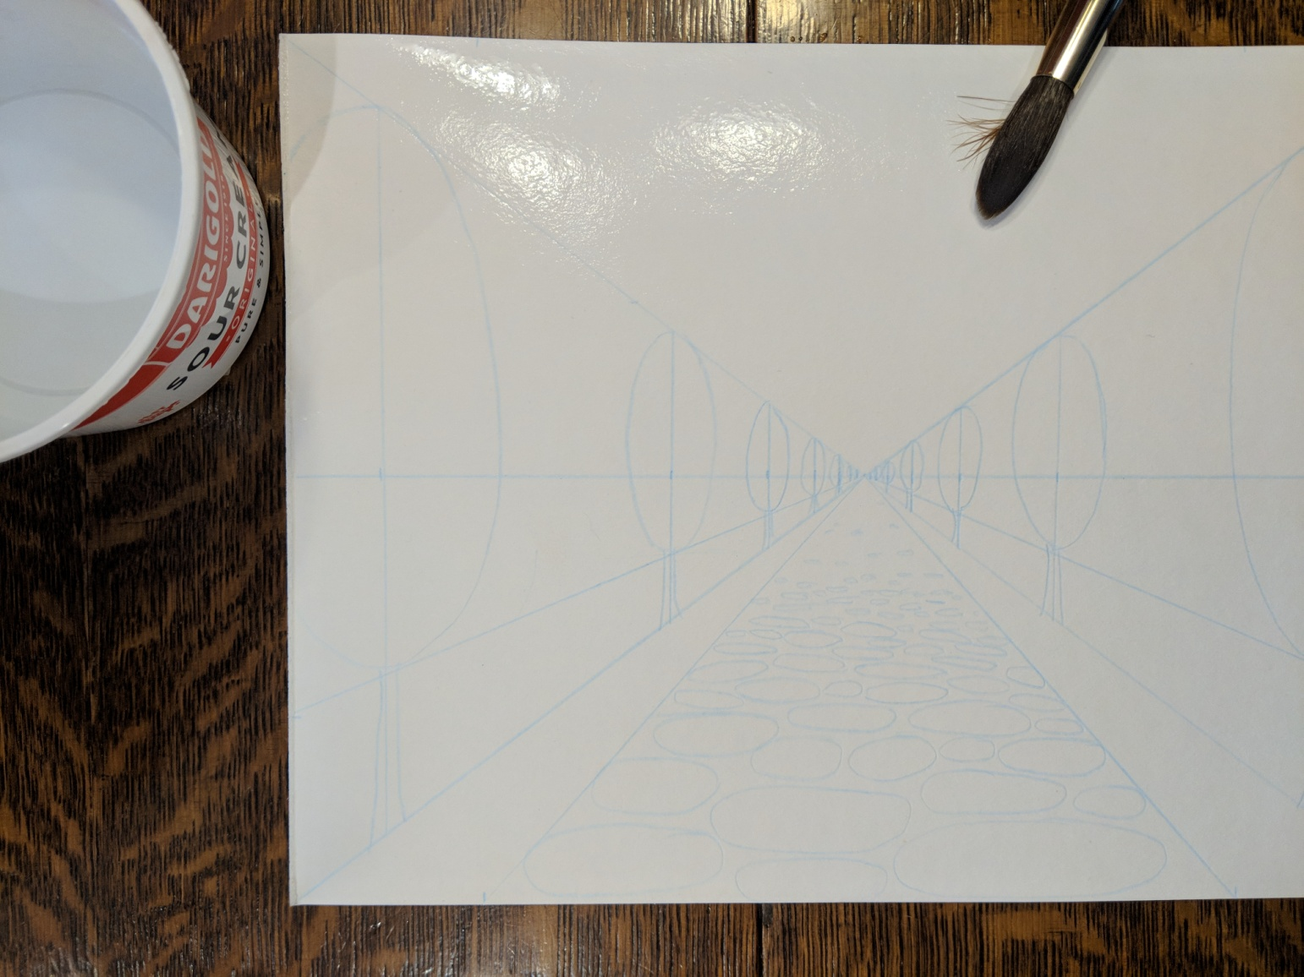
Paint Sky:
Use large brush to “paint” the TOP half of the paper above the HORIZON LINE with clean water.
Horizon Line

Slide 21
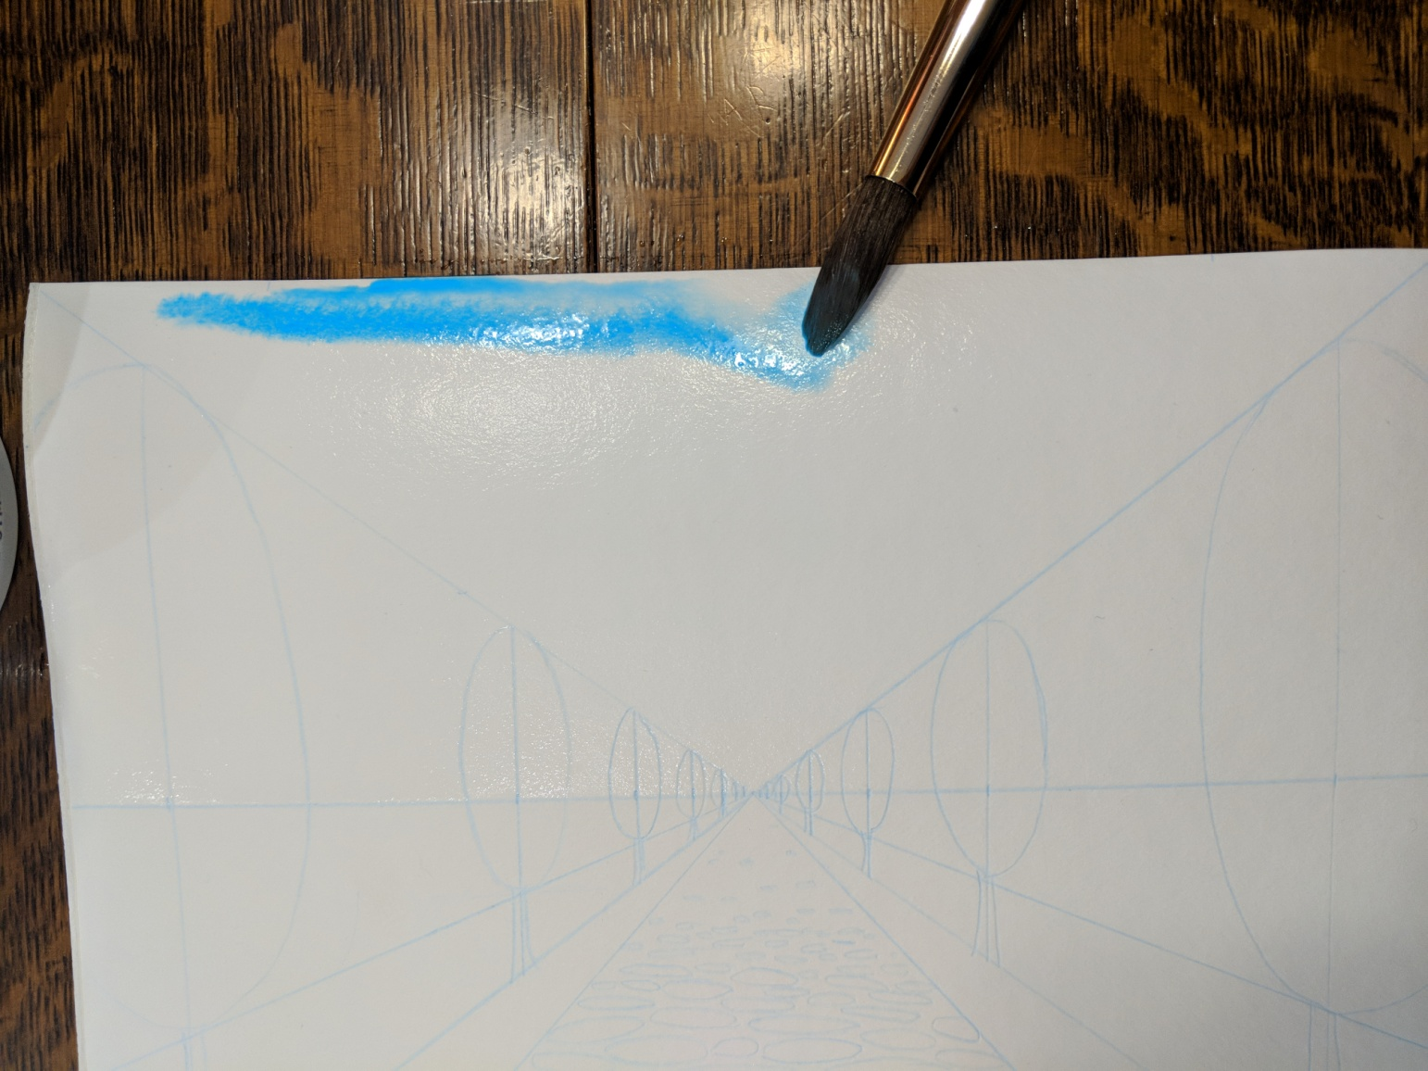
Paint Sky:
Load large brush with light blue paint and start painting at the top of the paper – painting stripes back and forth over the wet area down to the HORIZON LINE – WITHOUT getting more paint.
Horizon Line

Slide 22
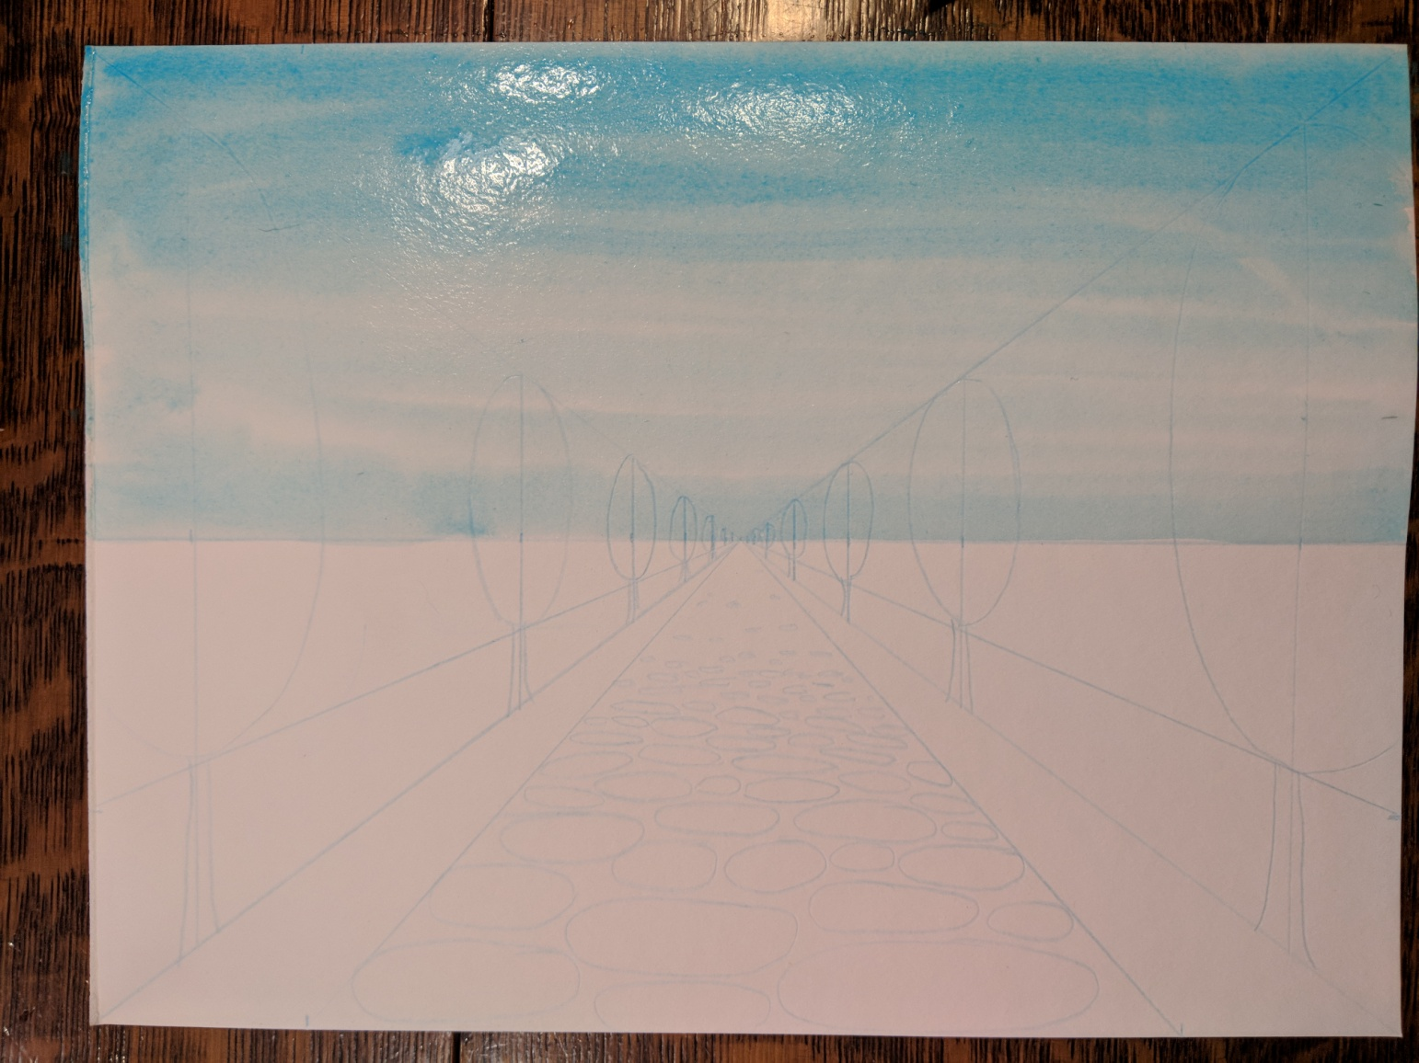
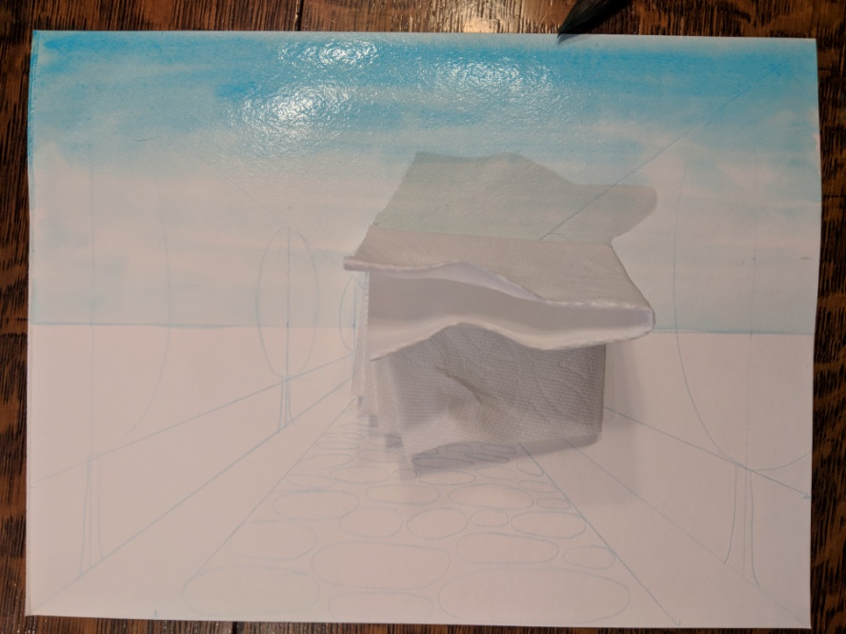
Paint Sky:
Use paper towel pad to GENTLY blot wet paint off of the sky along and just above the HORIZON LINE, taking care to leave the dark top.
This gives the illusion of ATMOSPHERIC PERSPECTIVE

Slide 23
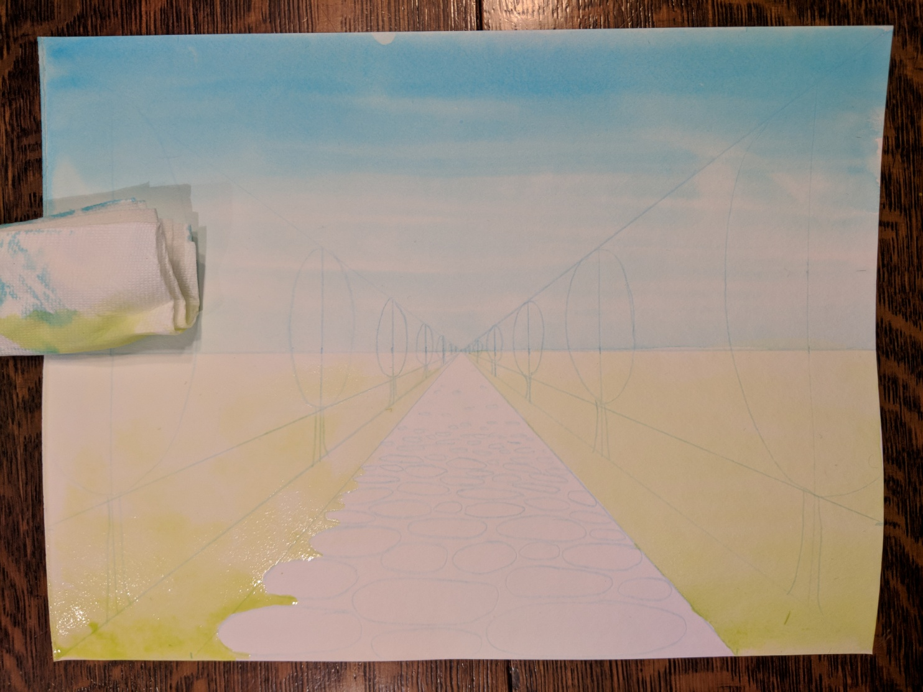
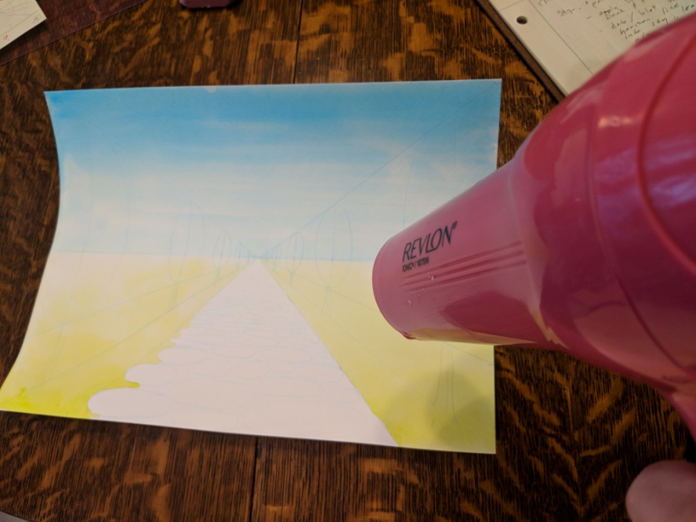
Paint Grass:
Repeat process for the grass – CLEAN WATER wash, paint light green along the bottom and paint back and forth toward the HORIZON LINE, then use paper towel pad to GENTLY blot wet paint off along and just above the HORIZON LINE, taking care to leave the dark bottom. Hair dryer can be used to speed dry time.

Slide 24
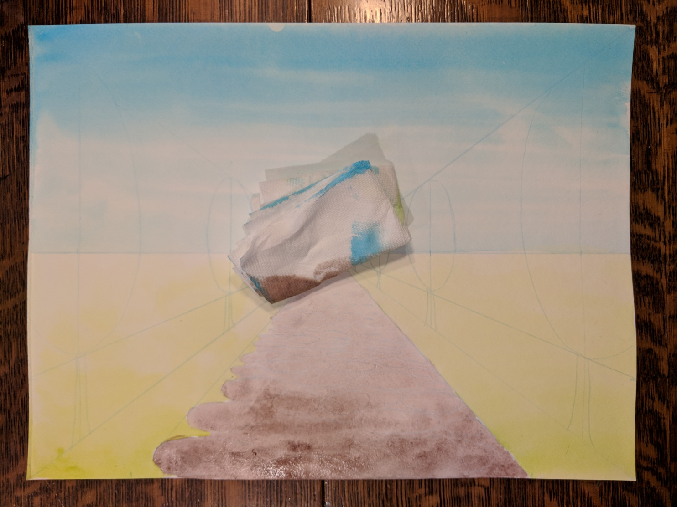
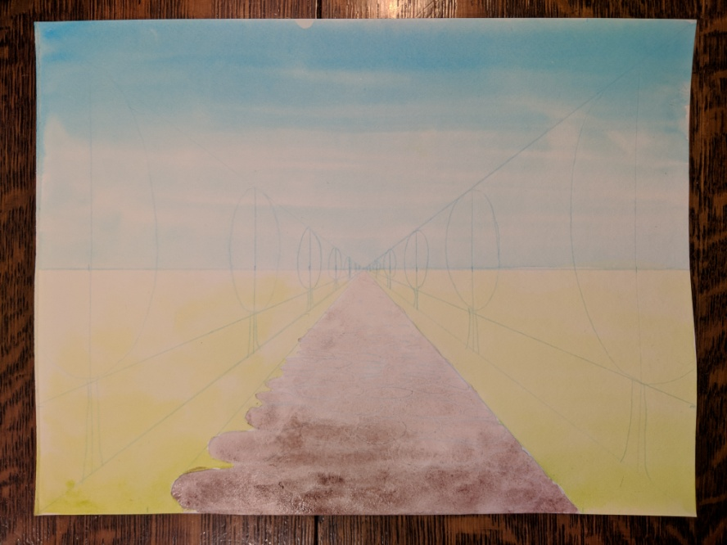
Paint Path:
Repeat process for the path – CLEAN WATER wash, paint brown along the bottom and paint back and forth toward the HORIZON LINE, then GENTLY blot wet paint off along and just above the HORIZON LINE, taking care to leave the dark bottom.

Slide 25
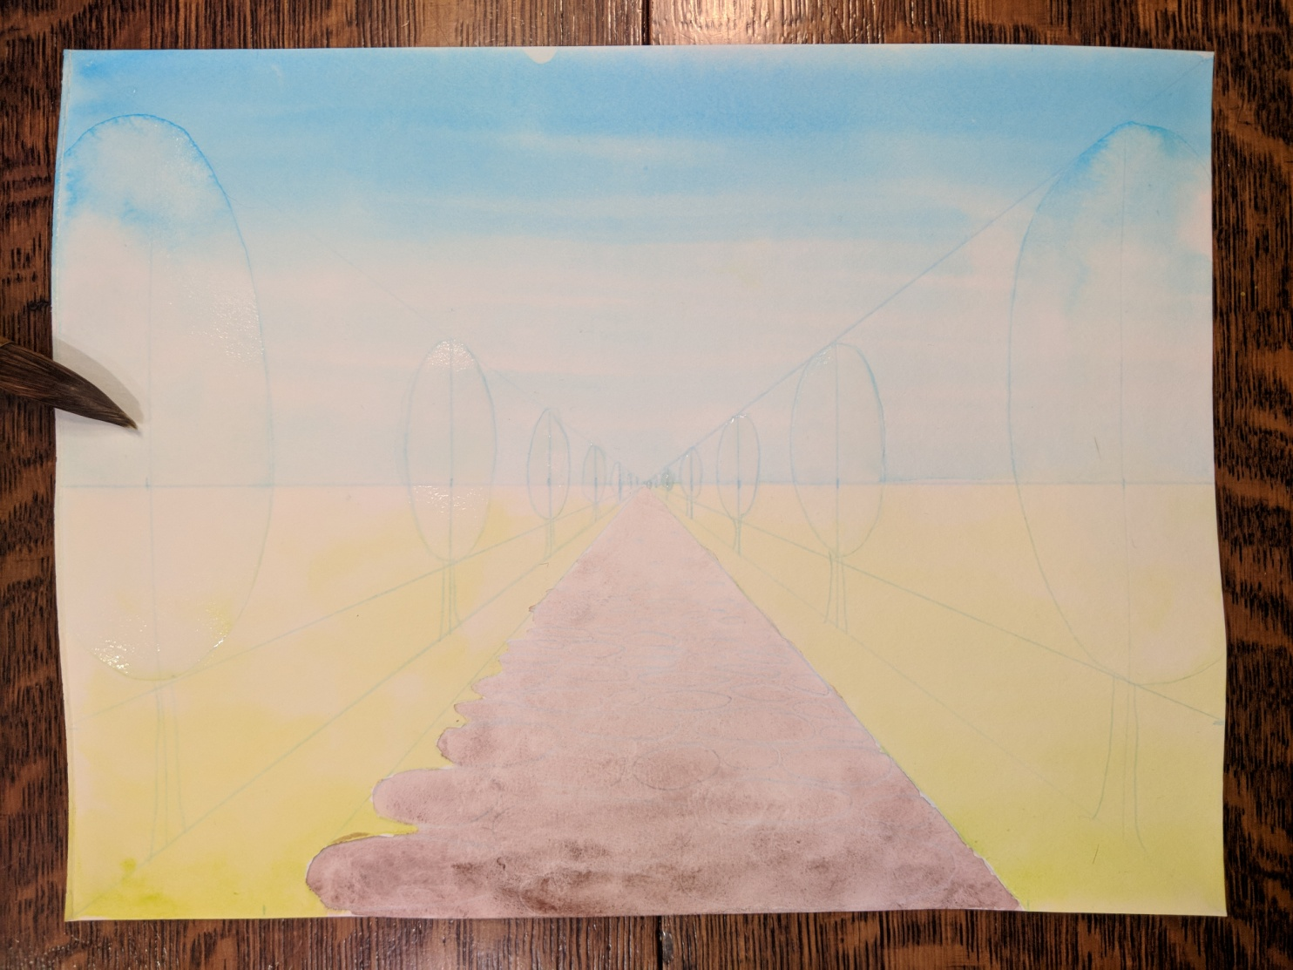
Paint Trees:
Repeat process for the trees – CLEAN WATER wash each tree canopy oval…

Slide 26
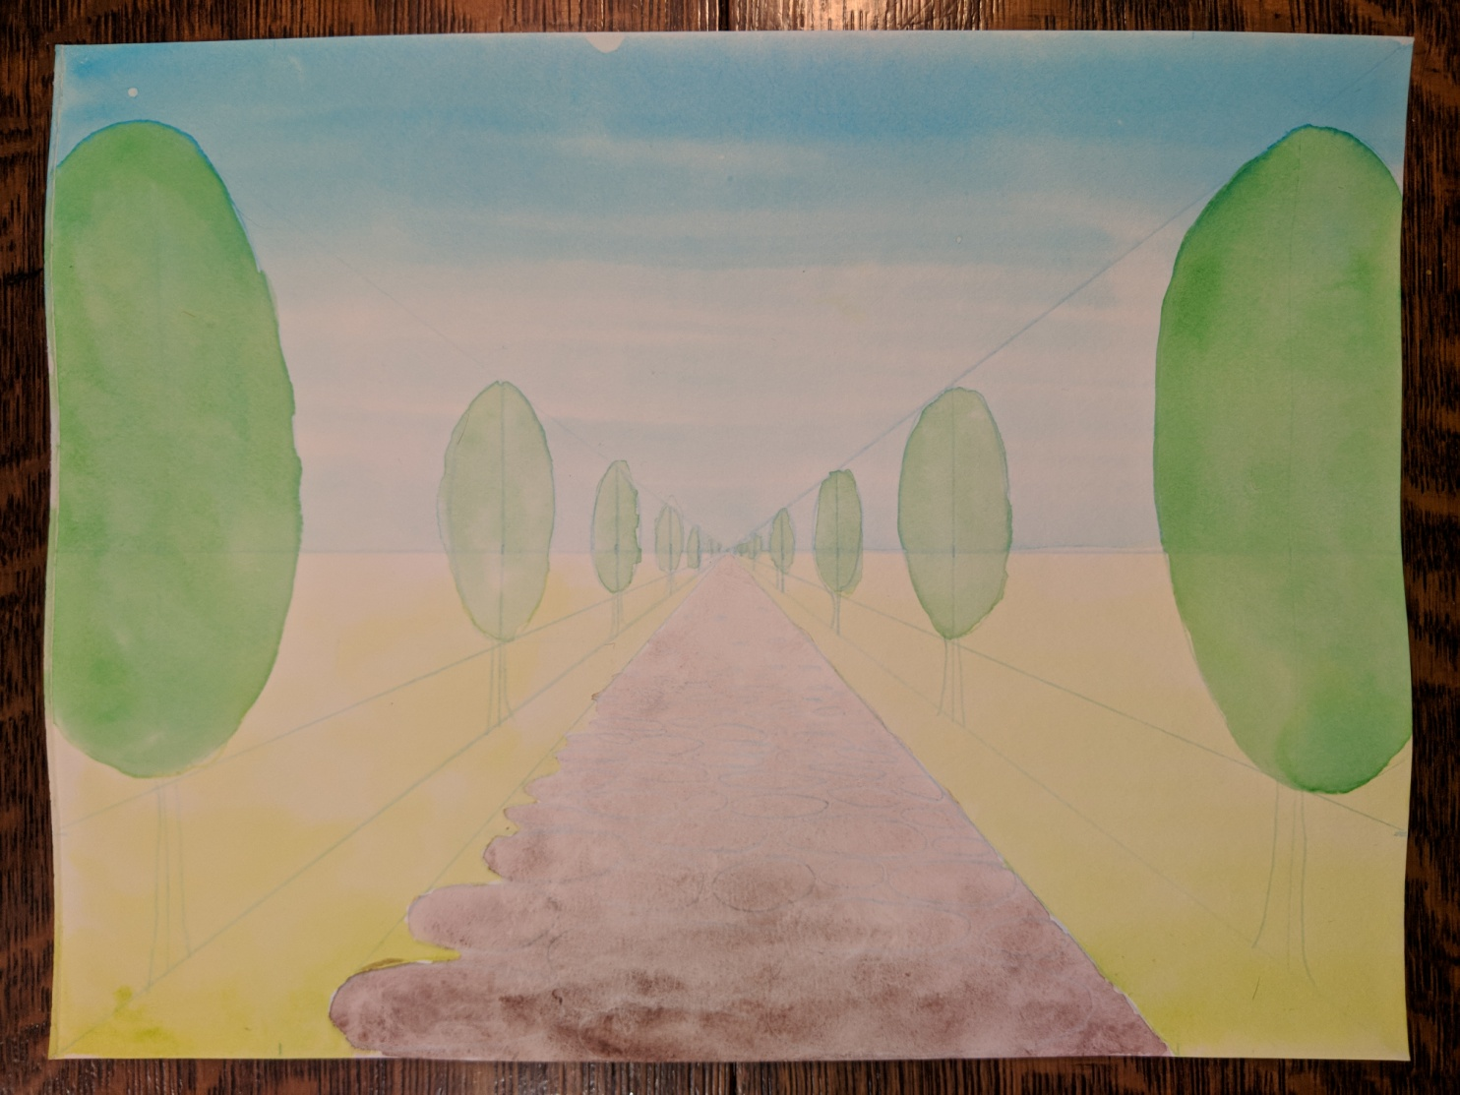
Paint Trees:
Then apply green paint to the biggest trees first, moving to the next smallest.
GENTLY blot wet paint off the smallest trees, taking care to leave the larger ones darker .

Slide 27
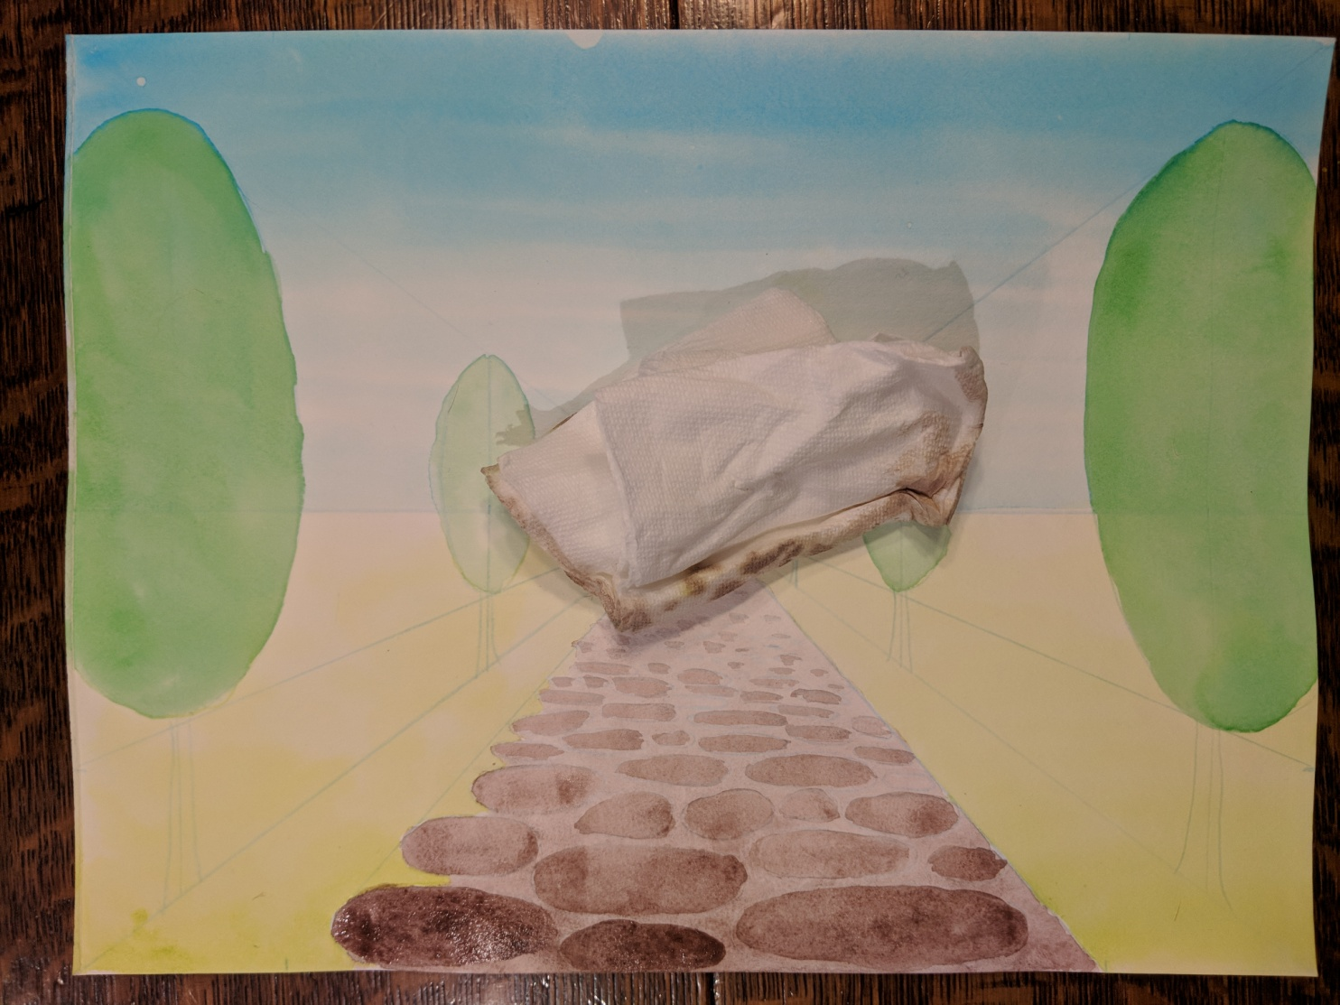
Paint Stones:
Repeat process for the stones – CLEAN WATER wash, paint brown along the bottom stones first then move back toward the HORIZON LINE. Then GENTLY blot wet paint off along and just above the HORIZON LINE, taking care to leave the dark ones at the bottom.

Slide 28
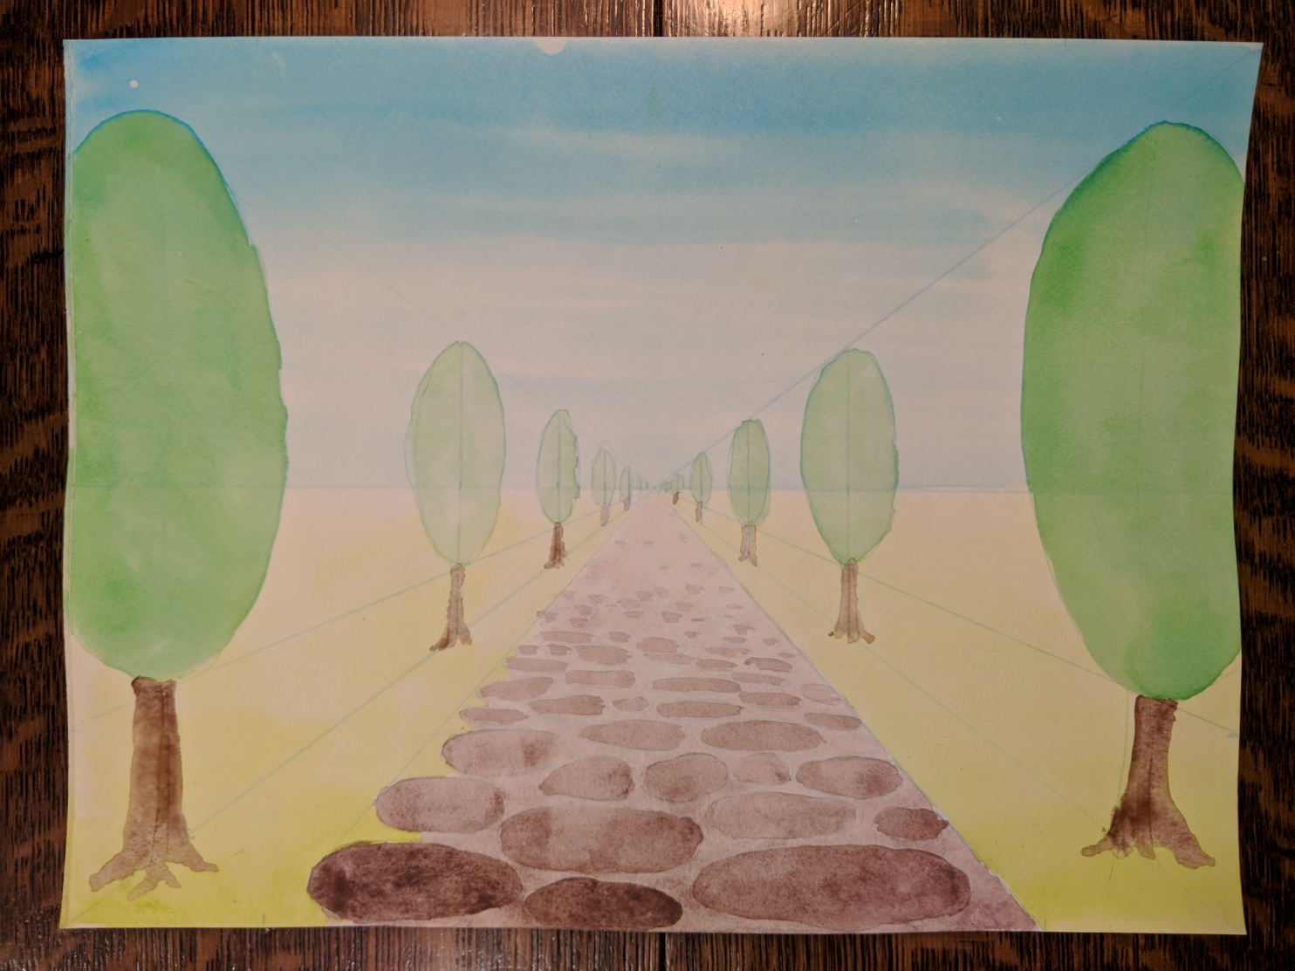
Paint Tree Trunks:
Repeat process for the trunks – CLEAN WATER wash, paint brown along the largest ones first then move back toward the HORIZON LINE. Then GENTLY blot wet paint off of the smallest – REMEMBER the larger the darker.

Slide 29
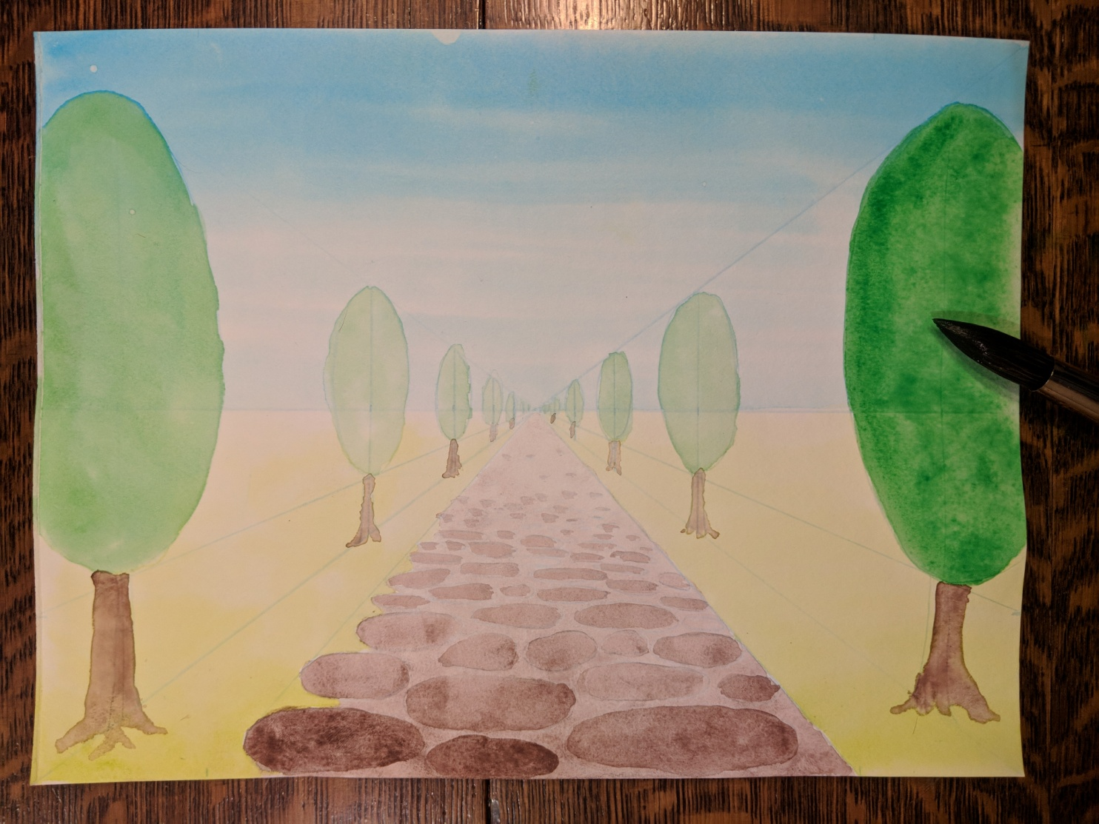
Add Colored Washes:
Paint additional washes of color to the closest objects and darken others to create the feeling of depth – make sure to WASH BRUSH between colors.
REMEMBER TO LET COLORS DRY BEFORE PAINTING NEXT TO THEM.

Slide 30
Finished:

