Slide 1
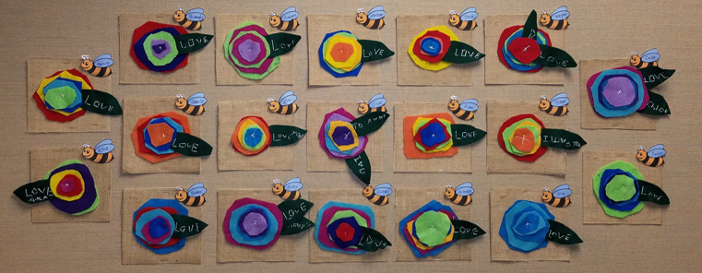
Felt Flower Hangings
Art Project

Slide 2
Making Texture and Geometric

Slide 3
Individual Flower Projects

Slide 4
Materials
1. You will need the following:
2 large squares of colored felt 5x5”
3 small squares of colored felt 3x3” or 2x2”
1 leaf 2”x4”
1 threaded needle (with long embroidery thread with both ends tied at the end)
1 burlap square 6x6
1 card board 6x6
1 ribbon 6”
Sharp fabric scissors
Tacky Glue (Aileen’s quick dry)

Slide 5
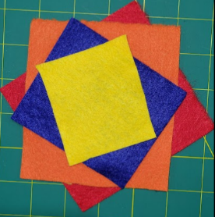
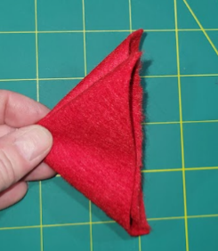
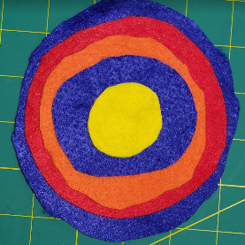
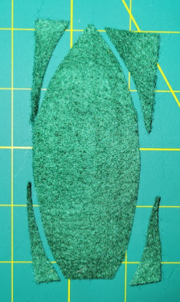
Step 1
Pick out 2 large squares and 3 small squares
Cut the 2 larger squares into circles, with one bigger than the other.
Cut the 3 smaller squares into circles, with each one getting smaller.
Take the long green rectangle (approx. 2x4 inches) and cut it into a long wide oval that comes to a point at one end

Slide 6
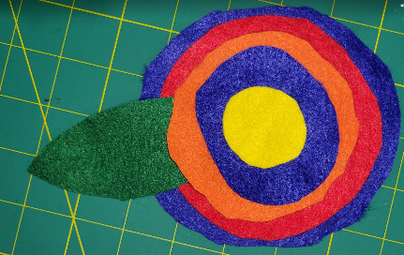
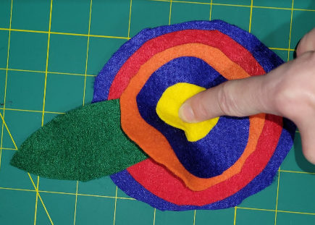
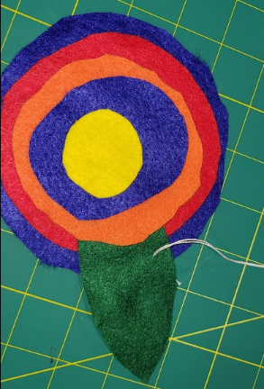
Lay the circles on top of each other how you want them to look.
Slide the Green leaf in between the 2nd and 3rd biggest circles, until the end meets the middle of the circle.
Take note of where the 3rd circle meets the leaf.
This is where you will start your letters with the thread.

Slide 7
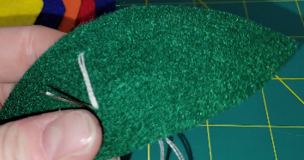
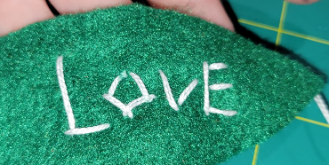
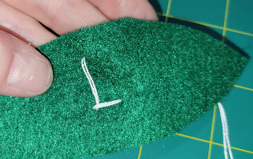
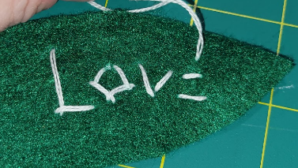
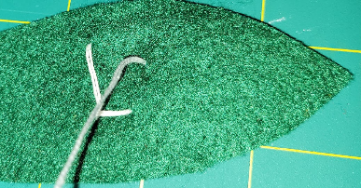
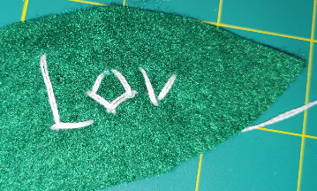
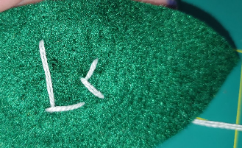
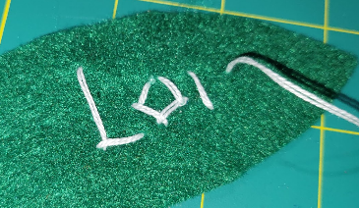
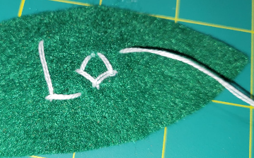
Write your message

Slide 8
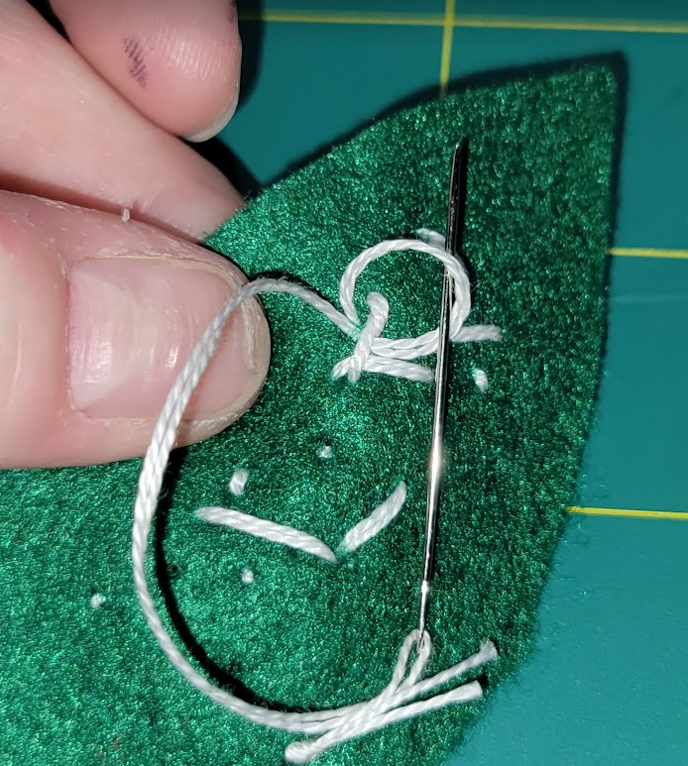
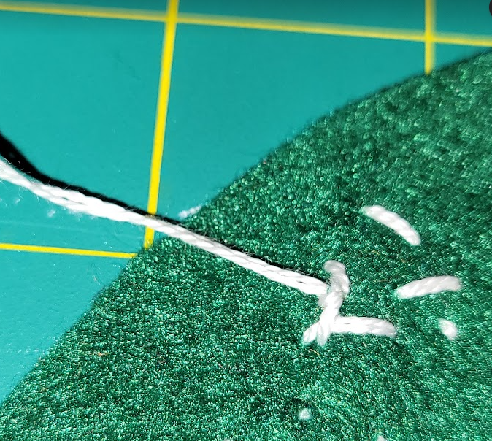
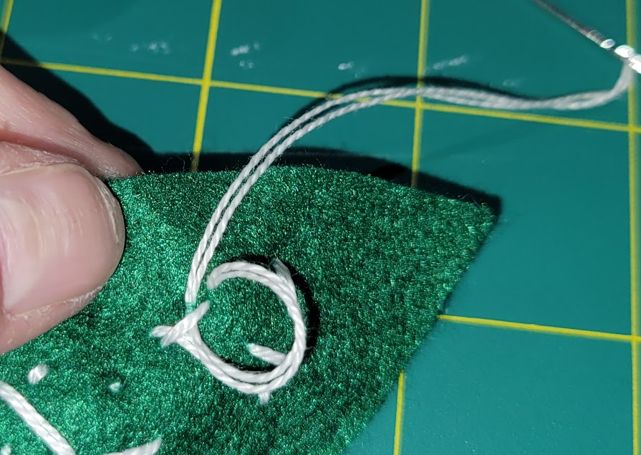
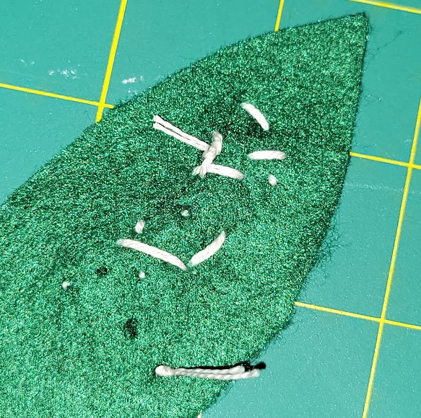
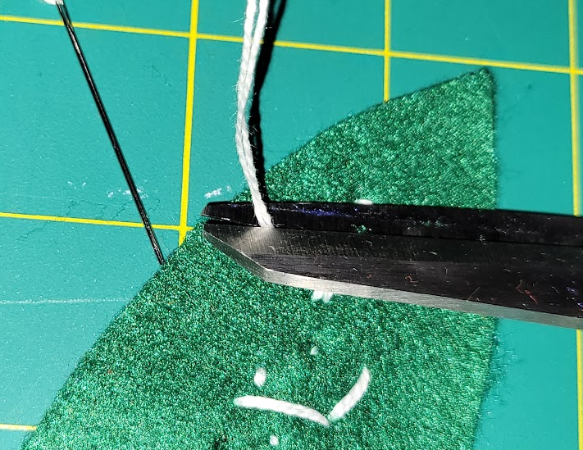
Tying it off on the backside
Tie your message off on the backside of the leaf

Slide 9
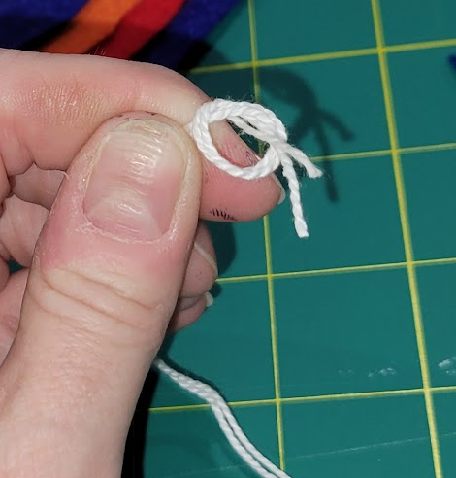
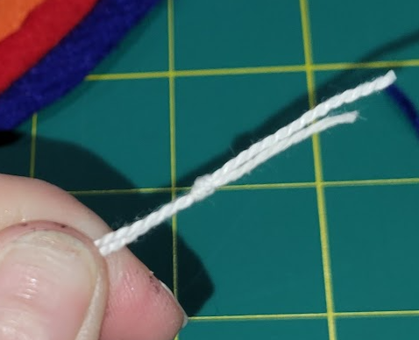
Sew the flowers to the leaf
Since you cut your first knot in previous step, you need to add a new knot at the end of your thread.

Slide 10
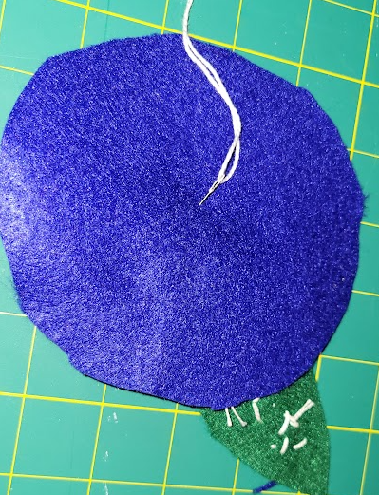
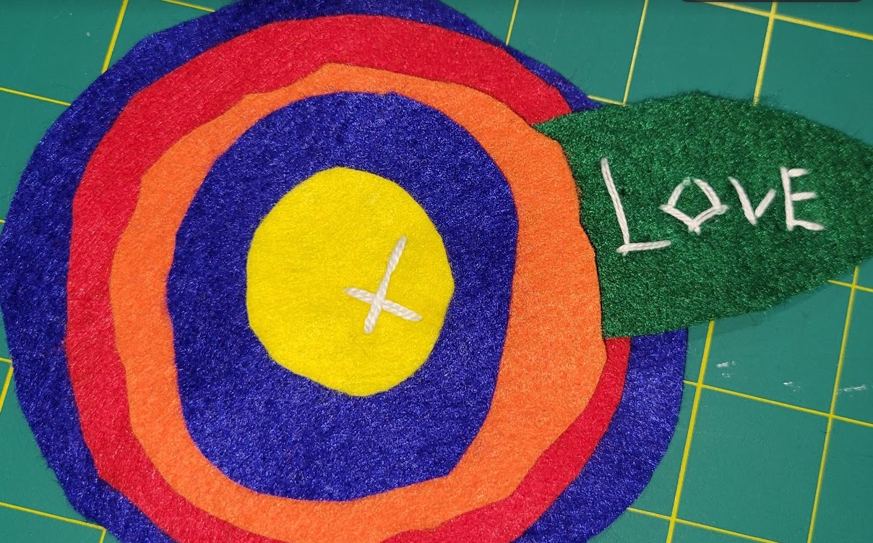
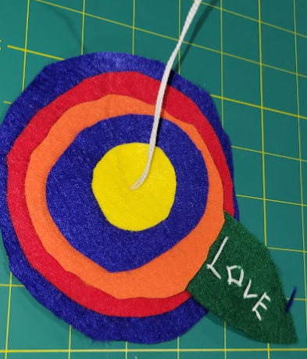
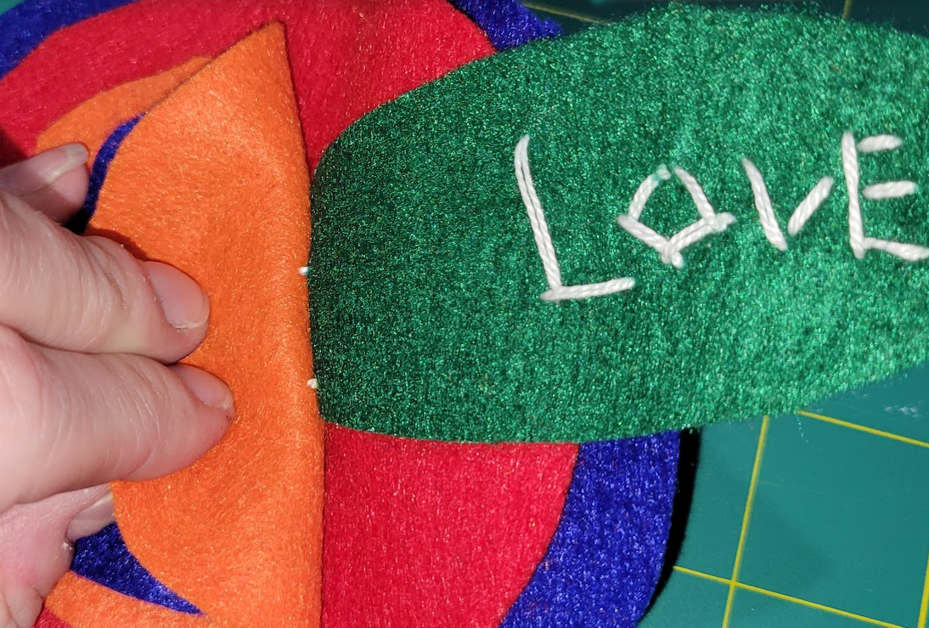
Starting from the backside of flower
Poke your needle through slightly off center of the middle of the backside.
Sew a big X making sure to capture two stitches into the leaf.

Slide 11
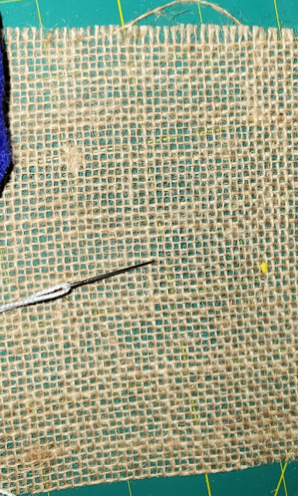
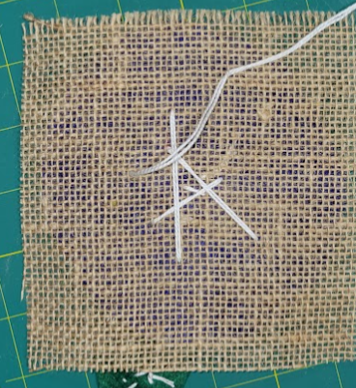
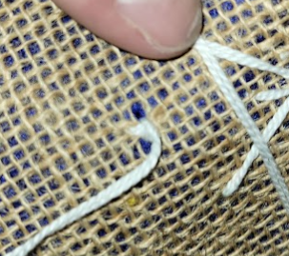
Sew flower onto burlap material
Start from the backside/middle of the burlap, poke your needle through ONLY the largest 2 circles.
Make large stitches back and forth to sew flower and leaf to the burlap.
Make sure not to go wider than the third circle’s edges
Tie off the thread on the backside

Slide 12
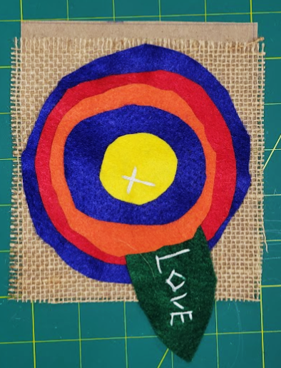
Adding flower to cardboard
Pick out a piece of cardboard that fits your burlap or comes close.
Square up the edges on the side with the leaf. Allowing any excess cardboard or burlap to run unevenly on the opposite side.
You will trim the burlap and board to fit (once it is glued)
Excess/uneven side

Slide 13
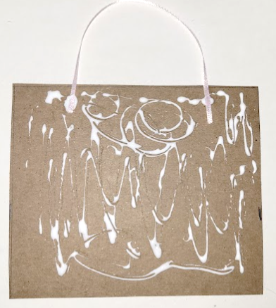
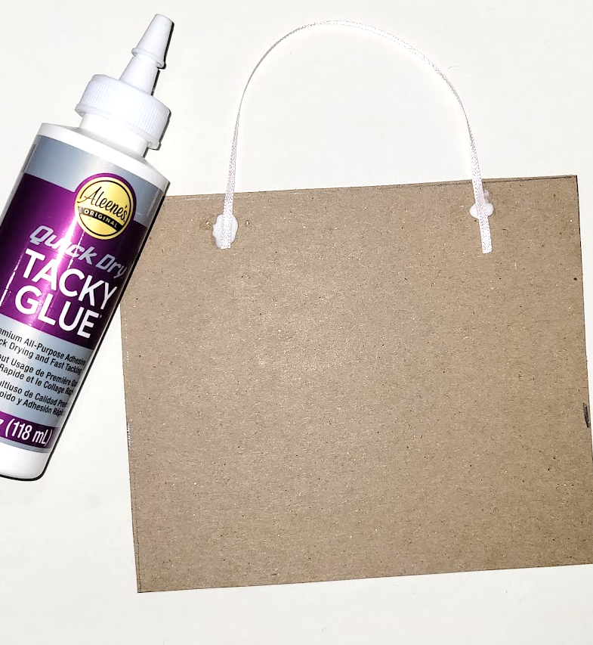
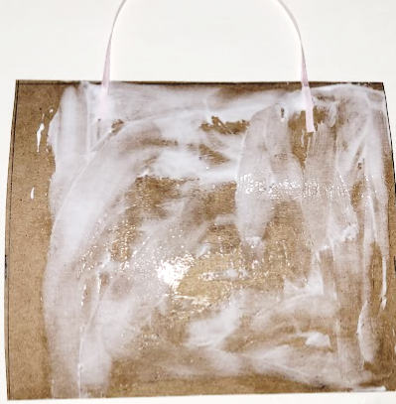
Add the ribbon and glue
Cut a 6” length of ribbon.
Add a dab of Tacky glue to the card board about 1.5” from left side and 1.5” from the right side.
Place your ribbon ends onto the glue dab.
Lightly scribble tacky glue all over cardboard. (not too thick!!!)
Spread it out with your finger

Slide 14
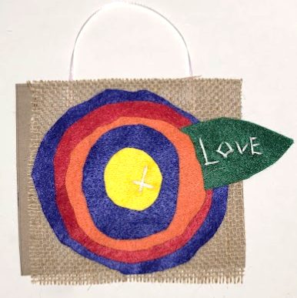
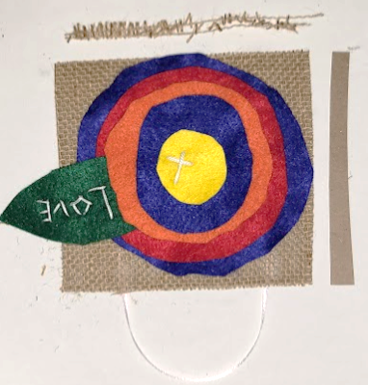
Quickly add the burlap flower
Smooth the burlap over the glue and ribbon. Press down on all corners and center of flower.
Trim off the excess burlap or cardboard (or both)

