Slide 1
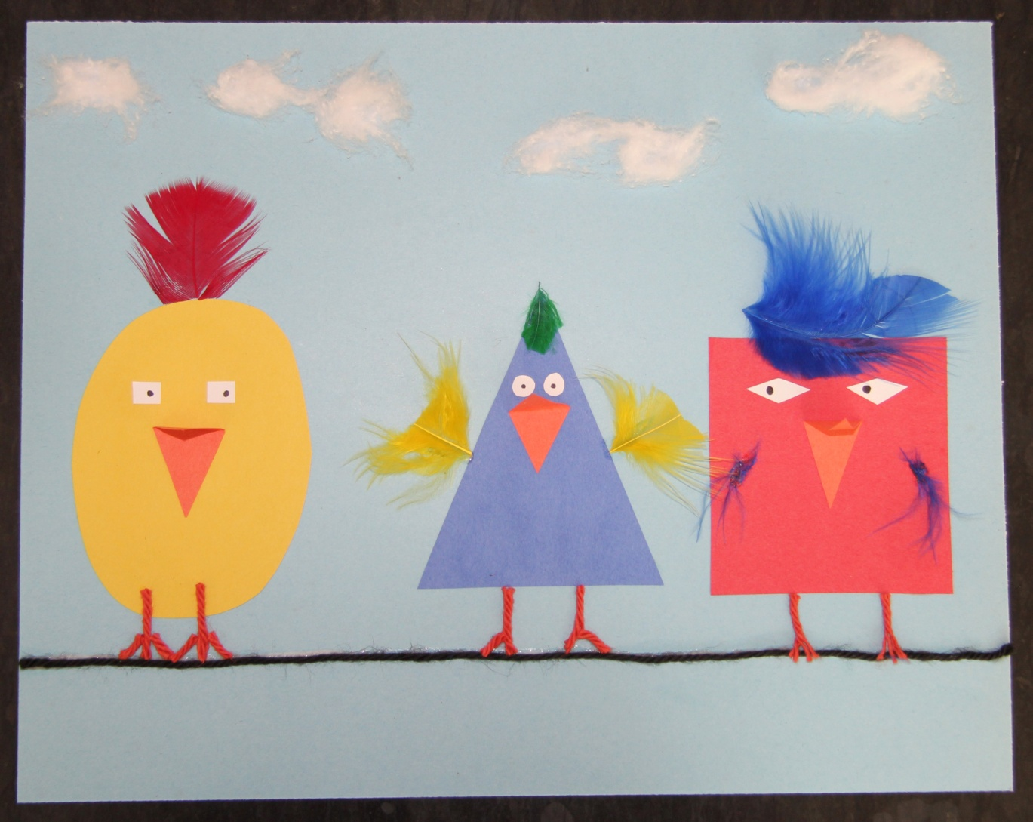
Birds on a Wire Project

Slide 2
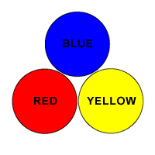
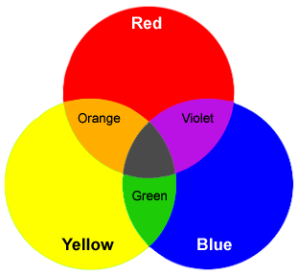
Today we will be reviewing the primary colors, lines, geometric shapes and organic objects to make our art.
Here you can see some color combinations that make up the secondary colors, like orange, green and violet.
The main primary colors are blue, yellow, and red. They are special because when you mix them they can create all other colors.

Slide 3
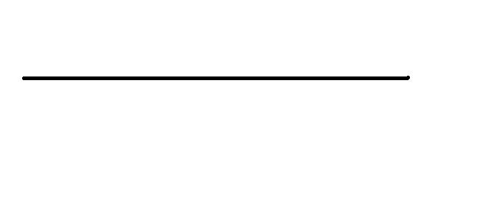
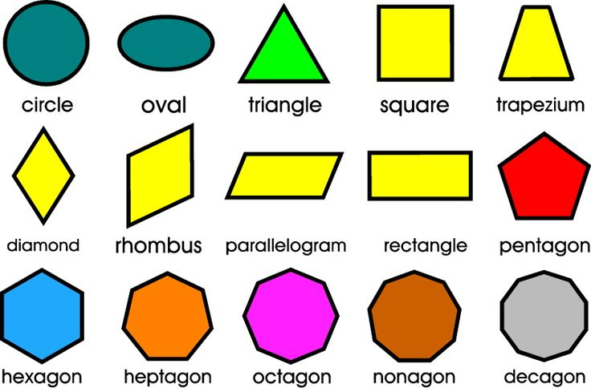
Line - A line is a continuous path of a moving point through space which can vary in width, direction, length, curvature, texture and color.
Shape - When a line connects, it creates a shape. Shapes are two dimensional objects containing length and width. They have precise edges.

Slide 4
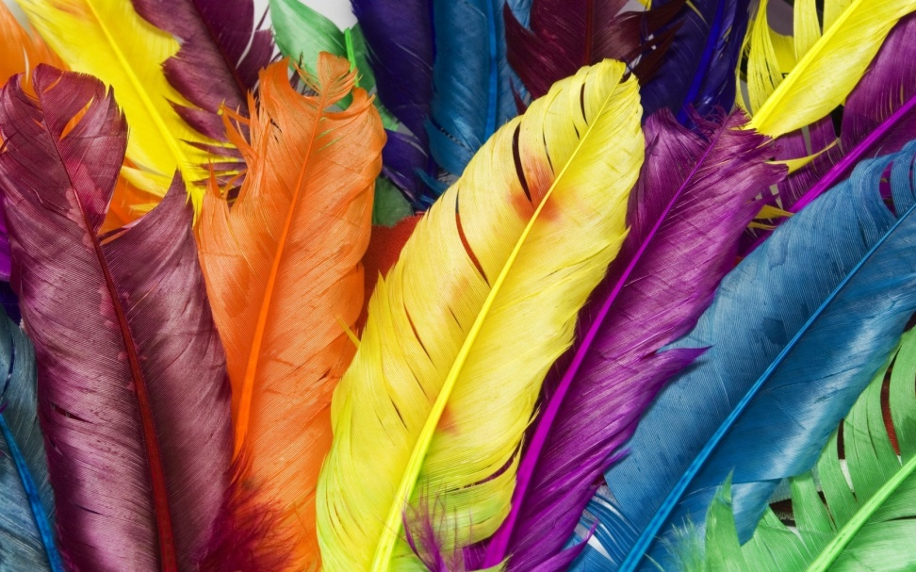
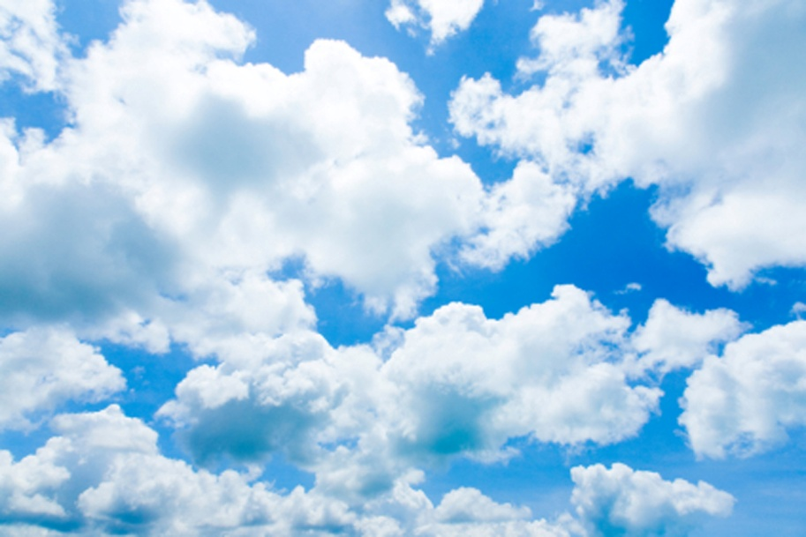
Organic forms are often found in nature. They do not contain straight edges.
Like feathers
Or clouds

Slide 5
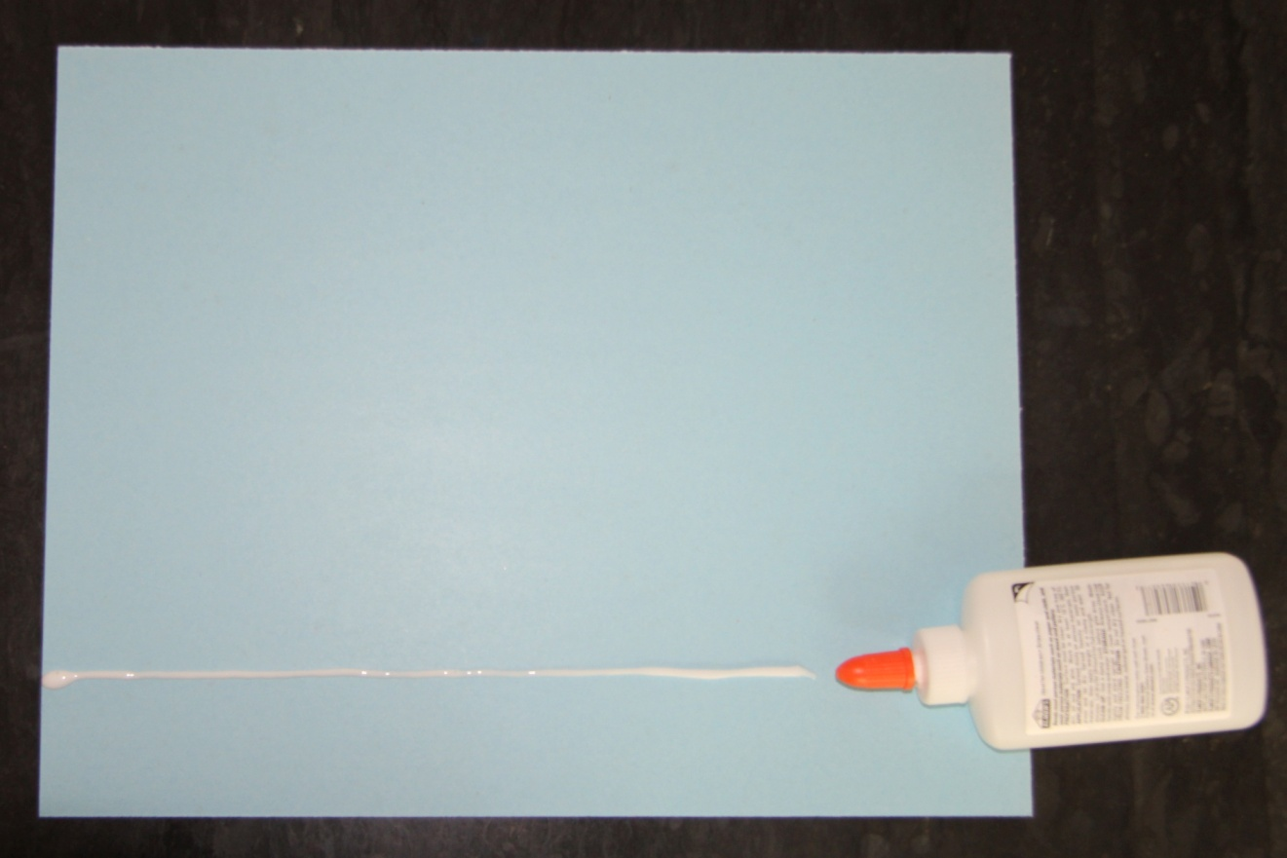
Step 1. Put your name on the back of your paper.
Step 2. Draw a line of glue along the bottom half of your paper.

Slide 6
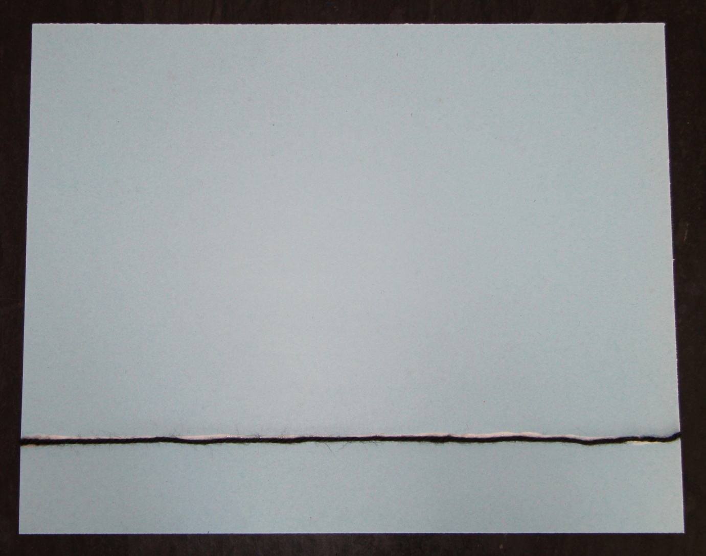
Step 3. Lay the black piece of yarn onto the glue line.

Slide 7
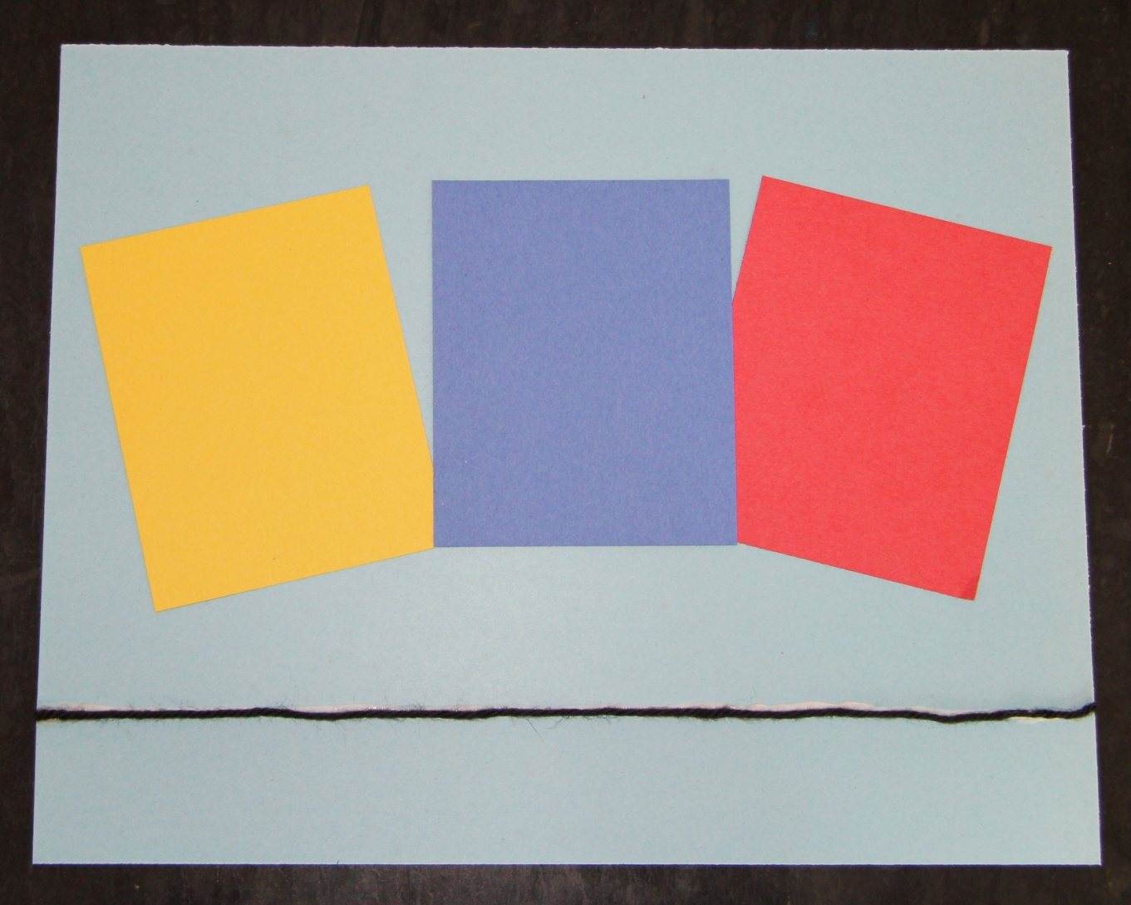
Step 4. Cut three different shapes out of the primary colored pieces of paper.

Slide 8
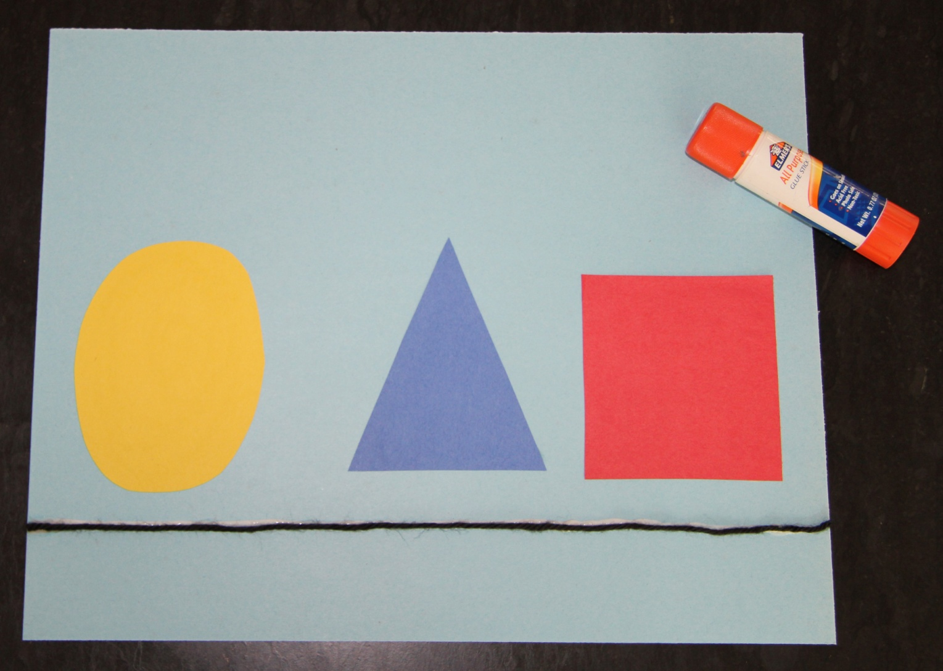
Step 5. Use your glue stick to adhere the shapes to your paper.
Make sure they are above the line so you have room to make legs.

Slide 9
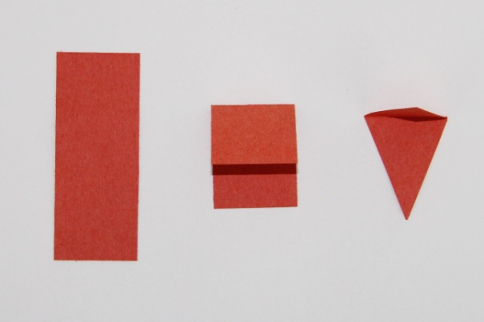
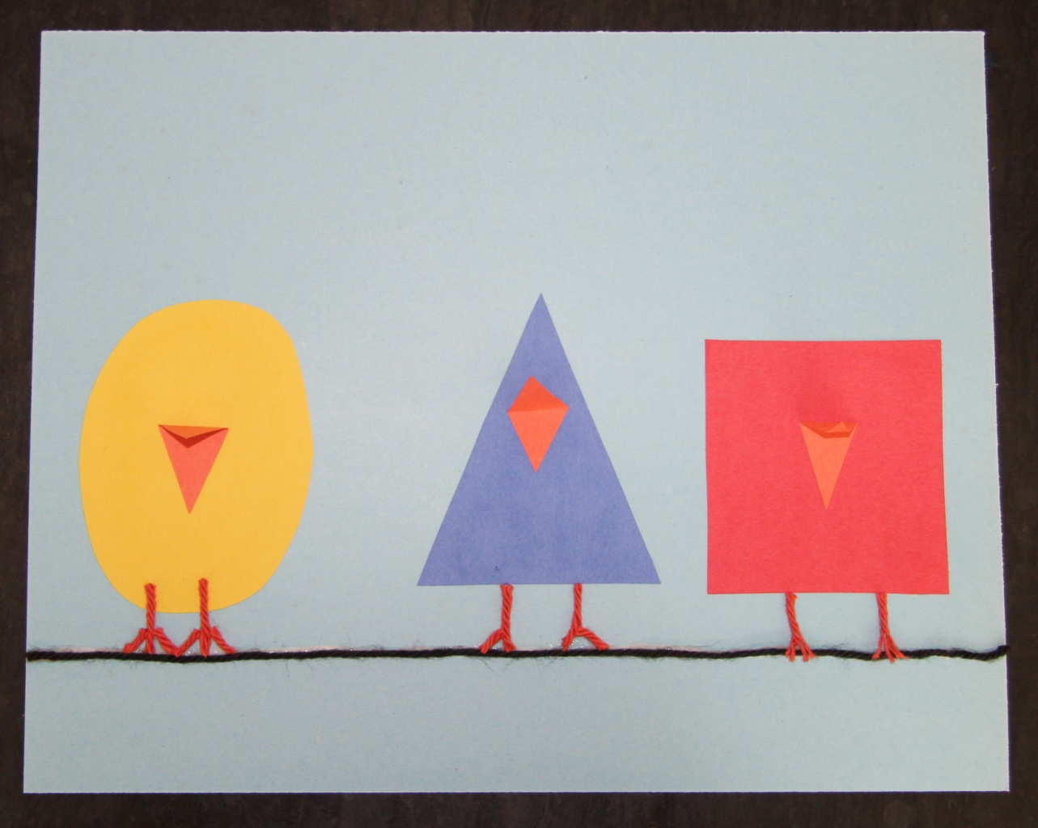
Step 6. Take the orange paper and fold it in half.
Then cut it into a triangle to make a beak.
Step 7. Glue the beaks onto the bird bodies.
Step 8. Cut orange string to make legs on your birds. Glue it down.

Slide 10
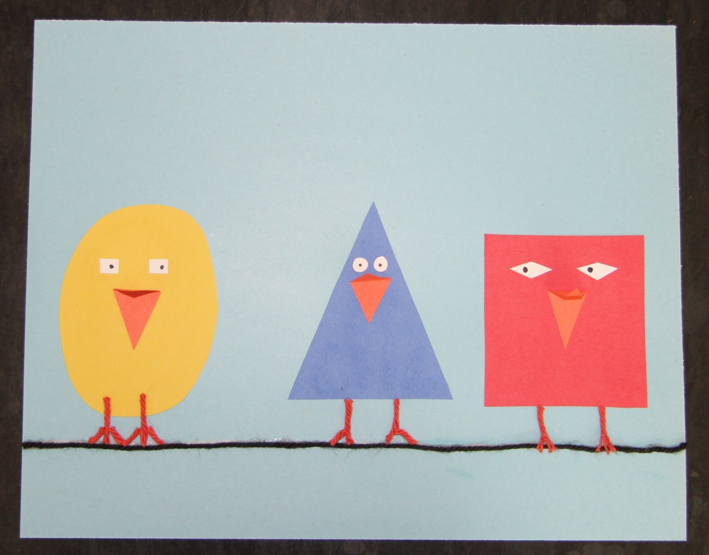
Step 9. Cut out eyes from your white paper. They can be shapes as well!

Slide 11
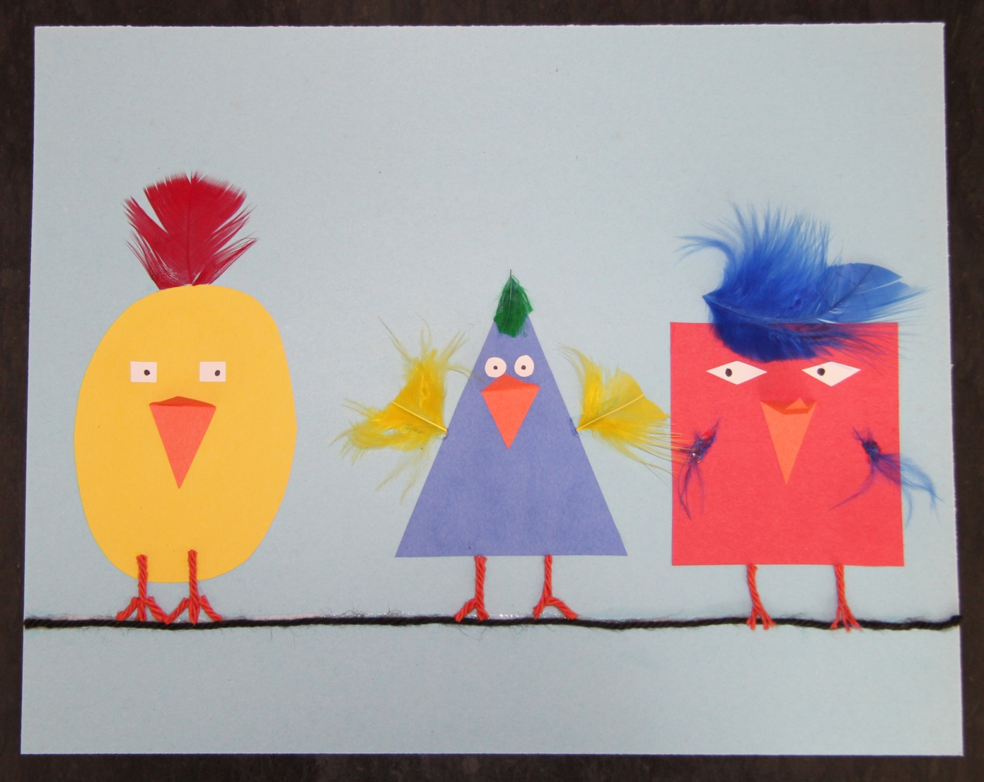
Step 10. Glue feathers to your birds. This incorporates organic shapes into your art.

Slide 12
Step 11. Take your cotton ball and pull it apart to make wispy clouds.
Then glue them to the top half of your paper.
Your art is now complete!

