Slide 1
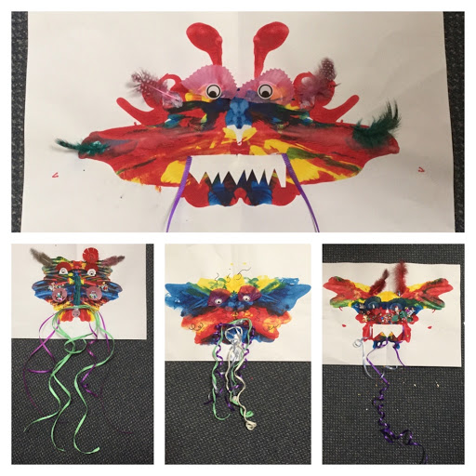
Color Mixing Dragons
Element:
Color
Theme:
Chinese New Year

Slide 2
Element
Color:
Primary Colors:
Red, blue and yellow are the primary colors and are the base of every other color. They cannot be recreated by mixing other colors together.
Secondary colors:
result when two primary colors are mixed together; they include orange, green and purple.

Slide 3
Chinese New Year Feb. 5 2019
Chinese New Year, commonly known as Lunar New Year, is a Chinese festival that celebrates the beginning of a new year on the traditional Chinese Calendar. The festival is usually referred to as the Spring Festival in modern China, and is one of several :Lunar New Years in Asia. Observances traditionally take place from the evening preceding the first day of the year to the Lantern Festival, held on the 15th day of the year. The first day of Chinese New Year begins on the new moon that appears between the 21st of January and the 20th February. In 2019, the first day of the Lunar New Year will be on Tuesday, 5 February, initiating the Year of the Pig.

Slide 4
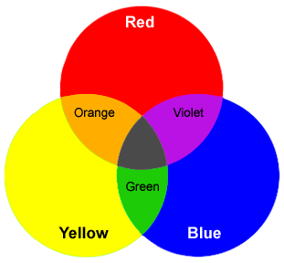
Primary & Secondary

Slide 5
Step 1
Start with your folded white paper in front of you
Don’t forget your name

Slide 6
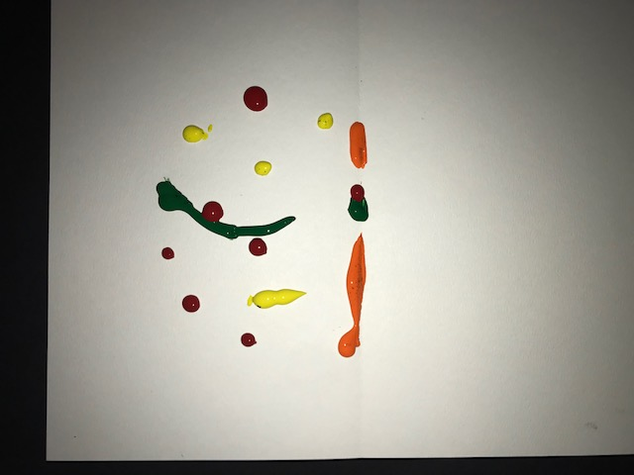
Step 2
Make several Green, yellow, orange and red small pea sized dots and a few thin lines on one side of your paper
Be careful to not get near the top or bottom of your paper..

Slide 7
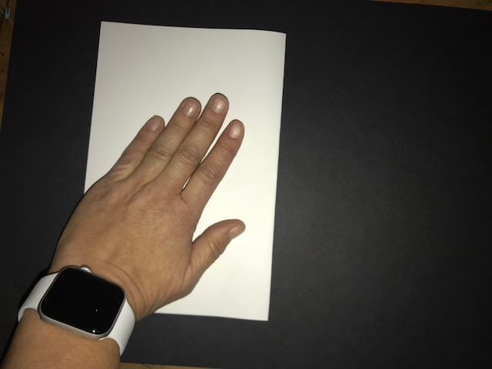
Step 3
Fold in half and rub your hand all over the paper to smear the paint inside

Slide 8
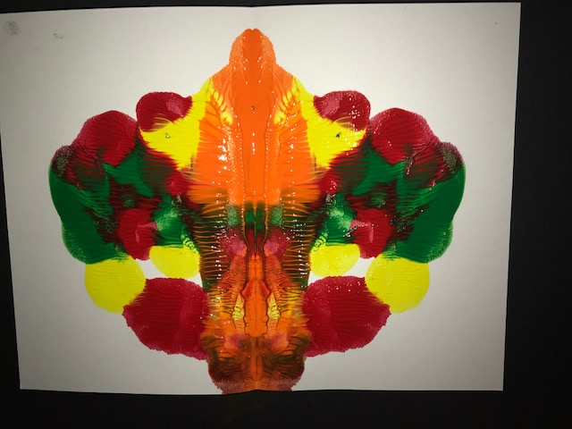
Step 4
Open back up and decide what side will be the top and what side will be the bottom

Slide 9
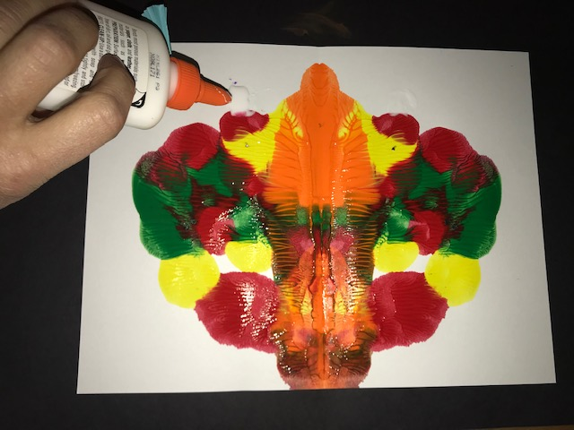
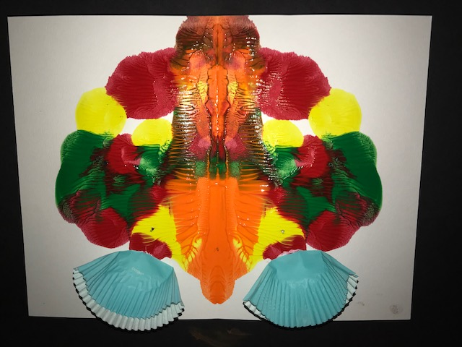
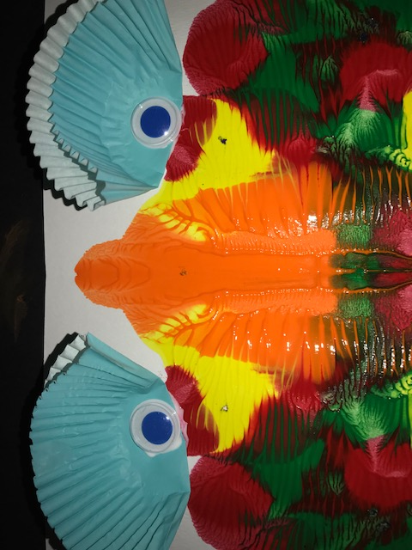
Step 5
Add small dot of glue Where you want to put your eyes
Glue down Cupcake papers in the places you would like your eyes
Glue down your googley eyes inside the cupcake paper

Slide 10
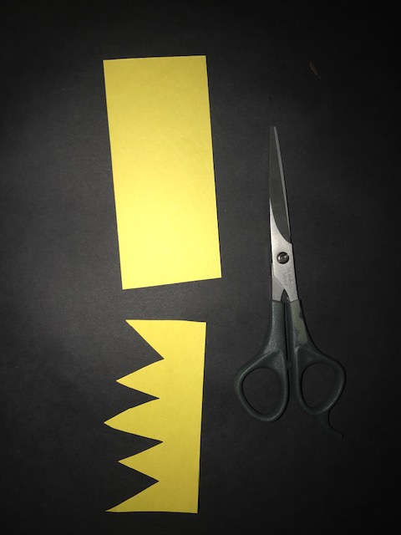
Step 6
Cut out a mouth from colored paper

Slide 11
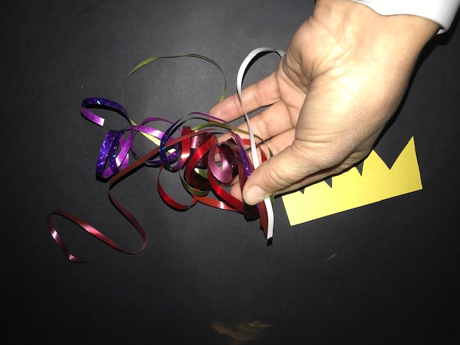
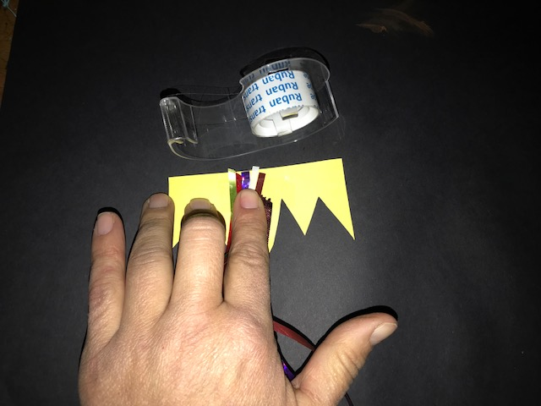
Step 7
Tape the ribbon your mouth, coming down from the teeth
Choose ribbons

Slide 12
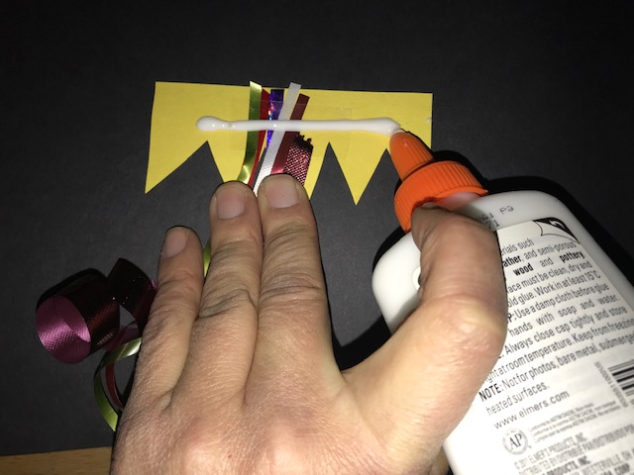
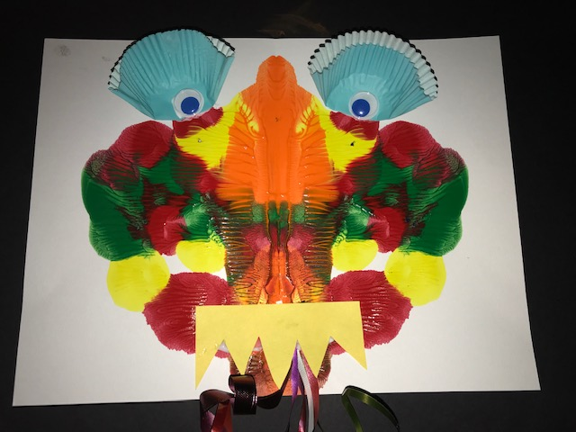
Step 8
Add a thin line of glue across the back of your mouth
Place the mouth on your dragon. Ribbons should be hanging down

Slide 13
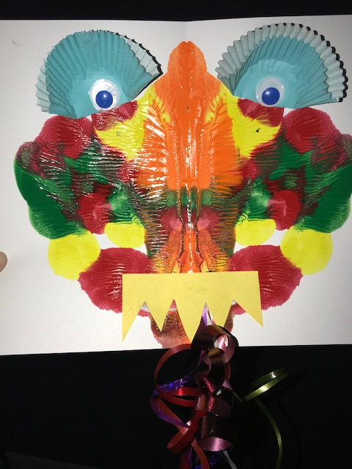
All Done
Give to an adult to be placed on a drying rack

Slide 14
Docent Notes
Supplies
Water color paper
Red, orange, yellow, green temper paint in small squeeze bottles
Cupcake papers folded in half
Googly eyes
White glue
Curling ribbon. Different colors and widths cut to 12 ish inches.
Scrap color construction paper
Scissors
Notes:
Pre fold paper for the kids to get a good even smear.
Really emphasize small dots and lines and to not get too close to the edges to avoid it
spilling out the sides
Pre fold the cupcake paper to save time
Put 2-3 glue on each table
Put all 4 colors on each table in the pods.
Spread out a variety of cupcake papers. eyes and ribbon on each table
I printed off 12 pictures of the slide showing the paint dots for reference at the tables..
Trim ribbon to desired length if needed
Mount as desired. Suggestion on black.
Please refill the paint if you see there is not enough for the next class
Please cut more ribbon if you see there will not be enough for the next class.

