Slide 1
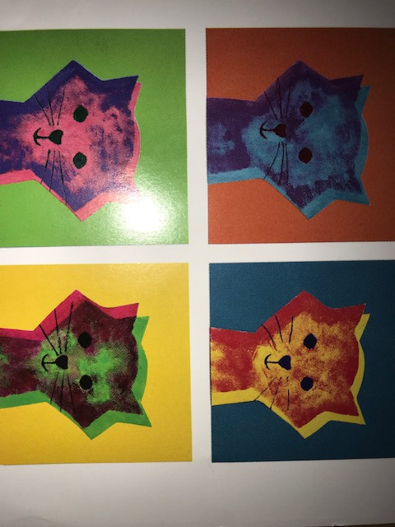
Colorful CATS
Art Element: Space
Master Artist:
Andy Warhol

Slide 2
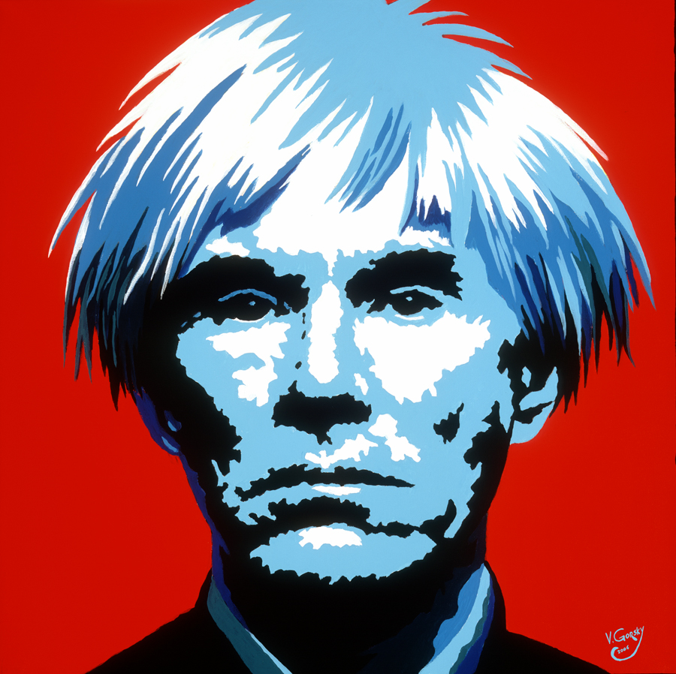
Andy Warhol
Andy Warhol is an American artist. His style was considered pop Art that was inspired by advertising and glamorous stars. Andy loved famous people, animals and especially color….

Slide 3
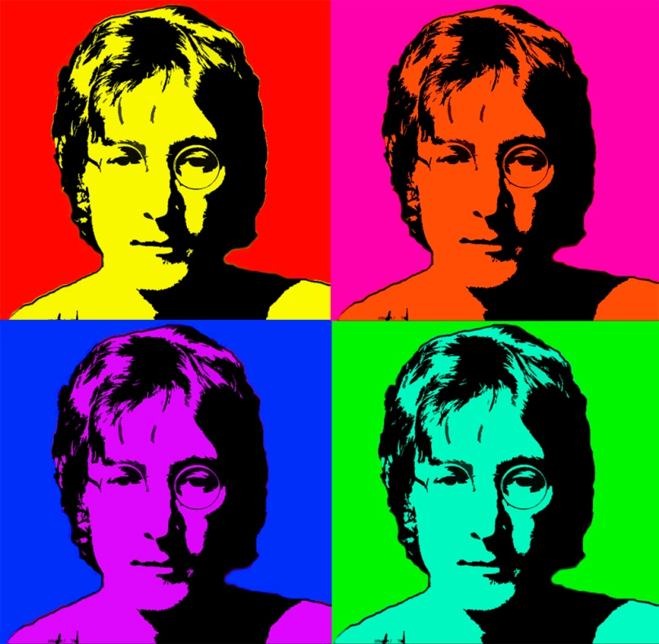
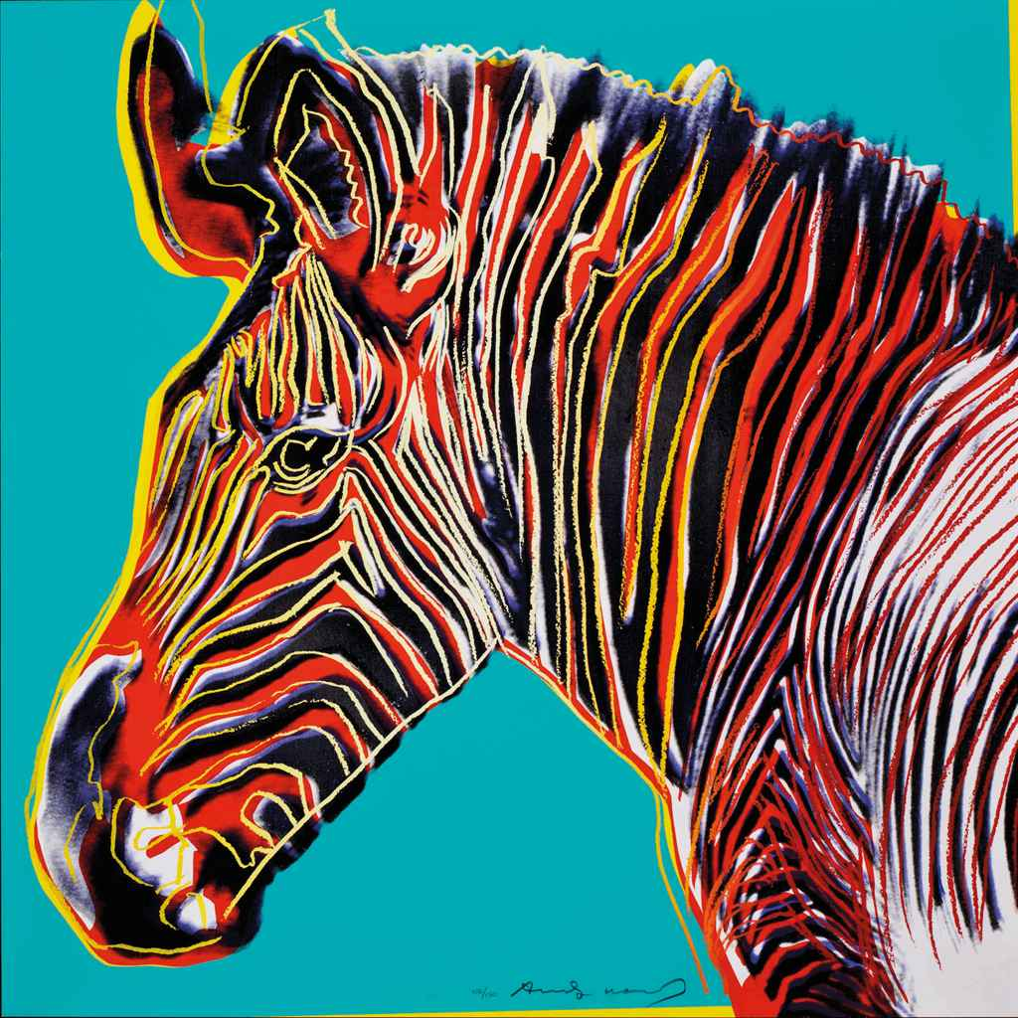
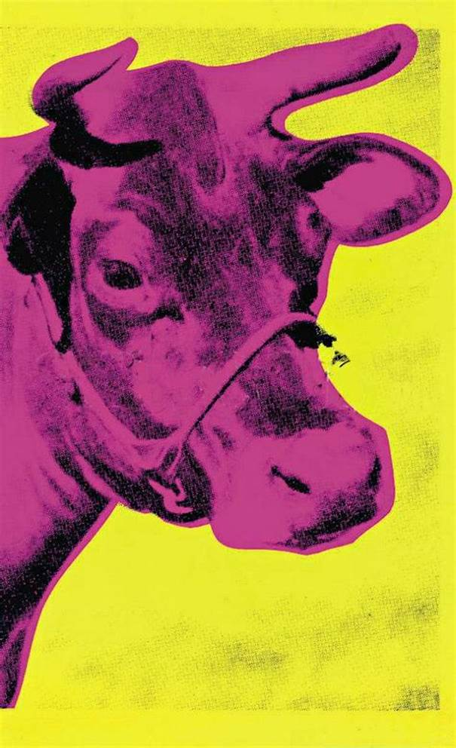
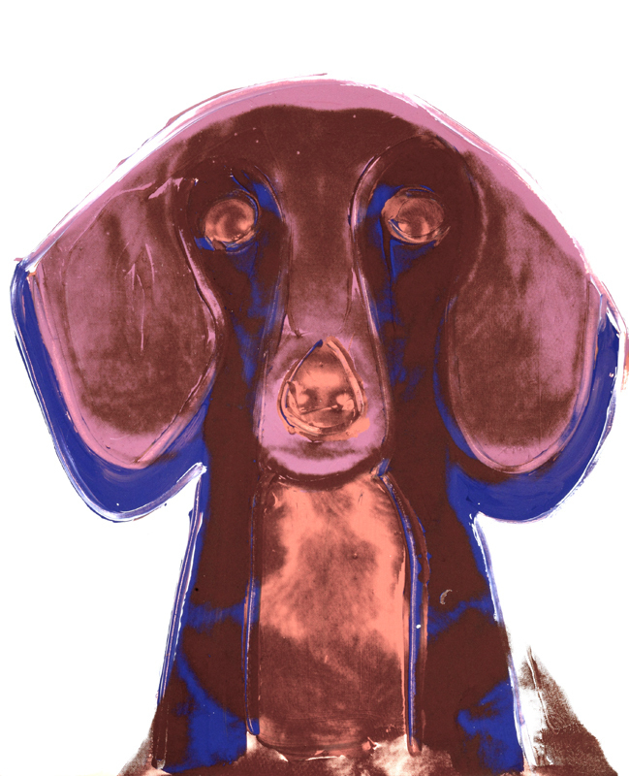
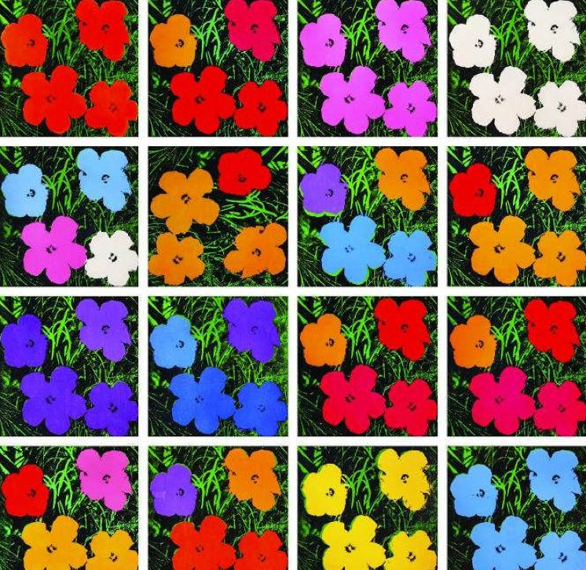

Slide 4
Element of Shape
Space is any area that the artist provides for a particular purpose. Space can be background, foreground, and anywhere in the middle.

Slide 5
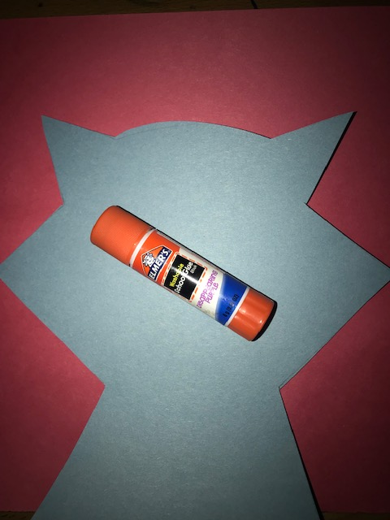
Step 1
Glue your cat head to your paper with a glue stick

Slide 6
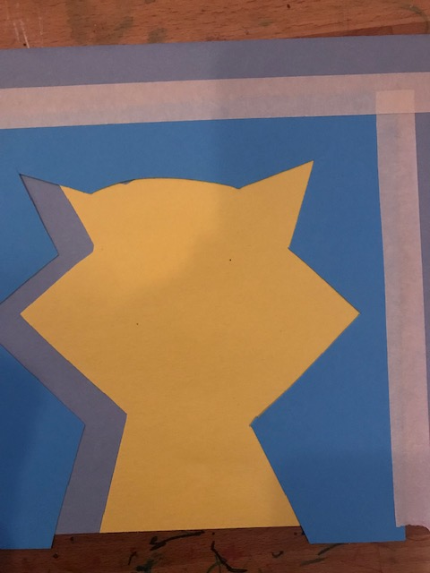
Step 2
Place your stencil over your cat head and move it just a bit down and to the left. Tape in place

Slide 7
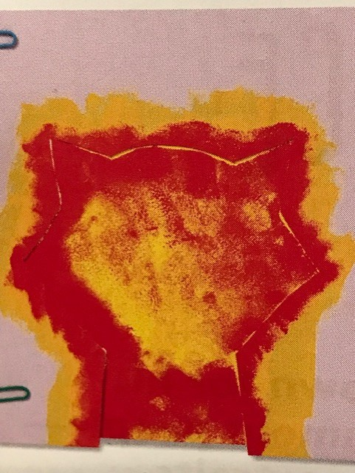
Step 3
Use a cotton ball to dab paint in the opening of the stencil. Make it lighter in the center and darker at the edges.

Slide 8
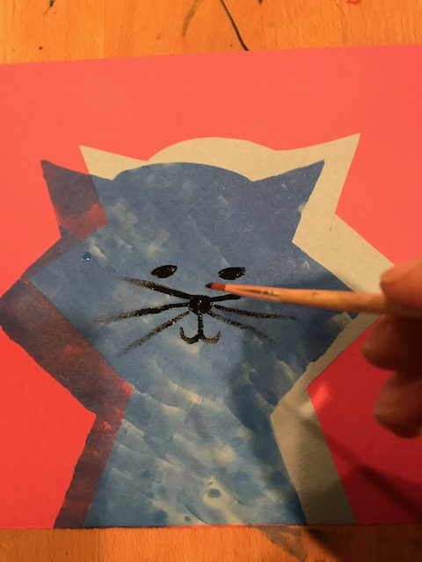
Step 4
Add your eyes, nose, mouth and whiskers with black paint

Slide 9
Step 5
Sign your artwork
And give it to an adult to he hung up

