Slide 1
FALL LEAF PRINT
Color & Texture

Slide 2
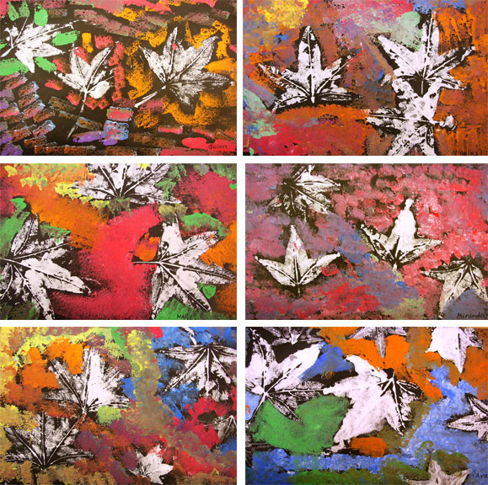
color

Slide 3

primary colors
Red
Yellow
Blue

Slide 4
(secondary)MIXING COLORS
Source: Color mixing
http://painting.about.com/library/blpaint/blcolormixingpalette1.htm

Slide 5
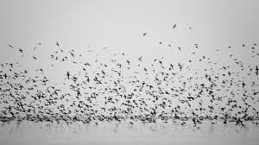
texture

Slide 6
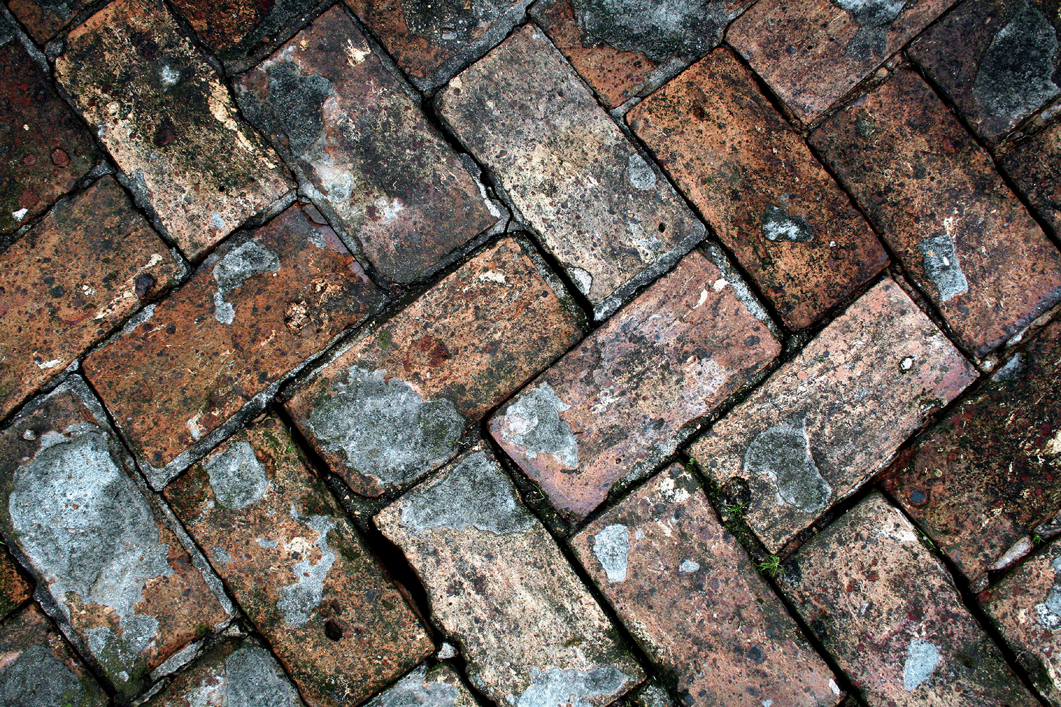
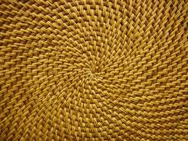
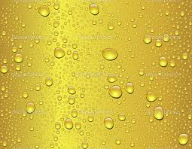
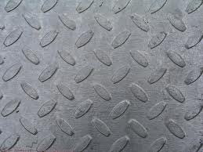

Slide 7
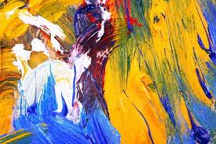
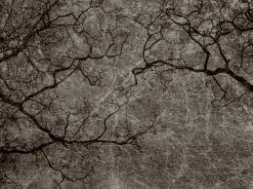
Color and Texture

Slide 8
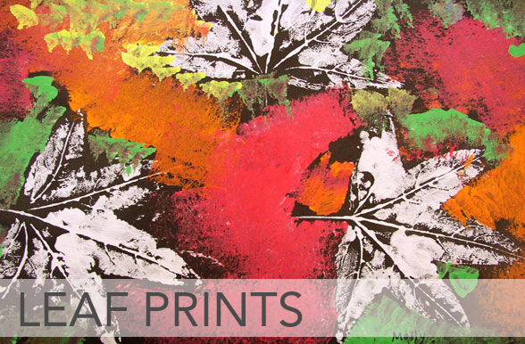
Example of today’s painted Leaf Project

