Slide 1
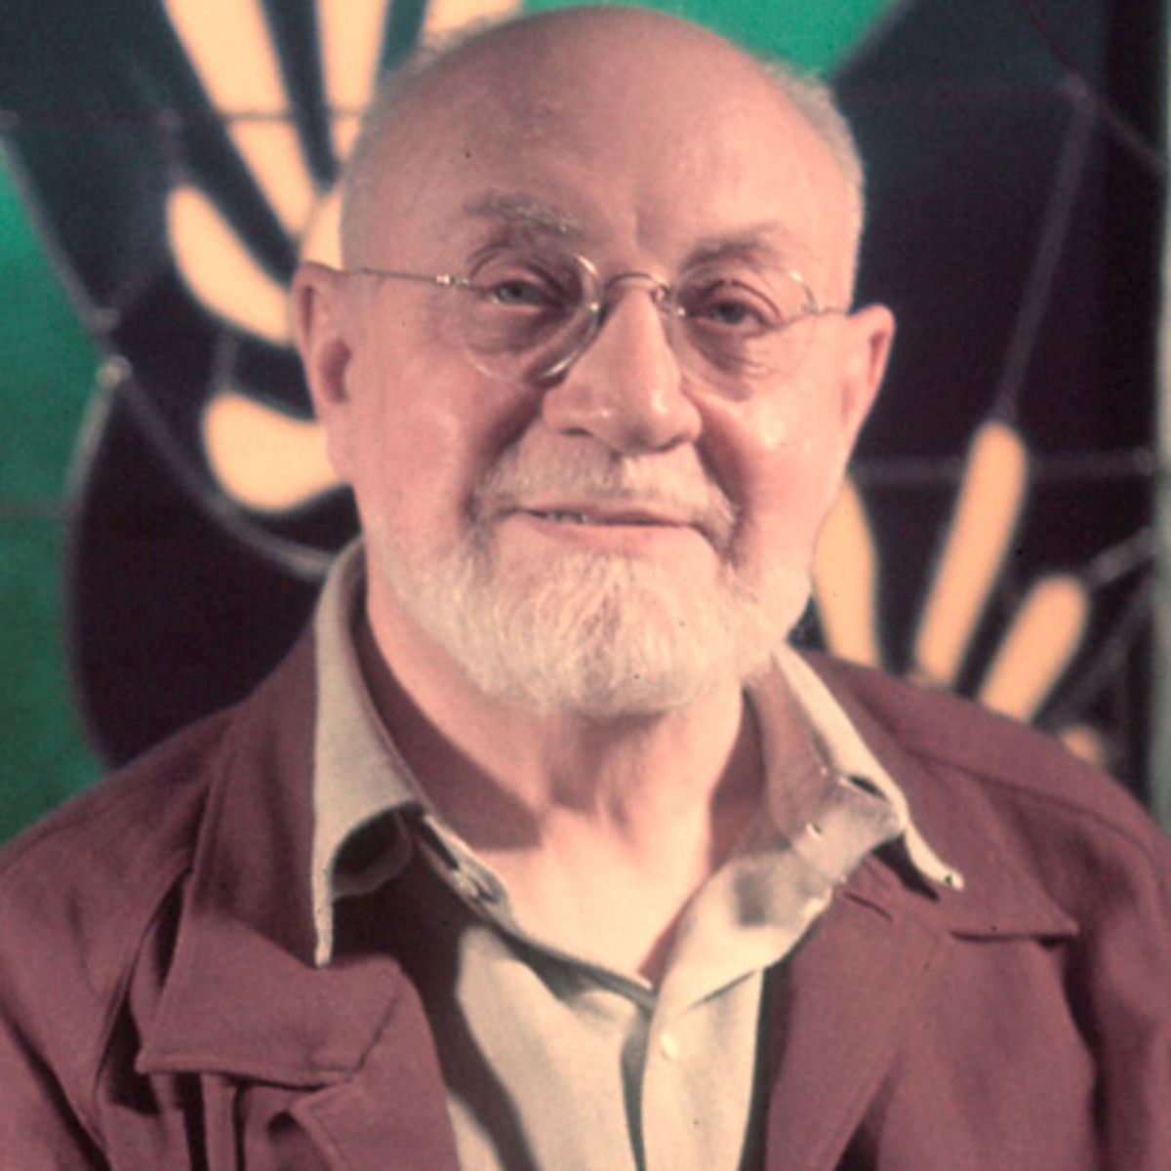
Henri Matisse
1869-1954

Slide 2
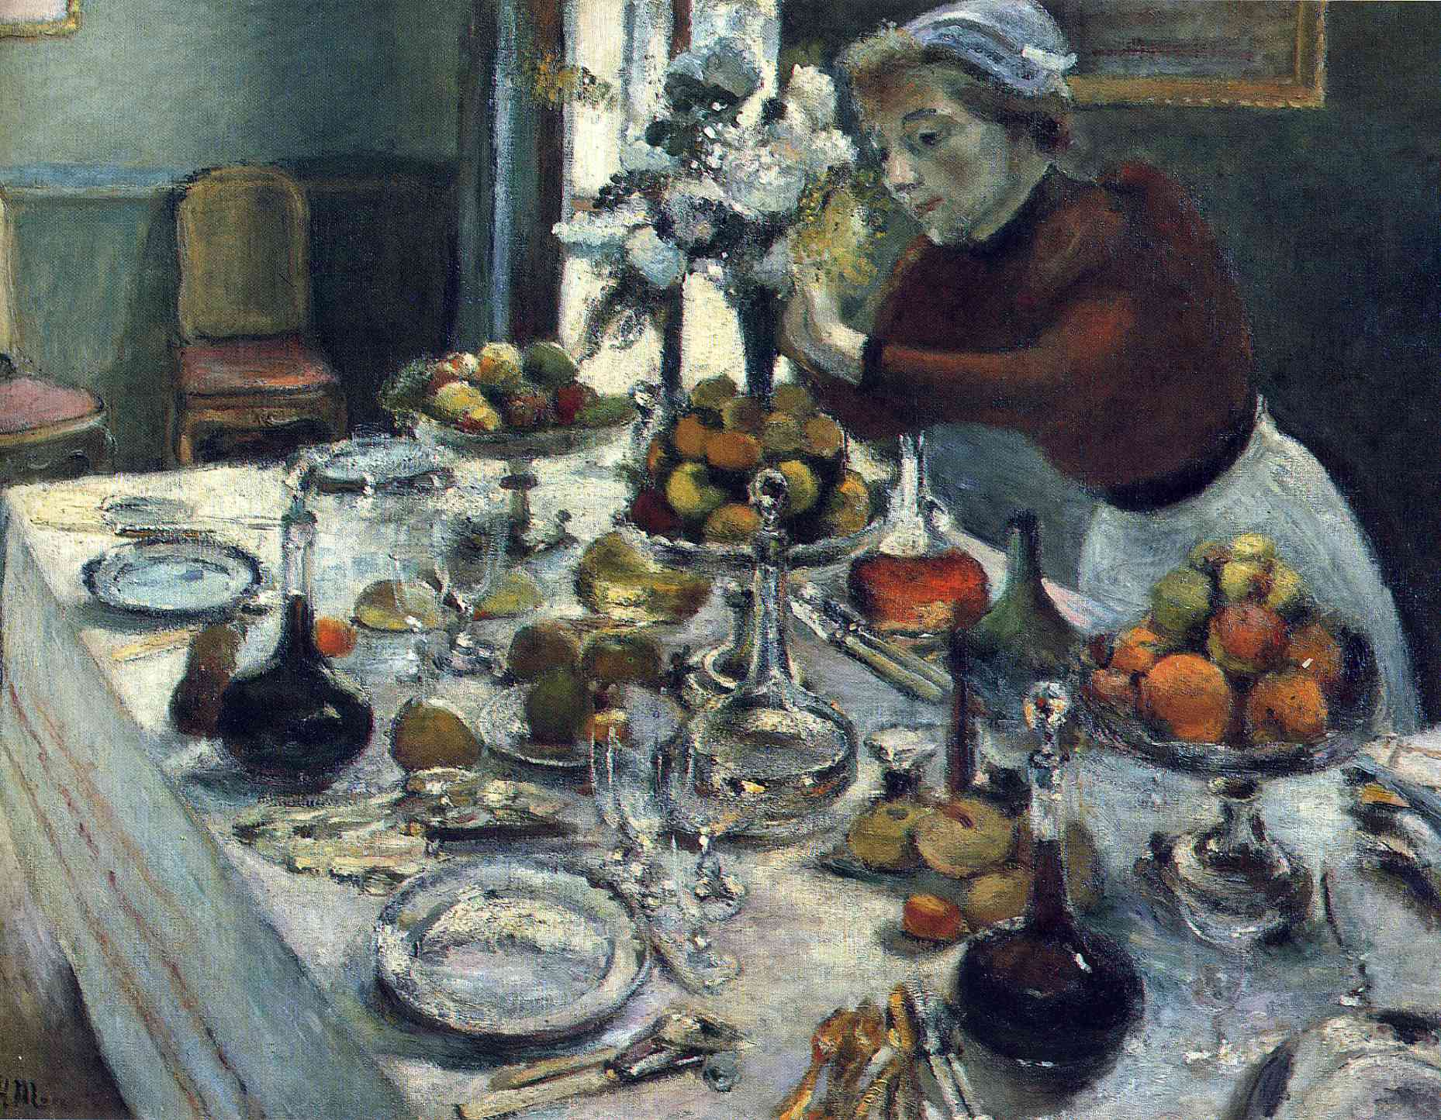
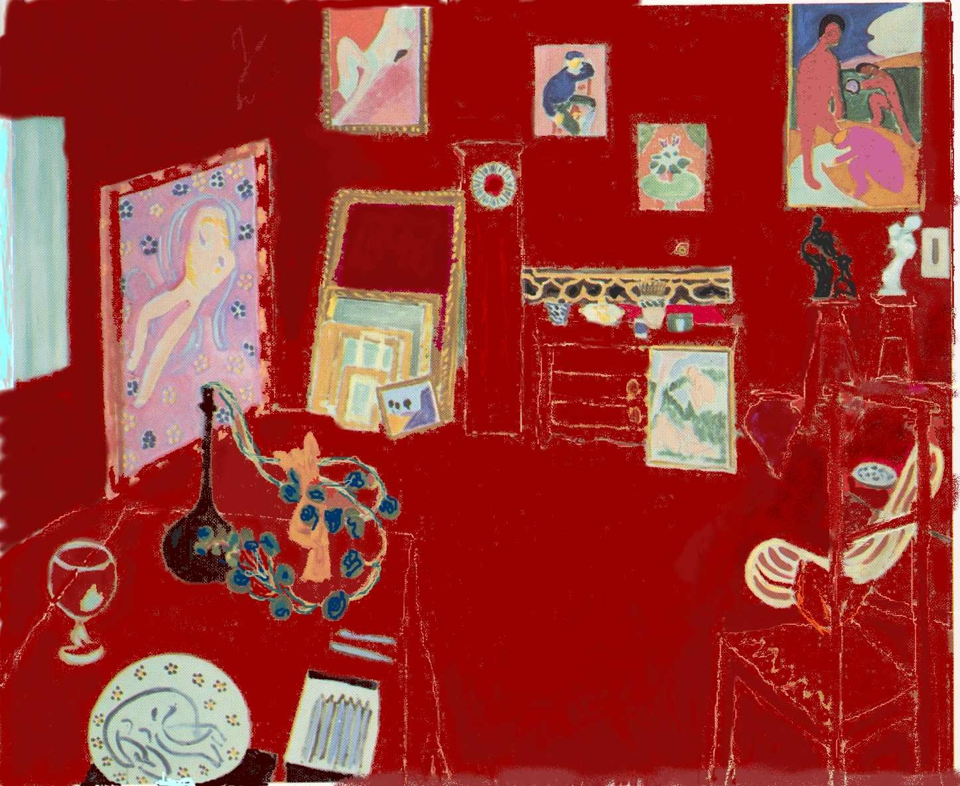
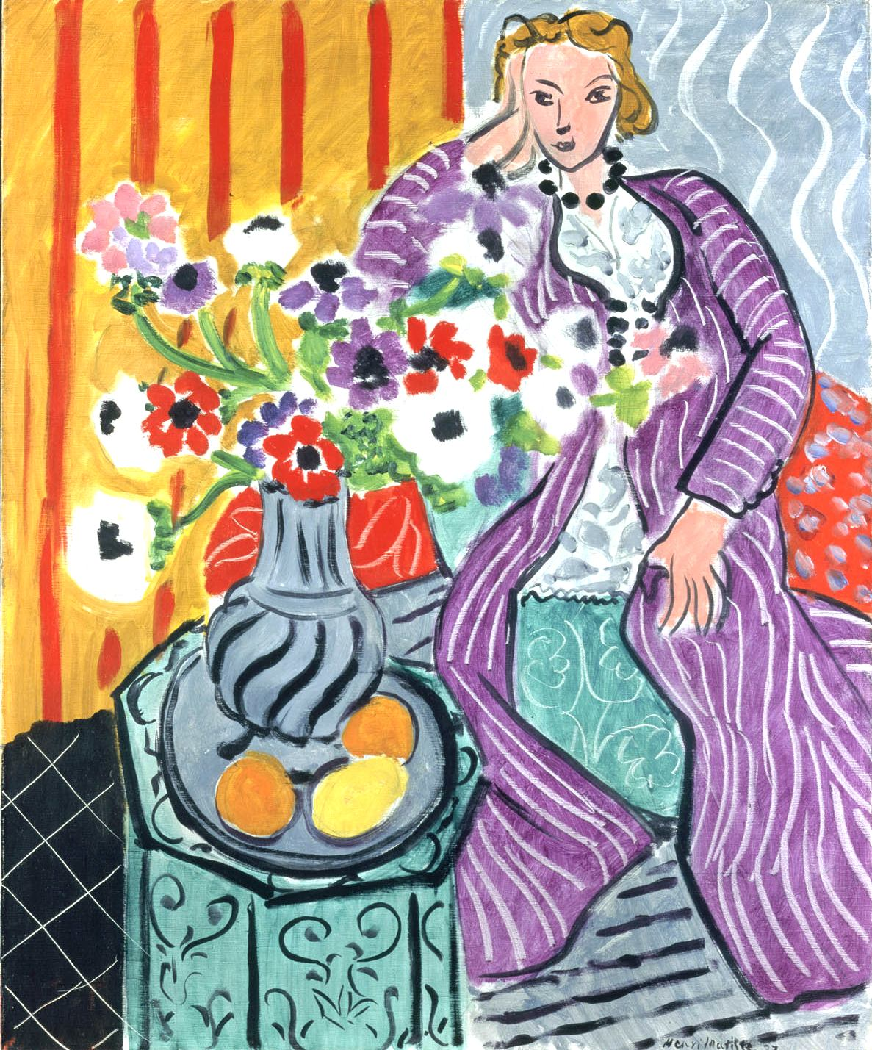
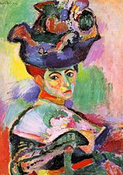
About Henri matissee…
Born in 1869 and grew up in France
Went to school to become a lawyer, but after receiving some art supplies while recovering from an illness, he discovered how much he loved art and decided to become an artist
Loved color and painted his emotions
Matisse’s first masterpiece, The Dinner Table (1897)
The Red Studio (1911)
Purple Robe and Anenomes (1937)
Woman With a Hat (1905)

Slide 3
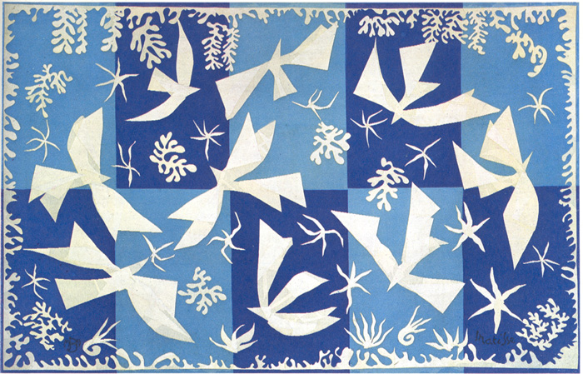
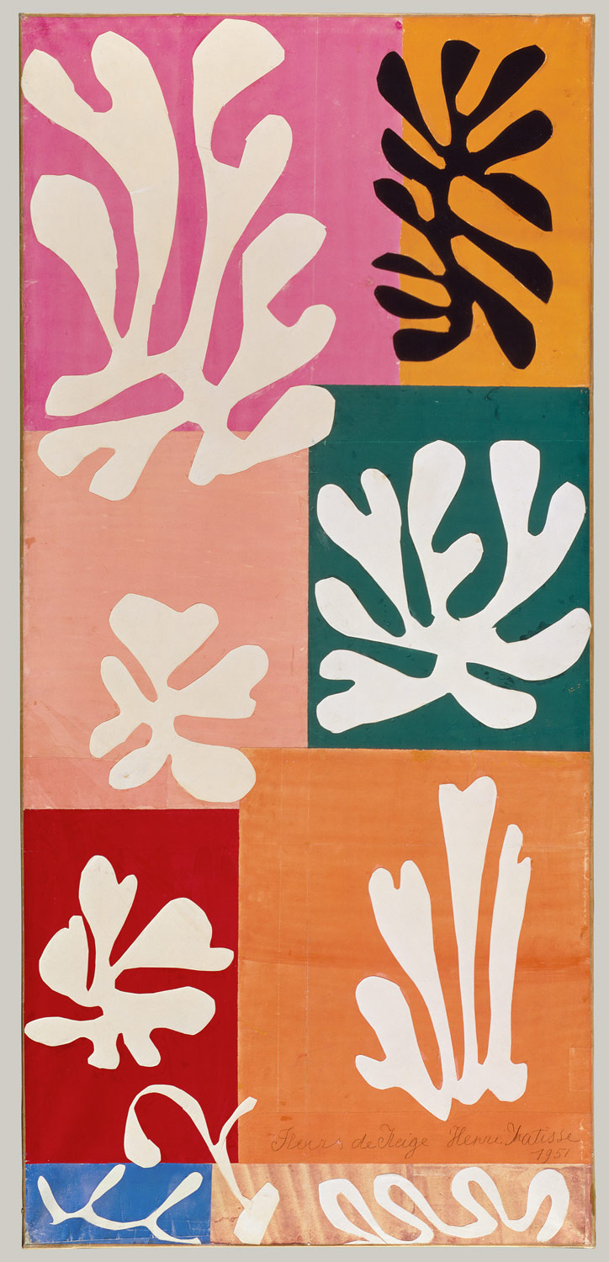
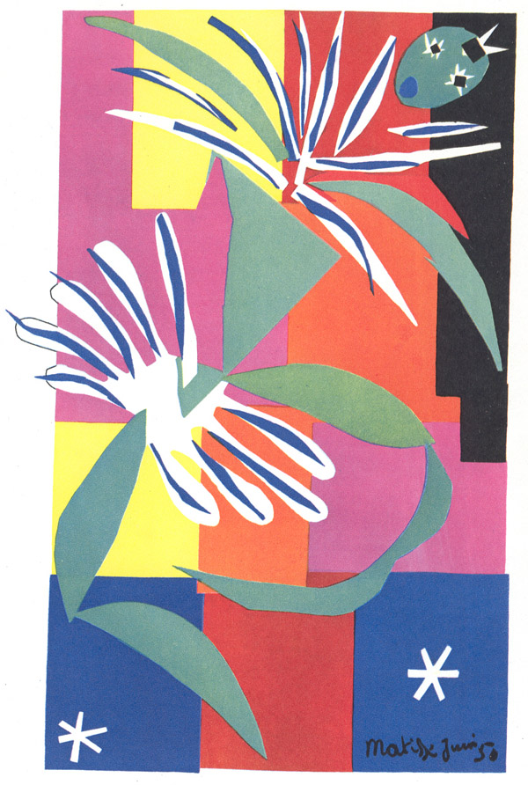
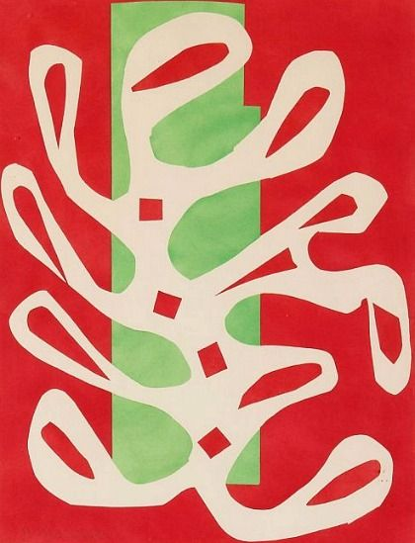
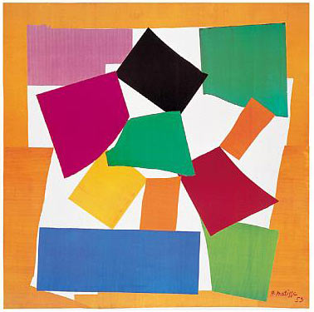
Cutouts
In his later years, Matisse began to experiment with cutouts.
He cut out colored paper and made collages.
Polinesia, the Sky (1947)
Snow Flowers (1951)
Creole Dancer (1952)
The Snail (1953)

Slide 4
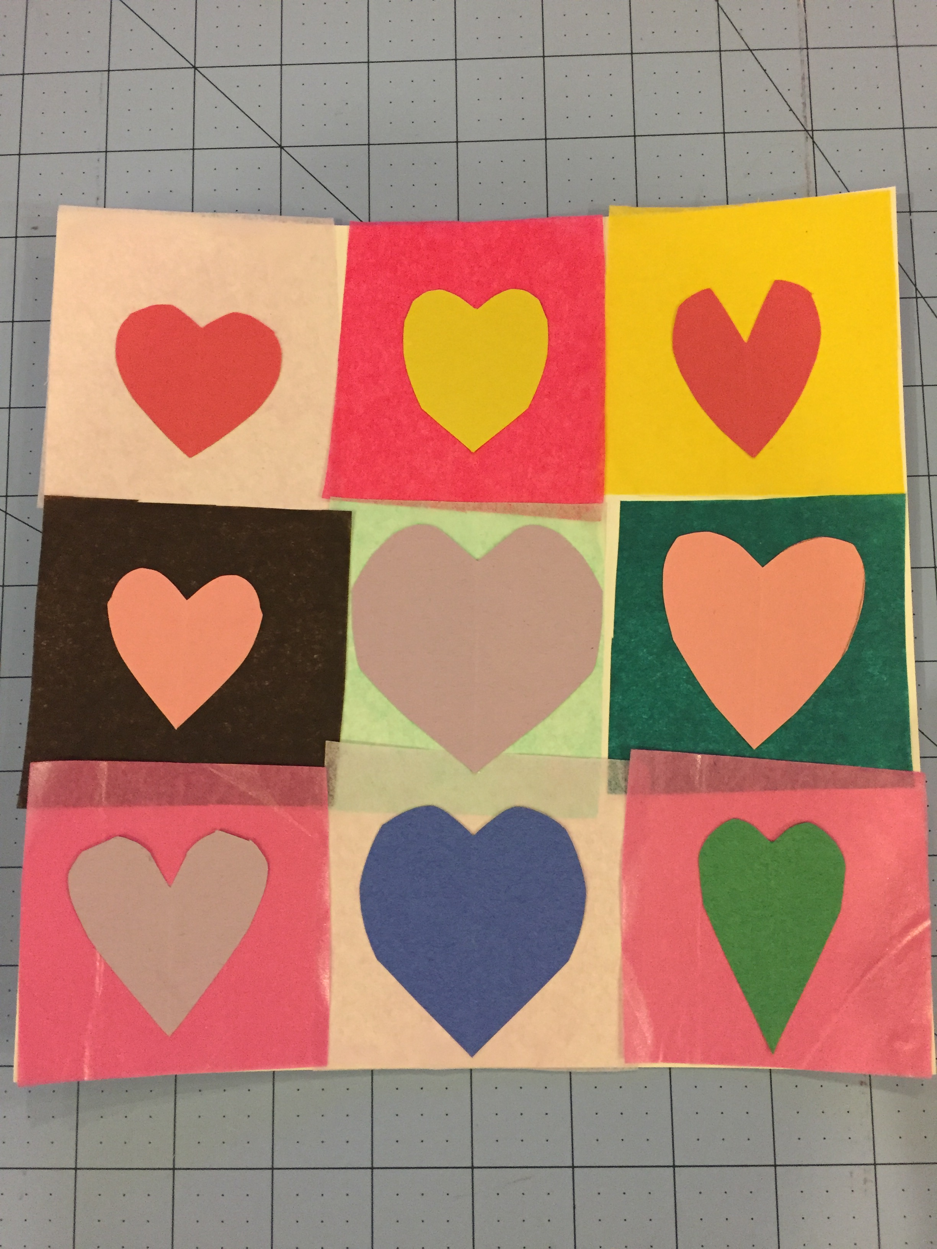
Matisse inspired heart art
Materials:
9”x9”White tagboard
3”x3” Tissue paper squares
3”x3” Construction paper for hearts
Scissors
Glue

Slide 5
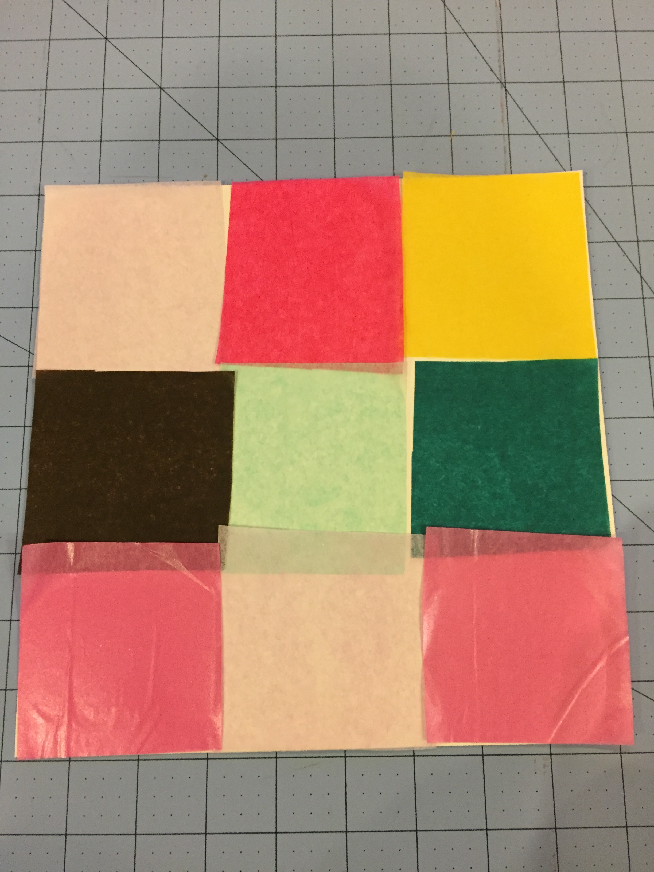
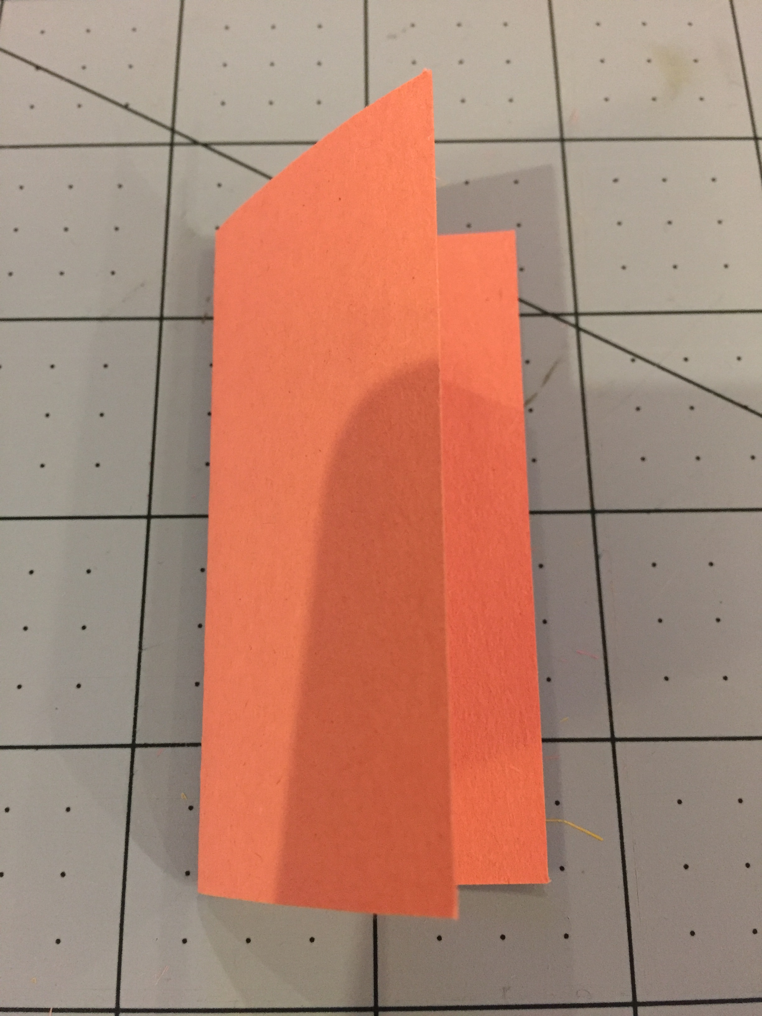
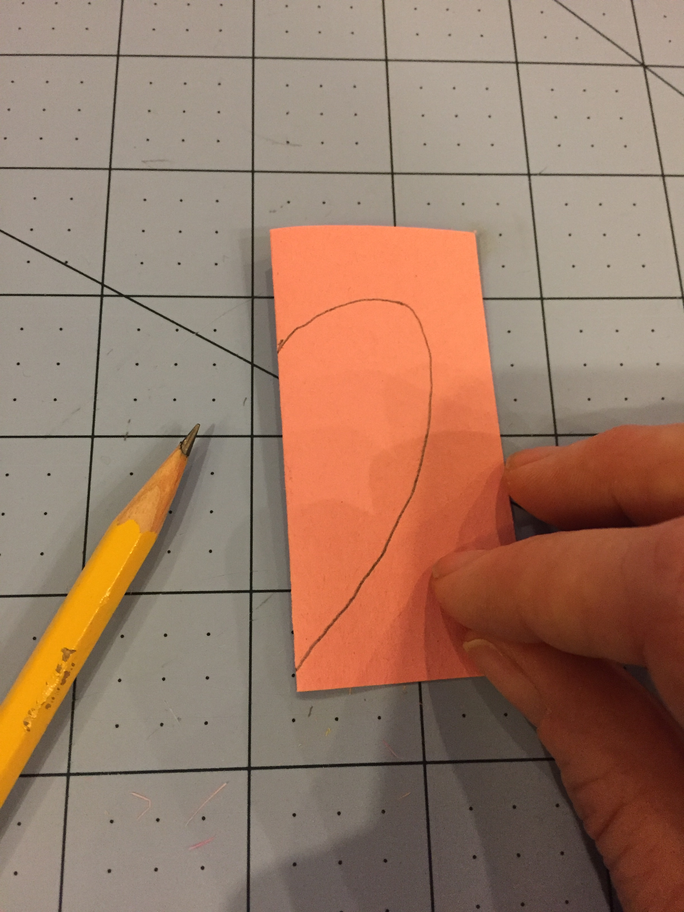
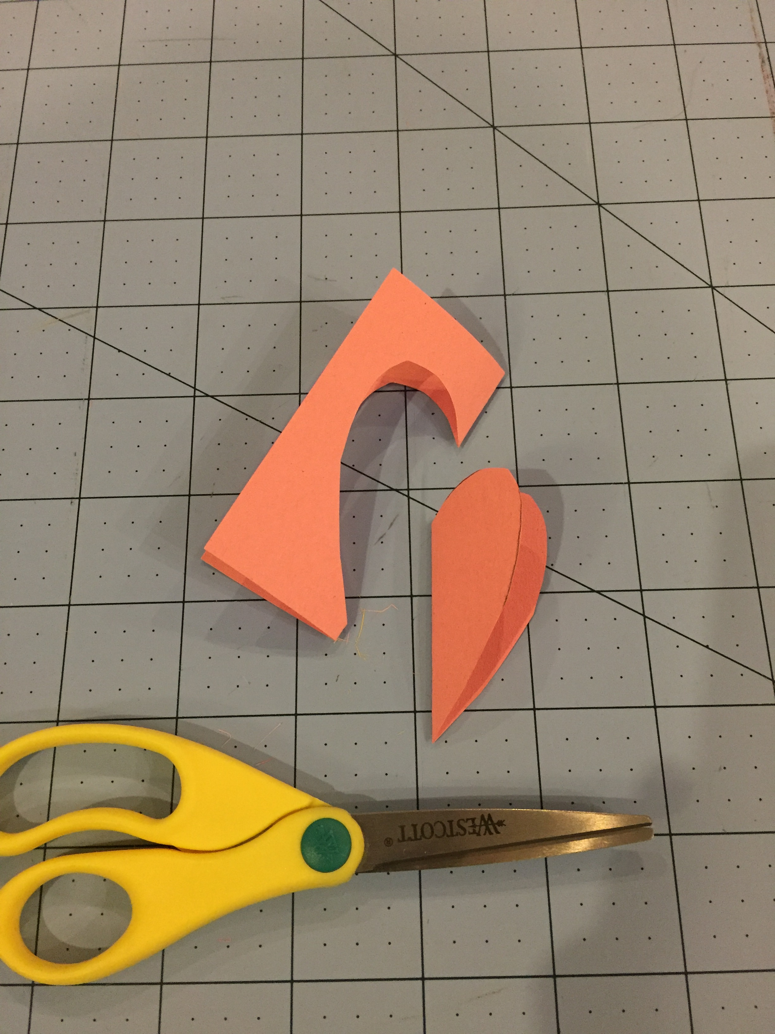
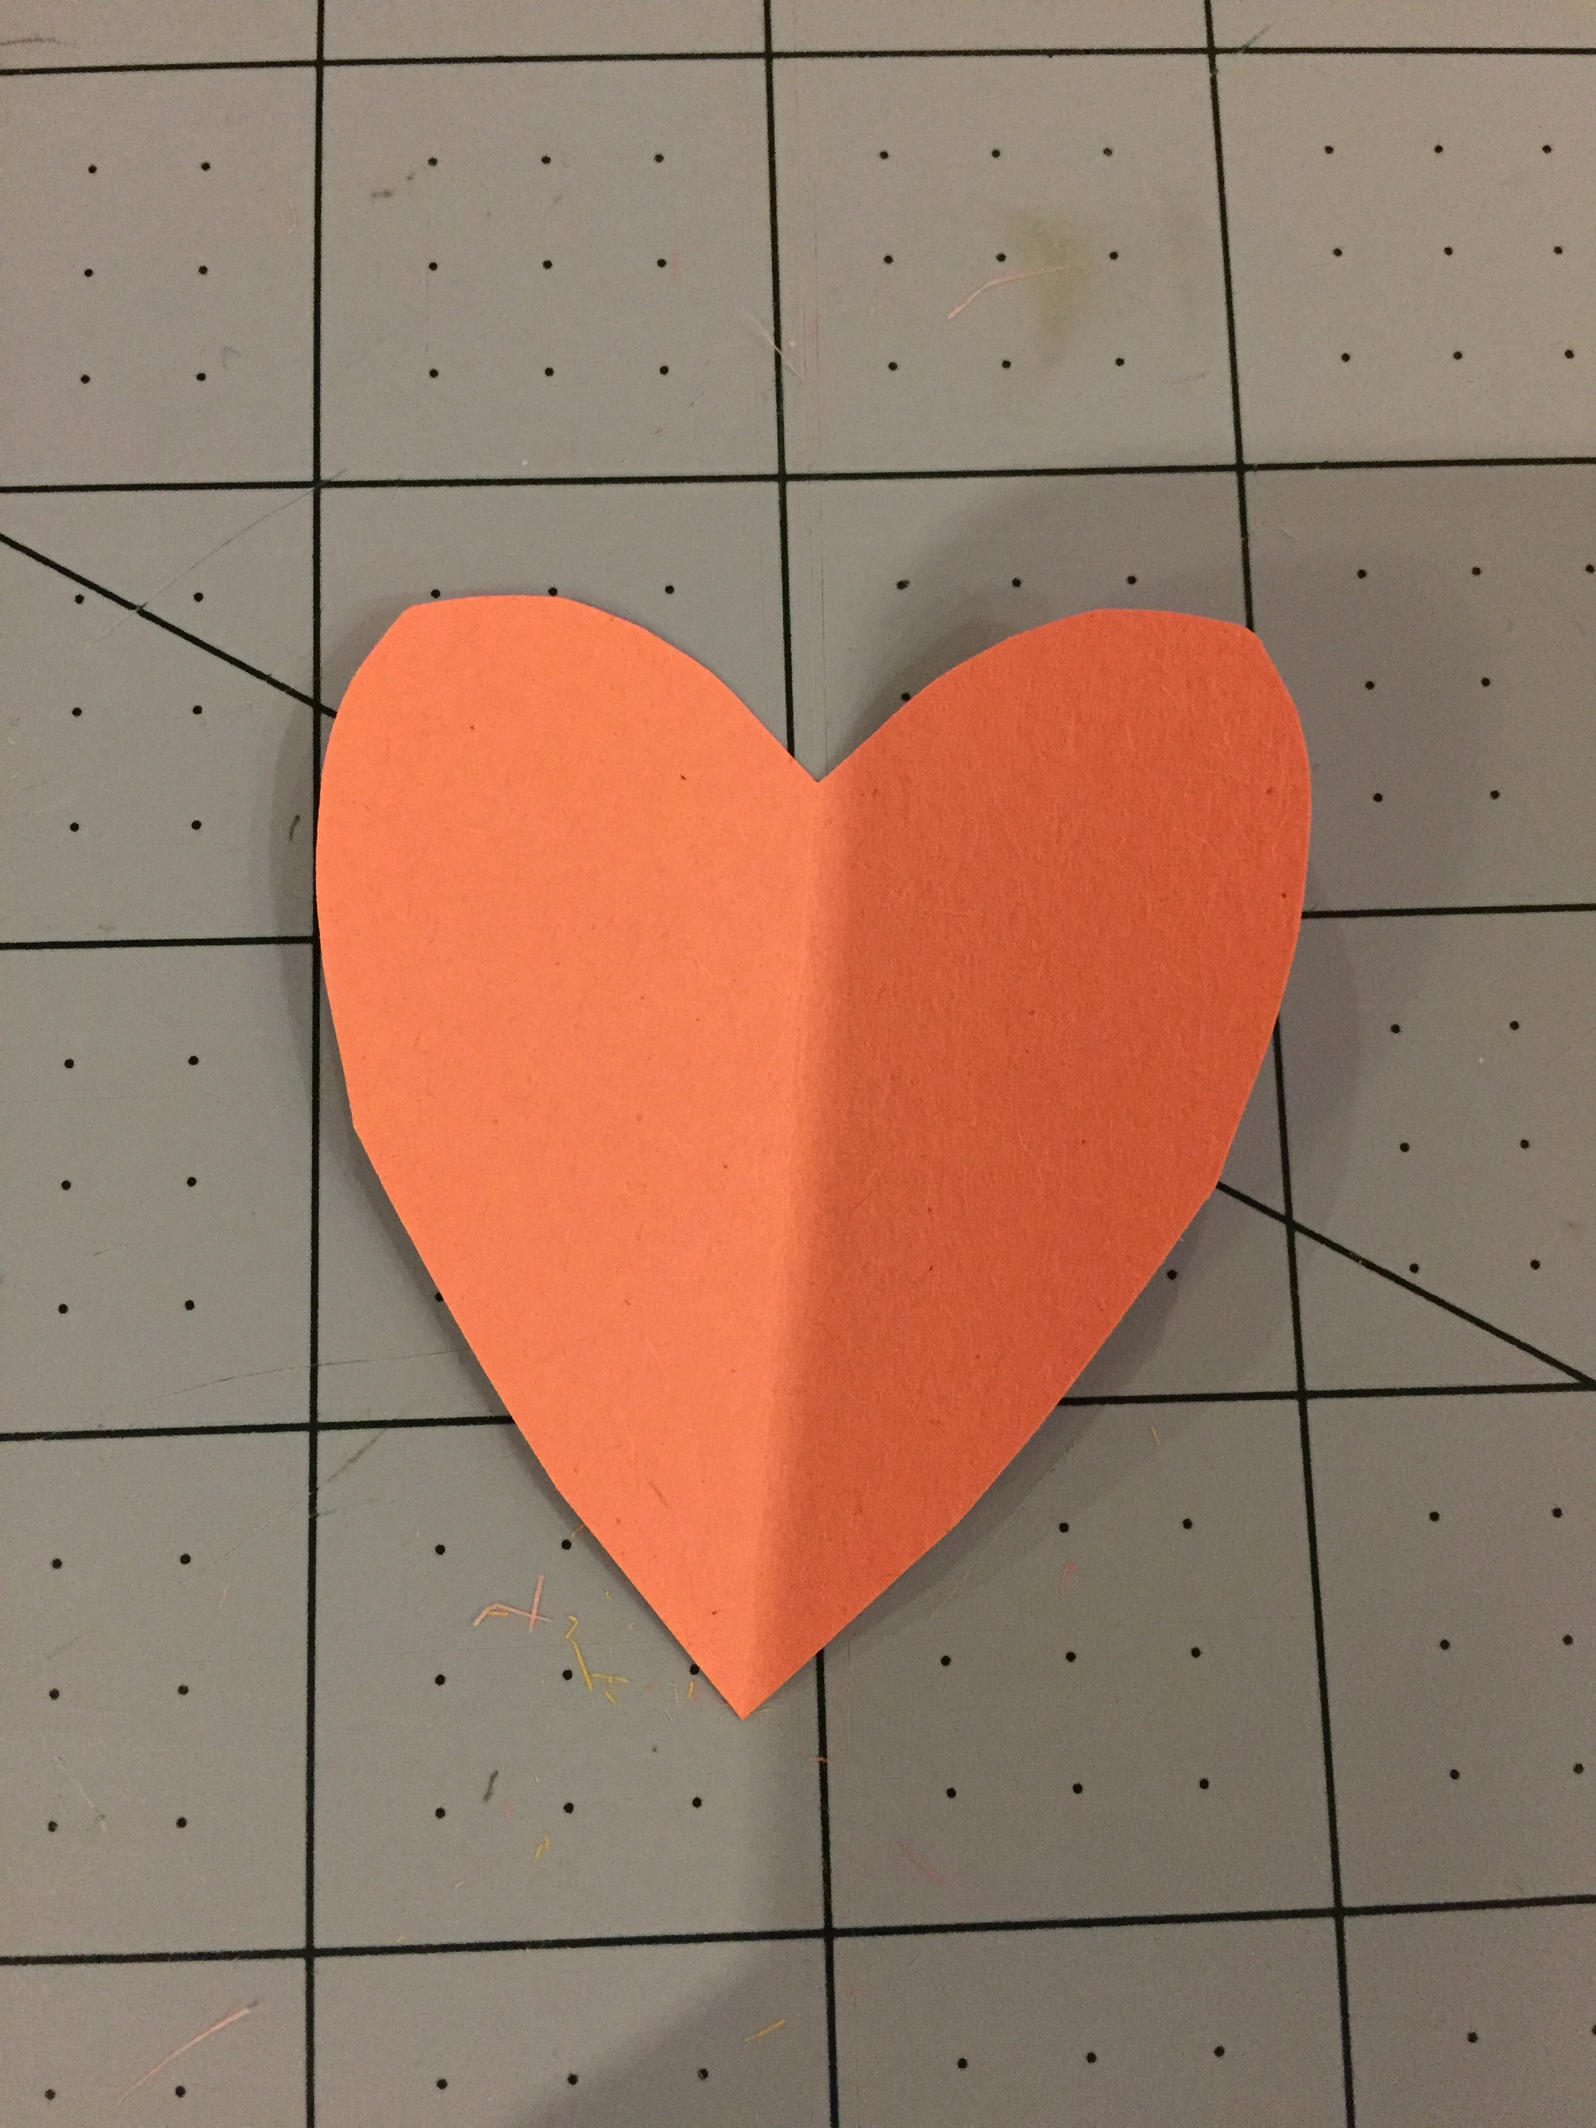
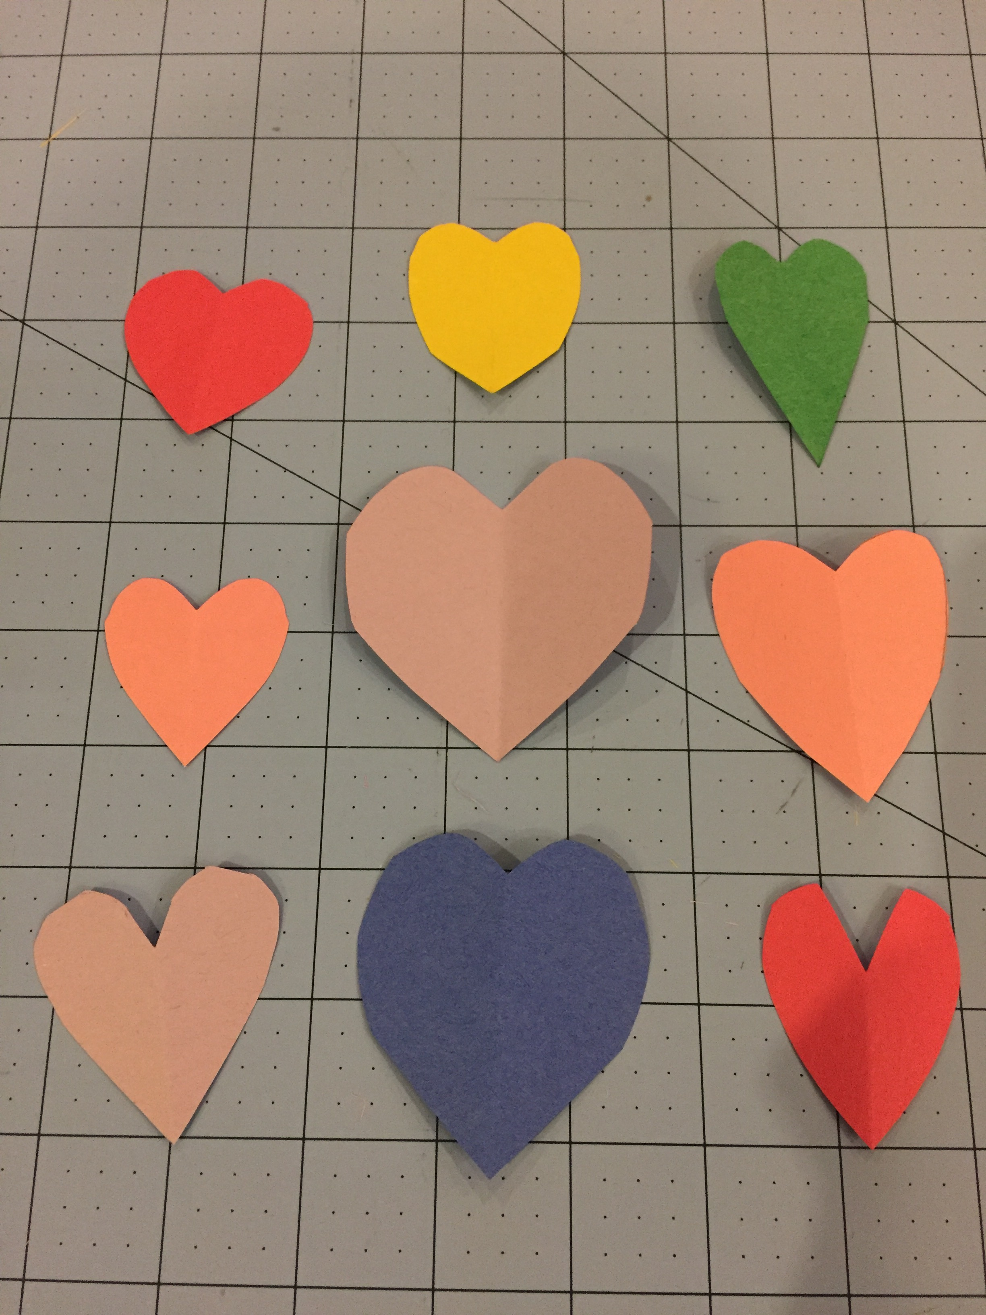
Steps:
Choose 9 tissue paper squares and arrange on white tagboard.
Glue tissue paper down.
Cut out 9 hearts from construction paper
Fold paper in half
Draw ½ heart shape
Cut on line – Don’t cut the fold
Glue ONE heart in each rectangle

