Slide 1
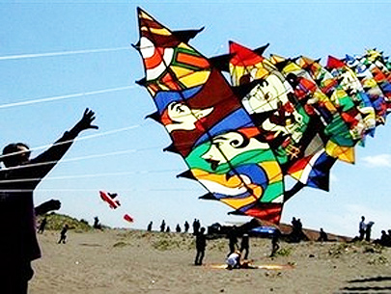
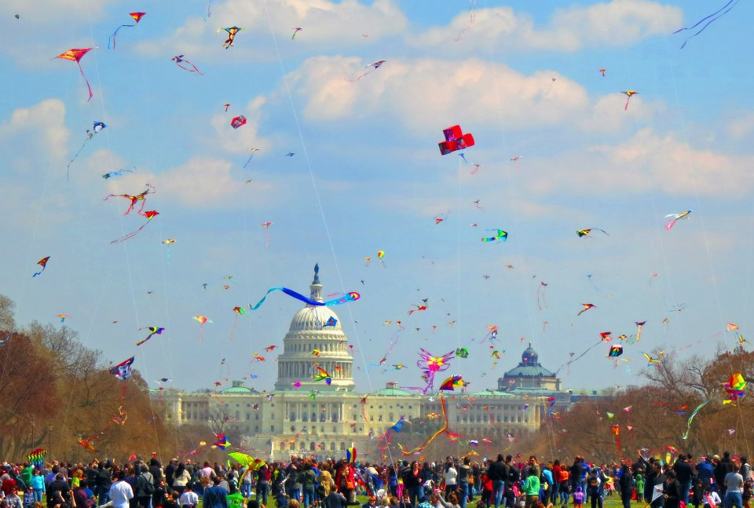
Kites
Art To Play With

Slide 2
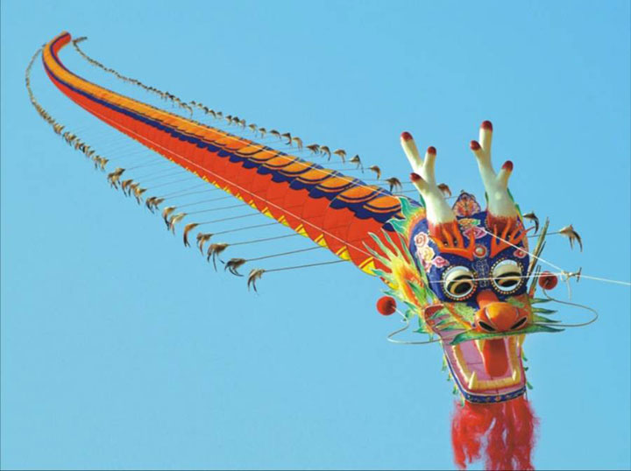
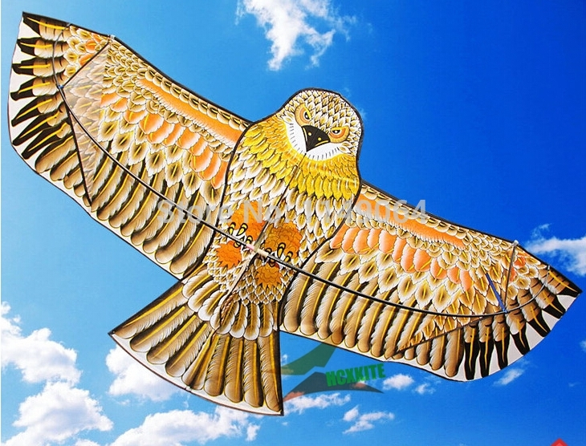
Kites are flown all over the world. They hold a very special place in society in Asian and East Asian countries such as Japan, China, Thailand, India, and Pakistan. Kites are not only used for fun and work, they are also considered an art form.

Slide 3
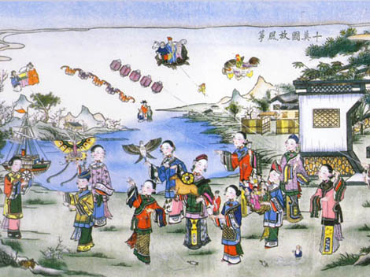
It is believed that the Chinese invented kites 2,800 years ago.

Slide 4
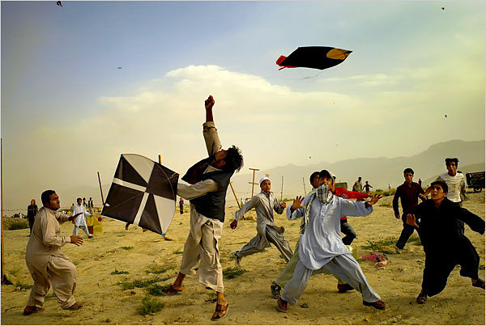
Through history, kites have been used for warfare, signaling, fishing, and playing. Some countries have competitions called kite fighting. Tiny bits of glass or porcelain are glued to the kite string so that they can cut their opponent’s kite strings and be the last kite flying.
Kite Fighting in Afghanistan

Slide 5
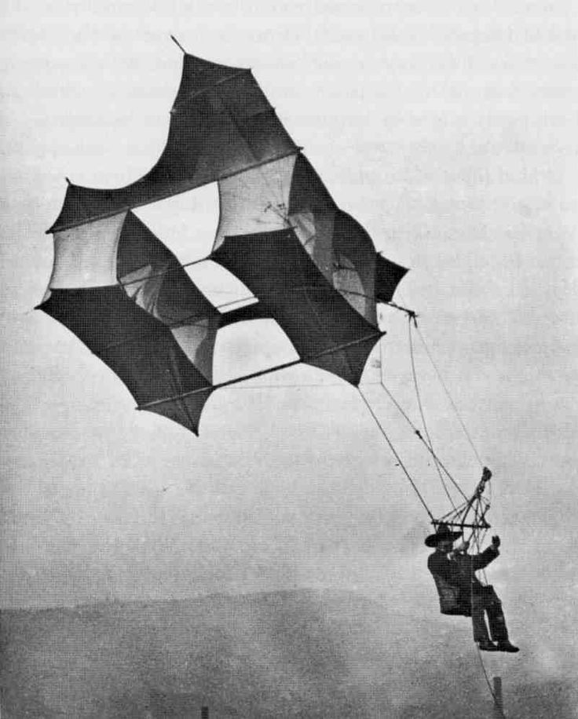
People have even tried to fly using large kites.

Slide 6
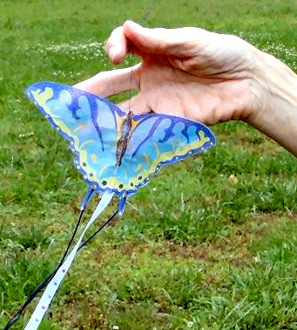
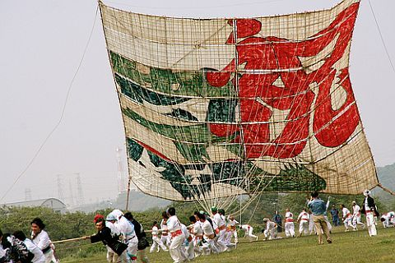
Some kites are small.
Some kites are huge.
Every year in Japan, teams build huge kites that weigh more than a truck and take dozens of people to fly them.

Slide 7
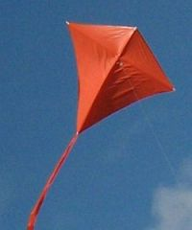
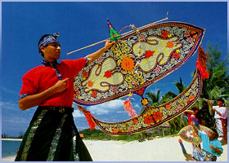
Some kites are plain.
Others are beautiful works of art.

Slide 8
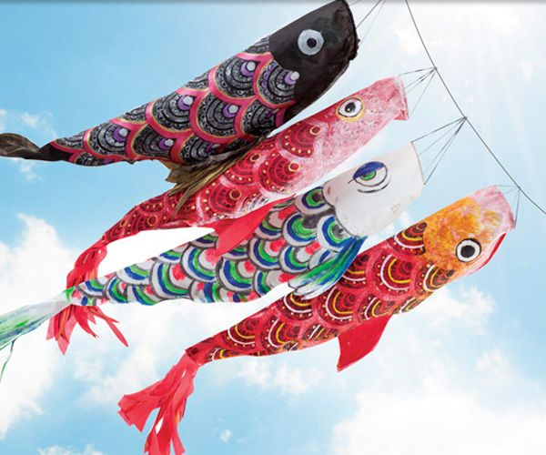
In Japan, May 5th is National Children’s Day.
Japanese families celebrate by flying windsock kites that look like carp (a big goldfish) called koinobori. Different colored fish represent different members of the family.

Slide 9
How to make a Koinobori

Slide 10
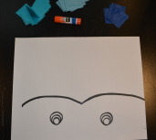
Write your name on the back of the paper.
Pick out three colors of tissue paper.
Get your glue stick ready.

Slide 11
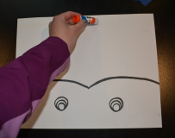
Starting at the back, draw a line of paste from one side to the other.

Slide 12
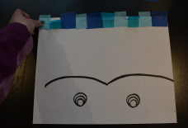
Put down different colors of tissue paper on the paste. It works best if you place one end of the tissue paper square on the paste so the other end can move in the wind.

Slide 13
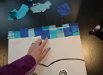
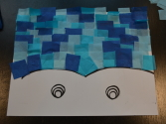
Make the next row by adding a row of paste, then tissue paper. Overlap the squares a little so you don’t see the paper underneath.
Work your way to the front until the whole area is full.

Slide 14
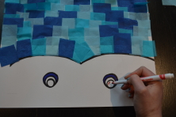
Color in the eyes with markers.

Slide 15
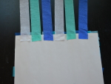
Turn your koinobori over and paste streamers to the tail of the fish.

Slide 16
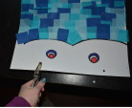
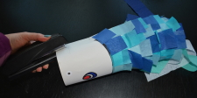
Have an adult help you punch holes in the sides of the fish (at least 3-4), attach hole reinforcers, and staple the fish into a tube.

Slide 17
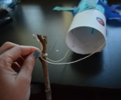
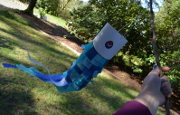
Guide a string through each hole and tie the strings to the end of a stick.
Enjoy flying your koinobori kite!

