Slide 1
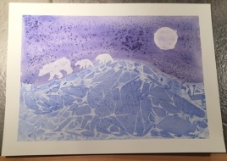
Polar Bears at Night
Kindergarten

Slide 2
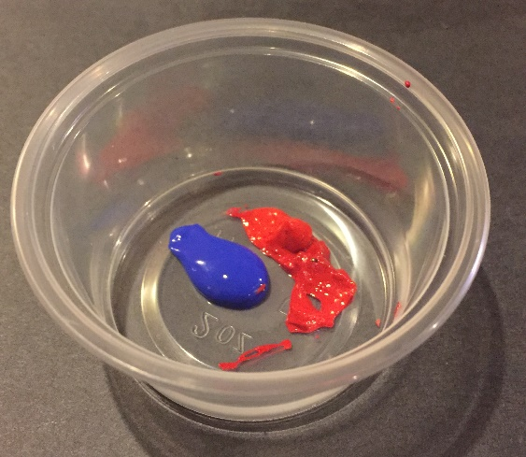
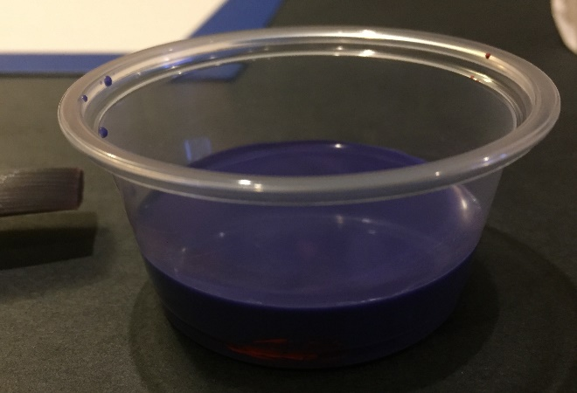
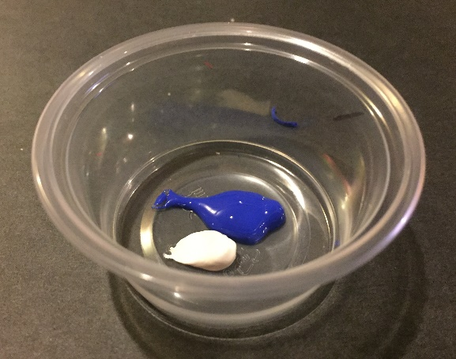
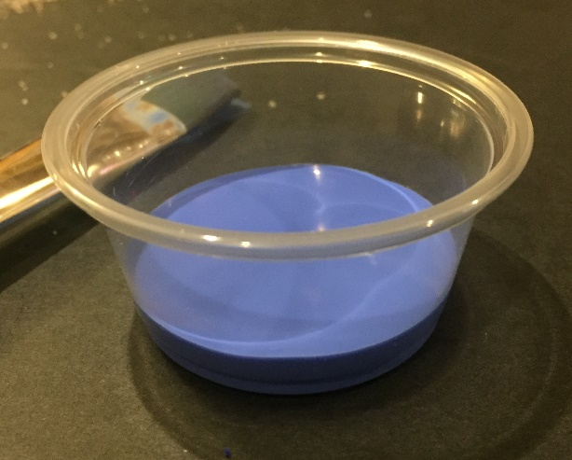
Materials:
Watercolor paper (you can add a frame around each paper with blue tape)
Purple and Blue watercolor (using the concentrated tube watercolors) →
Paint brushes for watercolor
White tempera paint (if using)
Sponges for tempera paint (if using)
Salt
Plastic wrap
Tissues
Cups
Polar bear stencil or cut-outs

Slide 3
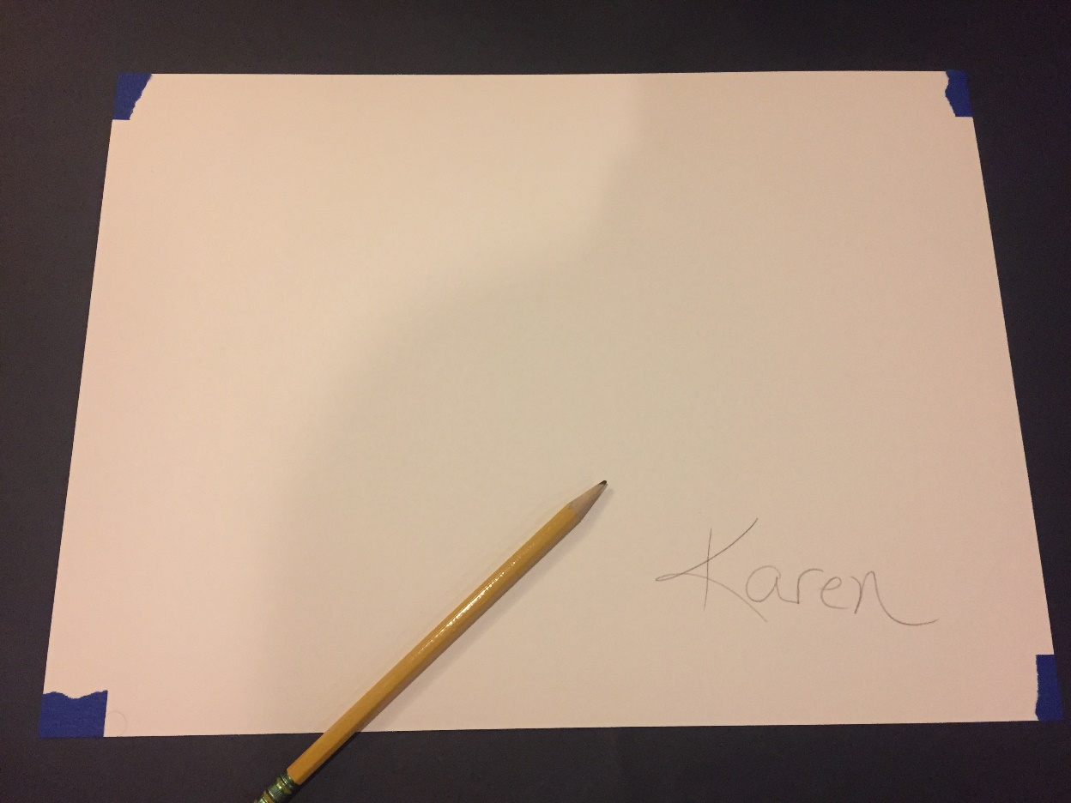
Flip over paper and write name on the back.
Flip back over to the front and draw a horizon line.

Slide 4
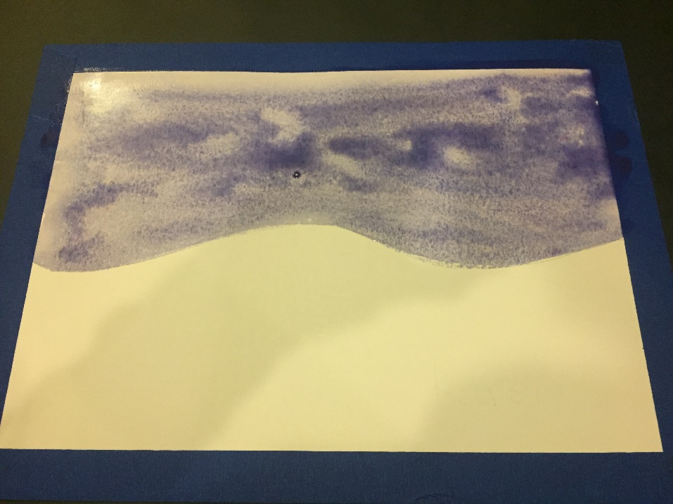
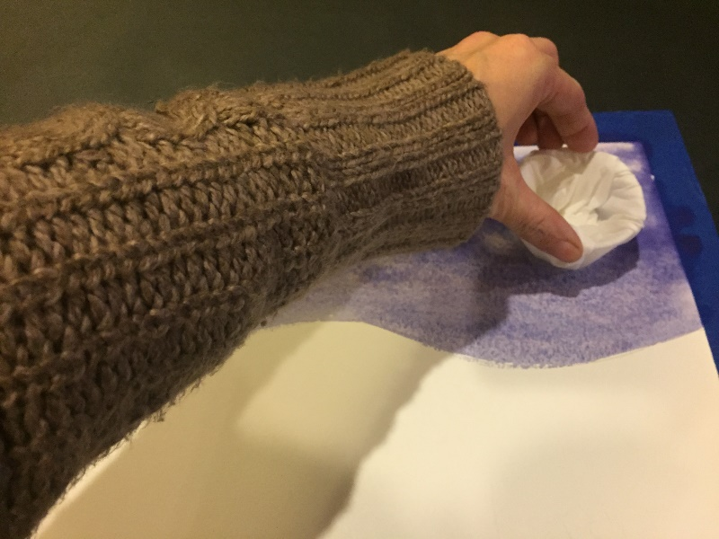
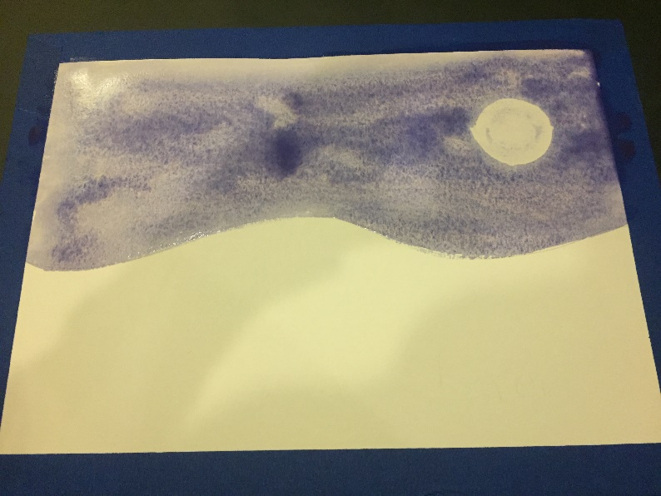
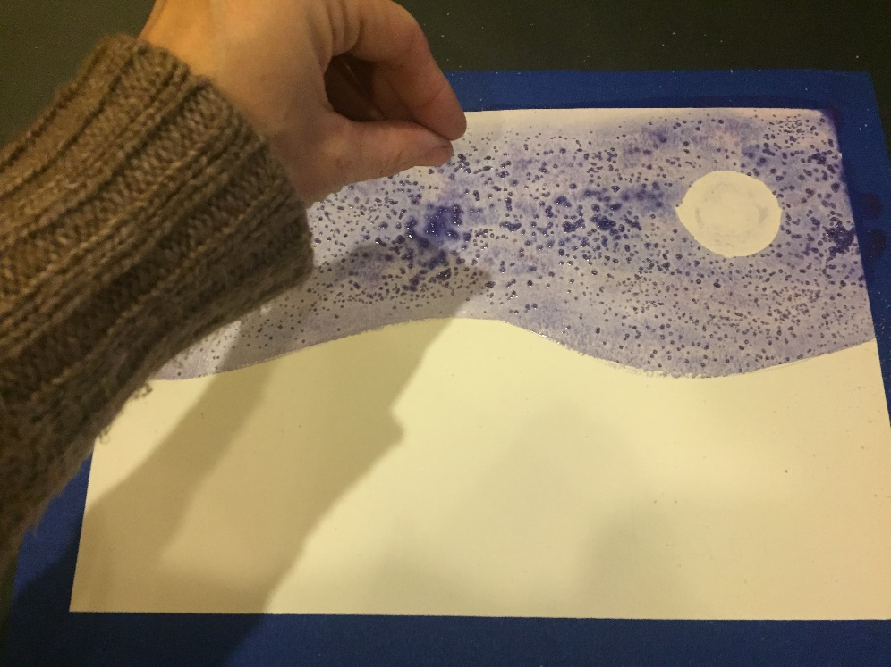
3. Paint sky with purple watercolor paint.
4. Use tissue covered cup to soak up paint and create a moon.
5. Sprinkle with salt.

Slide 5
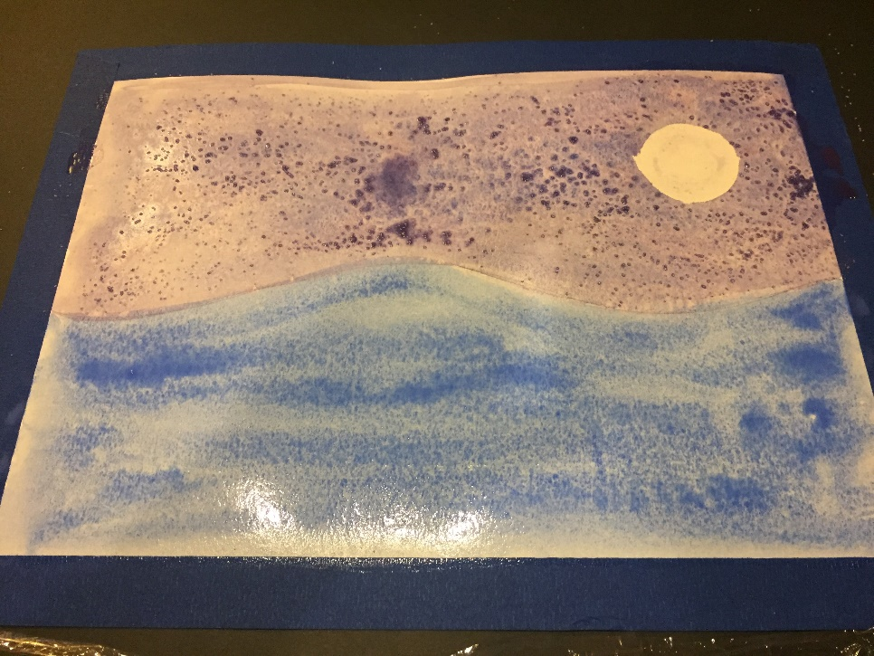
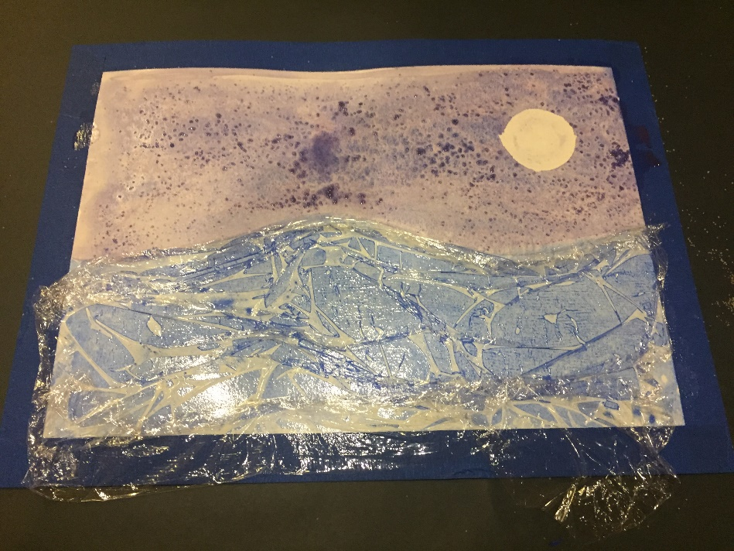
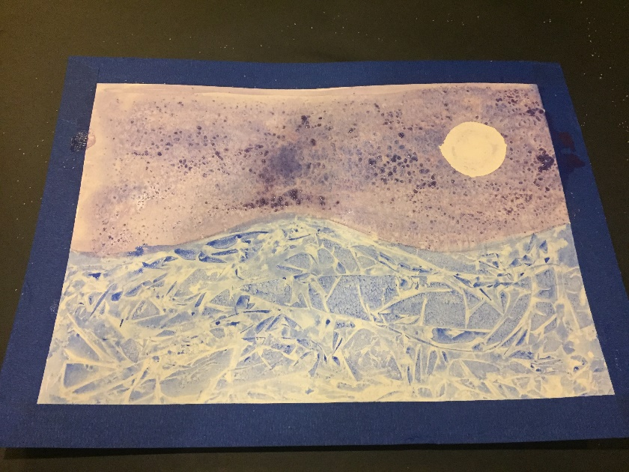
6. Paint ground with blue watercolor paint.
7. Cover with plastic wrap. Leave on.
8. Allow to dry before you remove plastic wrap.

Slide 6
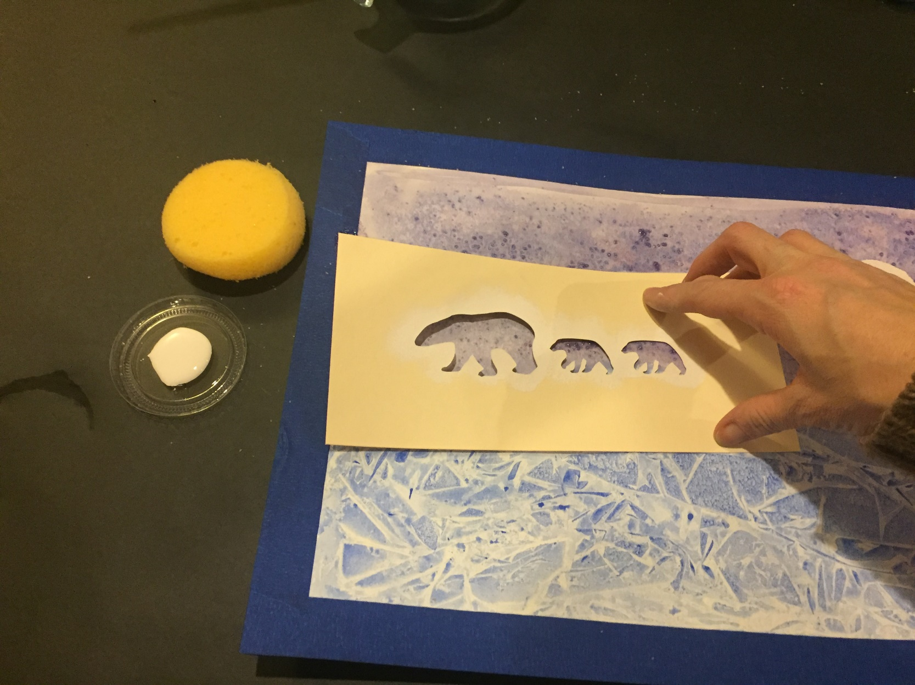
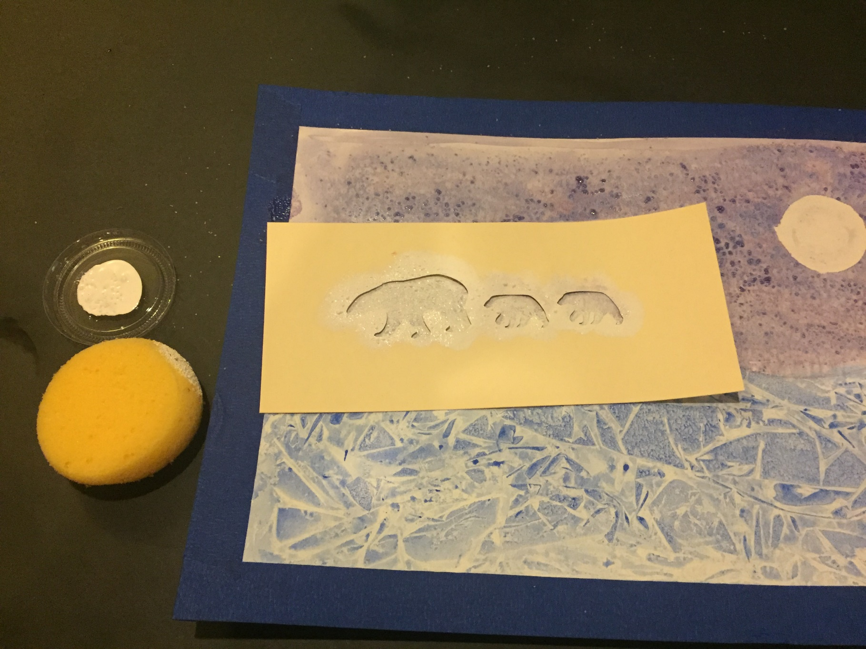
9. Hold stencil with one hand while you sponge on white tempera paint.

Slide 7
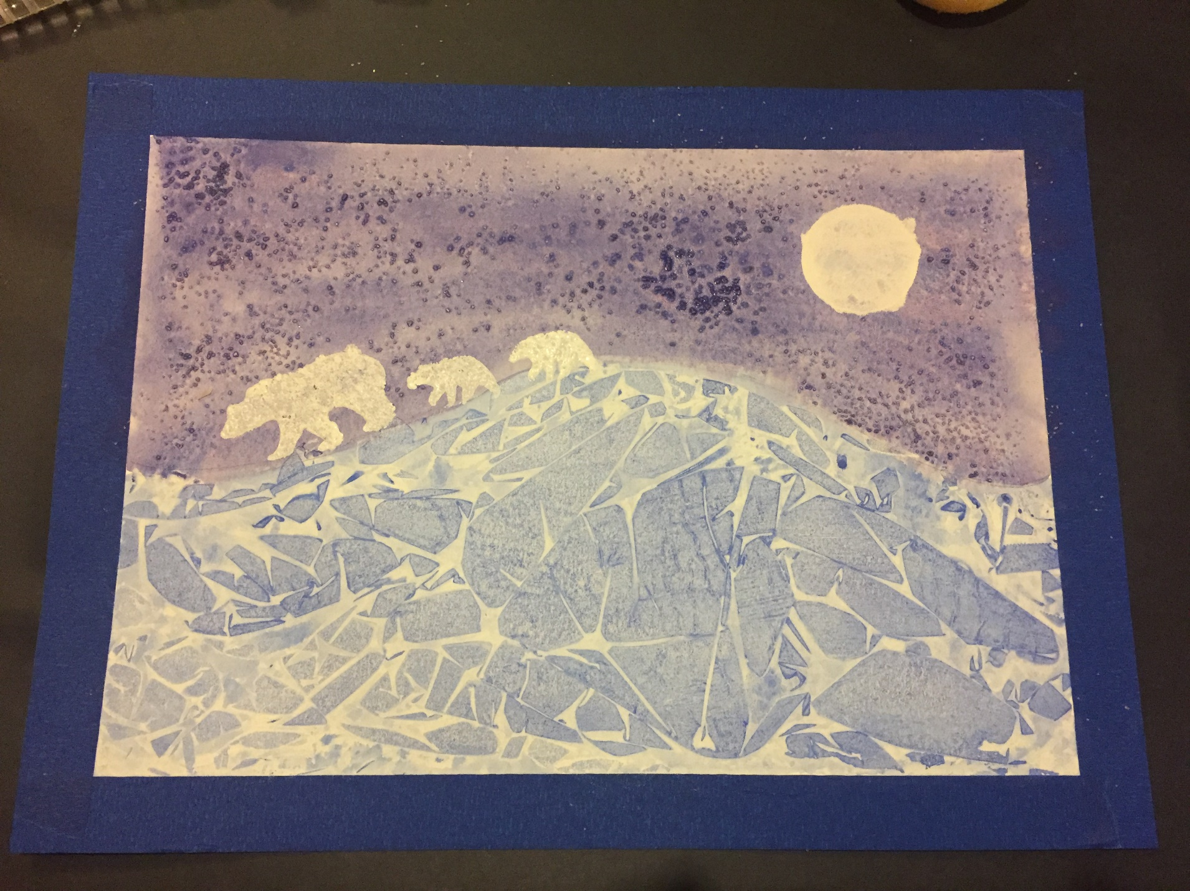
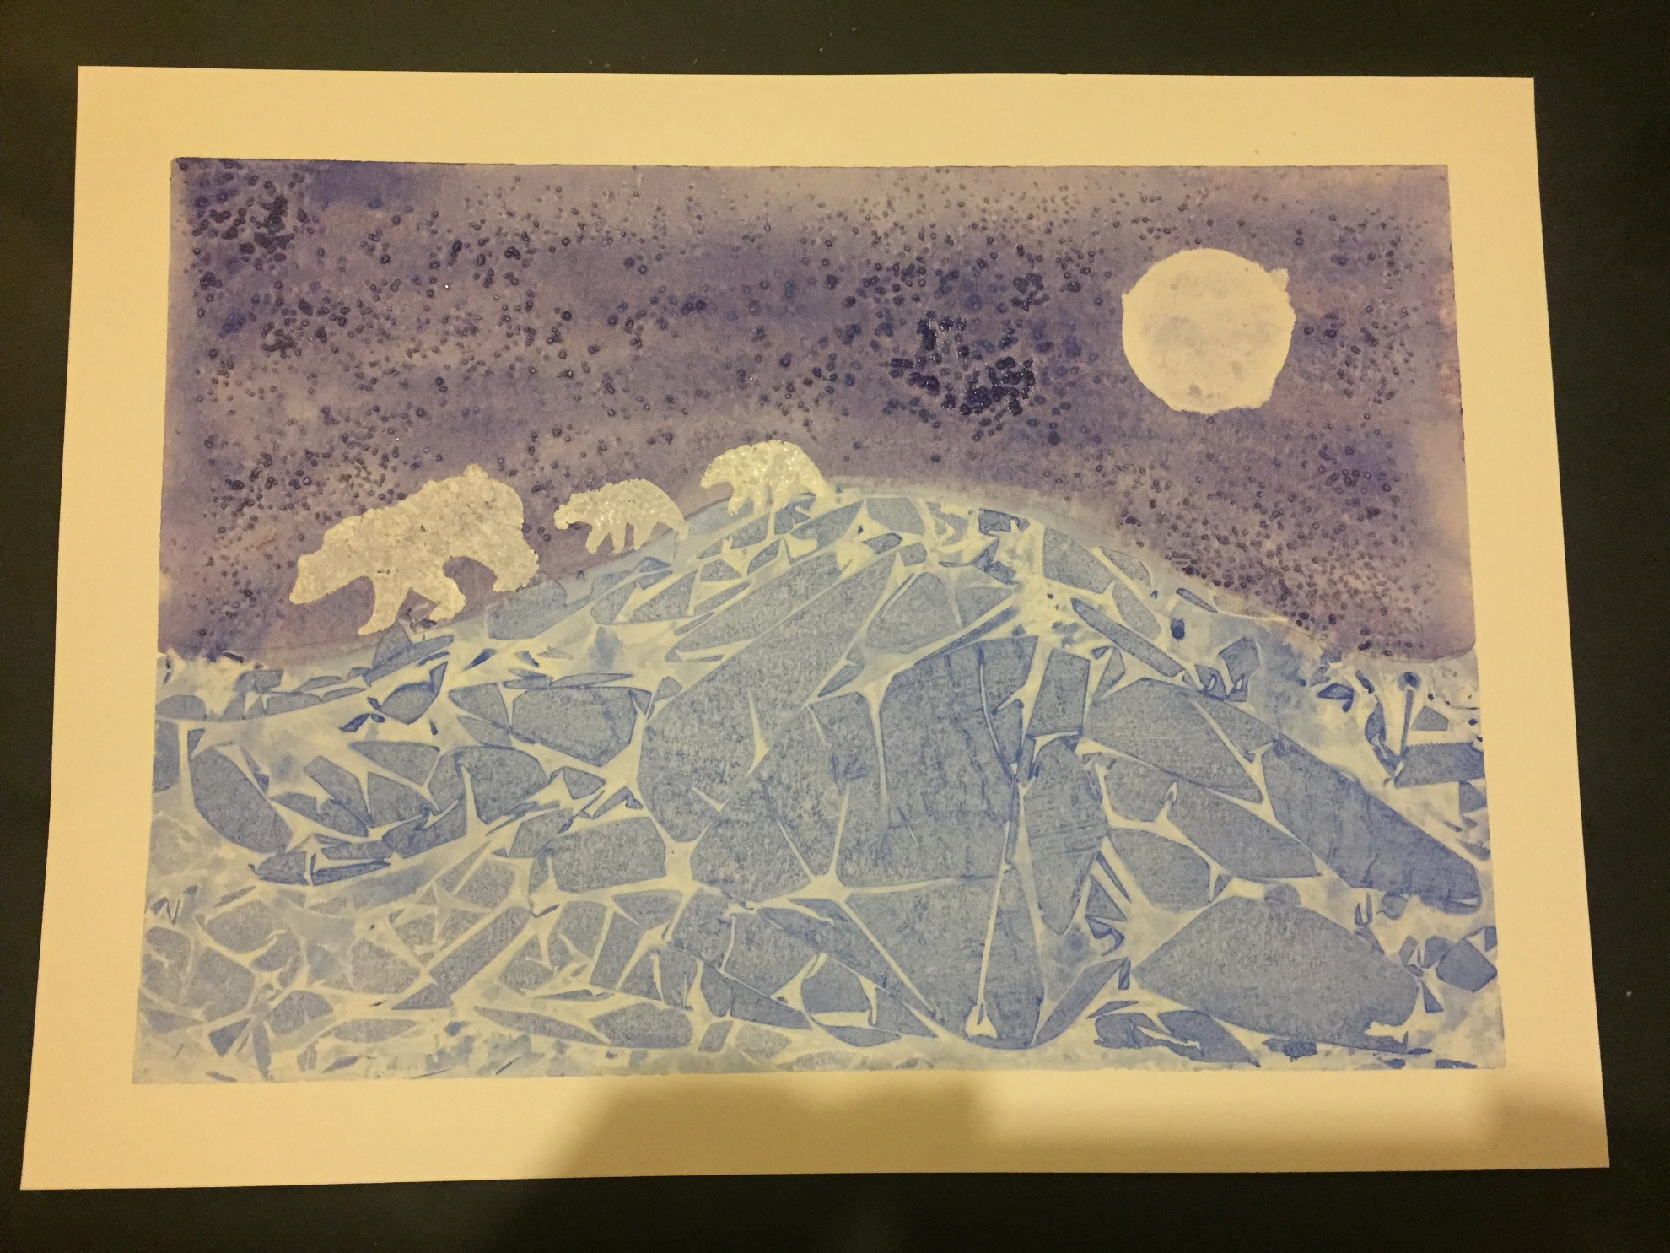
10. Remove blue tape.

