Slide 1
Outside-In
A lesson in positive and negative space

Slide 2
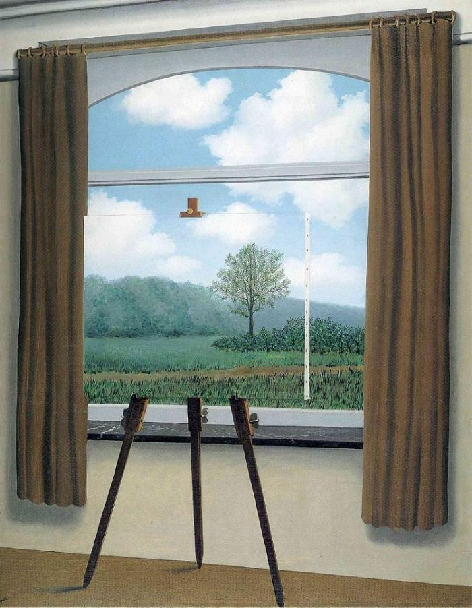
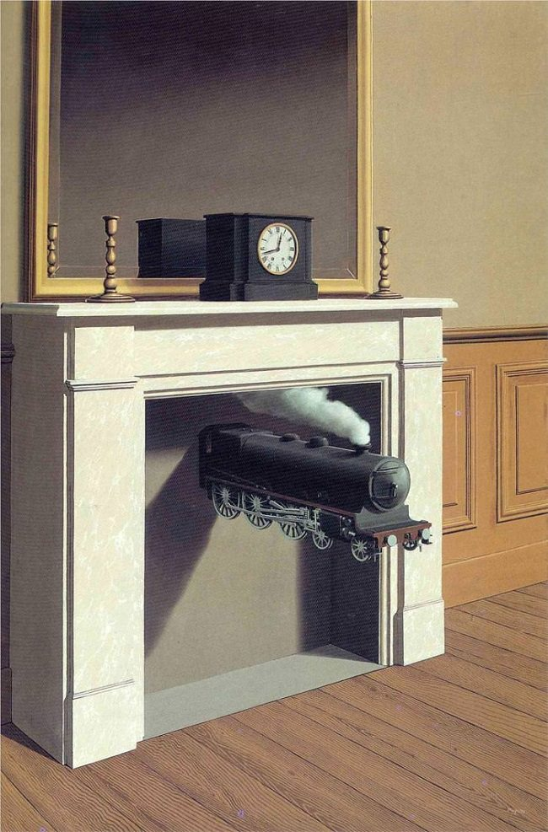
René Magritte-Artist
Magritte’s style is known as surrealism, which basically means “beyond real”. He painted ordinary objects but made us look at them in unusual ways. He was able to play tricks on the viewer. Many of his objects look real, but impossible at the same time!
Positive and Negative Space
Outside-In, a lesson in positive and negative space

Slide 3
What is Positive and Negative Space?
Simply put, positive space is the areas in a work of art that are the subjects of the piece. Negative space is area around the subjects.
Take a look at the image.
Doyou see faces or a vase?
If you are seeing a vase, then you are seeing the white area as the positive space. The black areas become the negative space. If you are seeing faces, then you are seeing the black areas as the positive space, and the white area as the negative space.
Notes:
Whichever you see as the subject of the art, that is the positive space.

Slide 4
Examples of uses of positive and negative space...
Balance of Positive and Negative Space
Mostly Negative Space
Mostly Positive Space
Notes:
There are equal amounts of positve (black) and negative (white) space in picture 1. In the center picture, there is mostly negative (white) space. In the last photo, there is mostly positive (black) space.

Slide 5
Notes:
In the example above, ask the children what they are looking at, or what the subject of the piece is. Batman! What color is he? That would be the positive space, and the yellow would be the negative space.

Slide 6
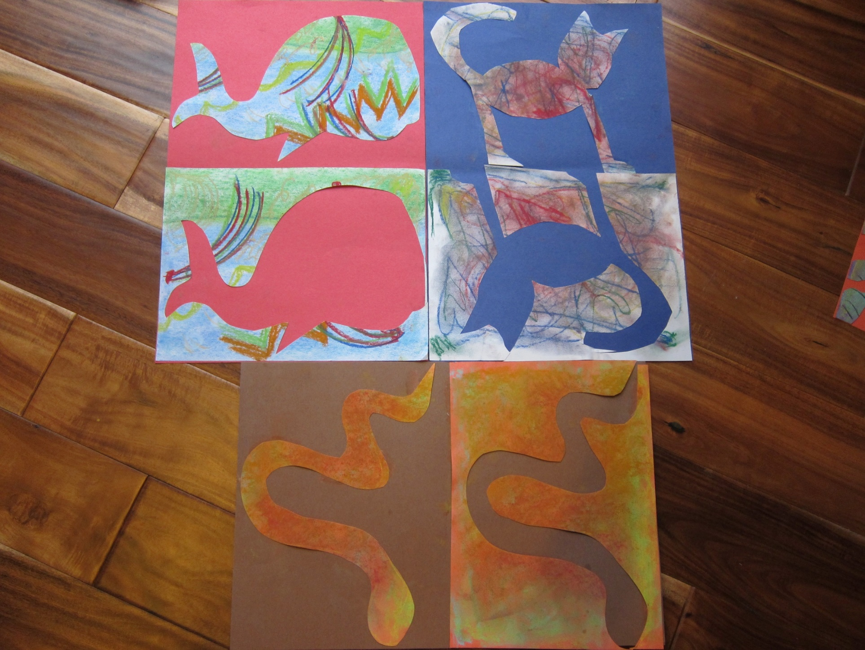
Here is an example of what we are going to make!

Slide 7
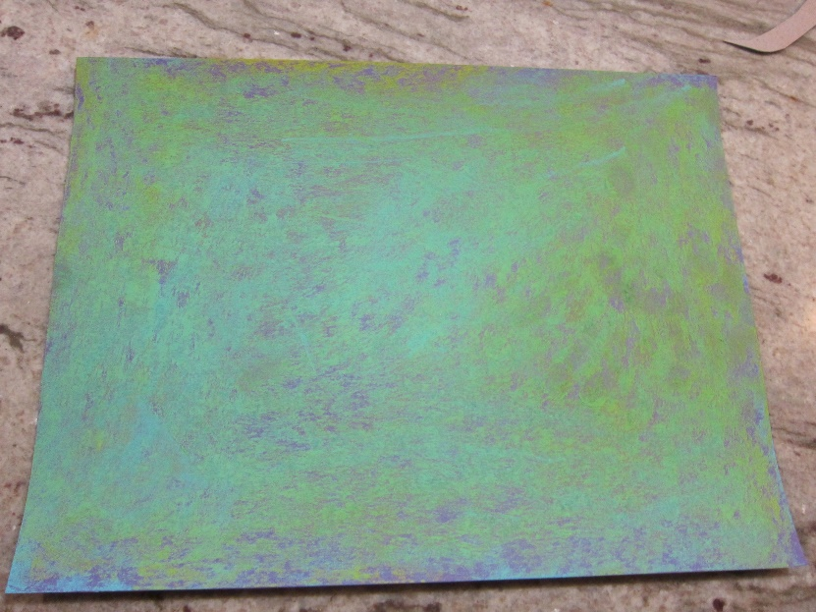
Supplies needed:
Chalk pastels
Scissors, glue, pencil, paper, template, paper towel
Decorate your 9x12 paper with chalk pastels. Turn your chalk pastel on its side to get more coverage on your paper. Be sure to cover the entire paper with color! Use a crumpled paper towel to blend the colors together. Then make designs, swirls, waves, shapes, using bold colors. Add patterns and shapes for interest!
Notes:
Have children use the chalk pastels on their sides to cover the entire paper.

Slide 8
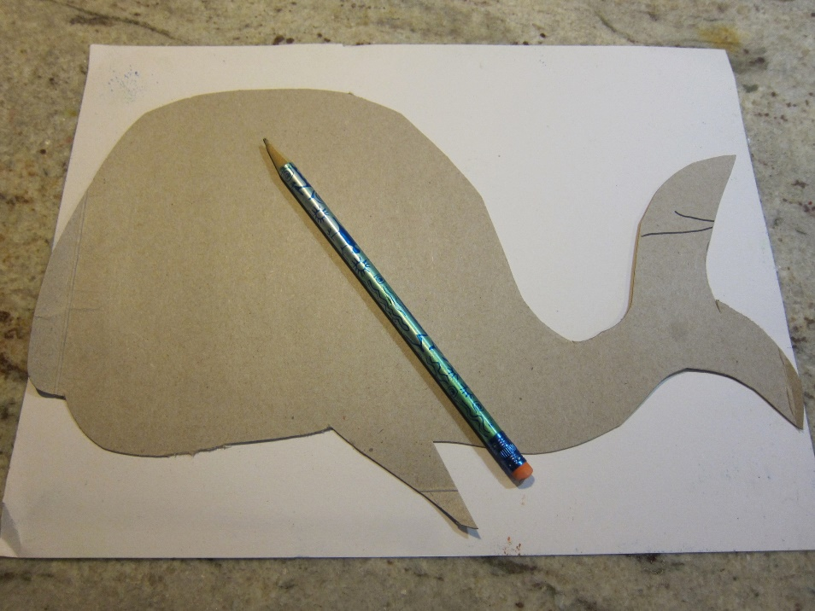
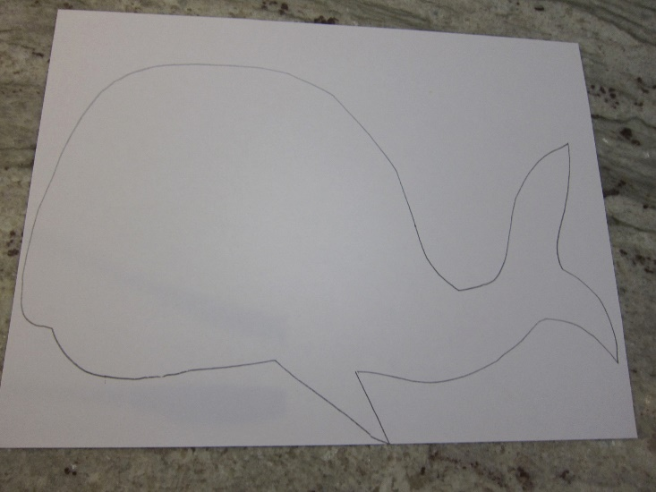
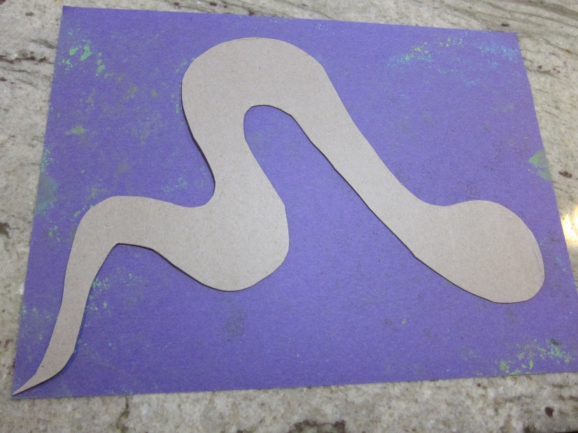
Choose your template. A Template is anything that serves as a pattern or model. Today you can choose a Snake, Whale or Cat.
Flip your paper over and trace your creature on the blank side. Have your neighbor help hold the template down as you trace, then return the favor! The whale’s bottom fin should be touching the bottom of the paper. The snake’s tail should be touching the corner of the paper. The cat’s feet should stand on the bottom of the paper
Notes:
I have the children partner up and help hold the template in place while tracing as it can be hard for them to hold and draw.
The whale should have one point of contact on the bottom of the paper with his fin. That is the starting point for cutting to get the best frame for cutting.
The snake should have his tail touching and that is the start of the cutting

Slide 9
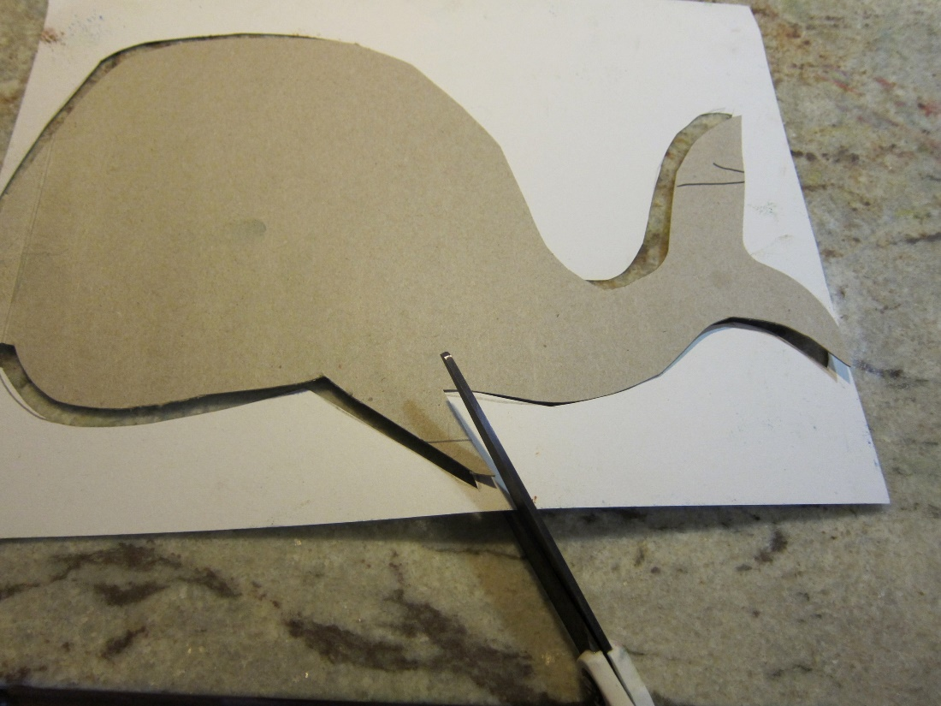
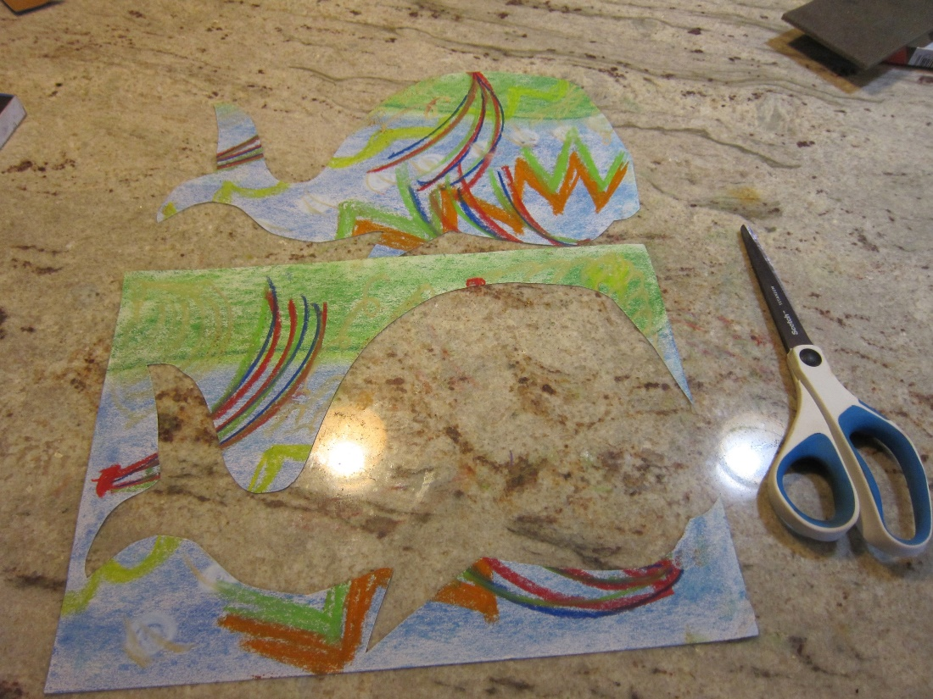
Cut out your picture. Begin at the whale’s bottom fin, the snakes pointy tail, or the cat’s foot. Try and keep one long piece of paper as you cut so we have 2 pieces when we are finished (3 if making the cat).
Flip over your creation!

Slide 10
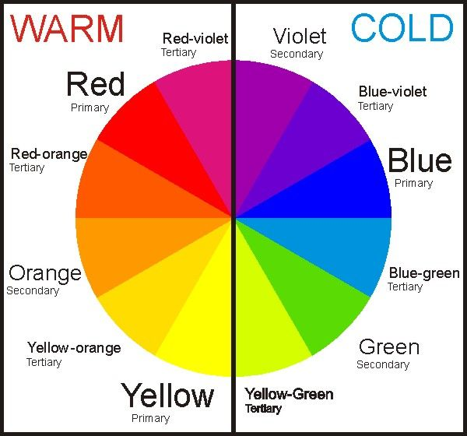
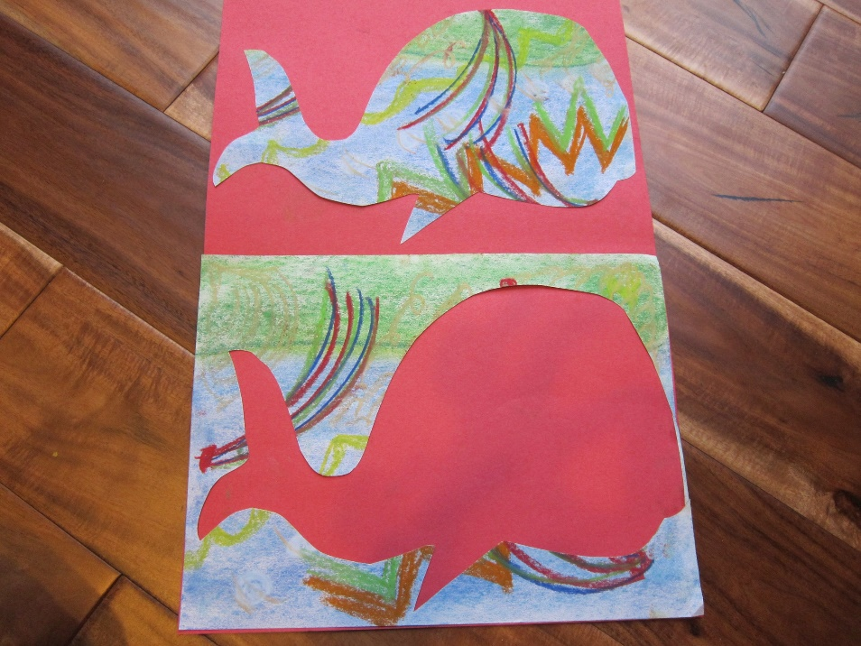
Choose your large background paper. Pick a contrasting color to the chalk pastel piece you created. Look at the color wheel. Pick a color on the opposite side of the wheel from your creature.
Fold your large paper in half like a book. Set your creature on one side of the fold, and place the scraps on the other side creating a positive and a negative picture of the same subject. Glue them on! Raise your hand if you need help gluing your scraps on! It can be a two person job!
Notes:
Talk about what Contrasting colors means. Choose a color on the opposite side of the color wheel.

Slide 11
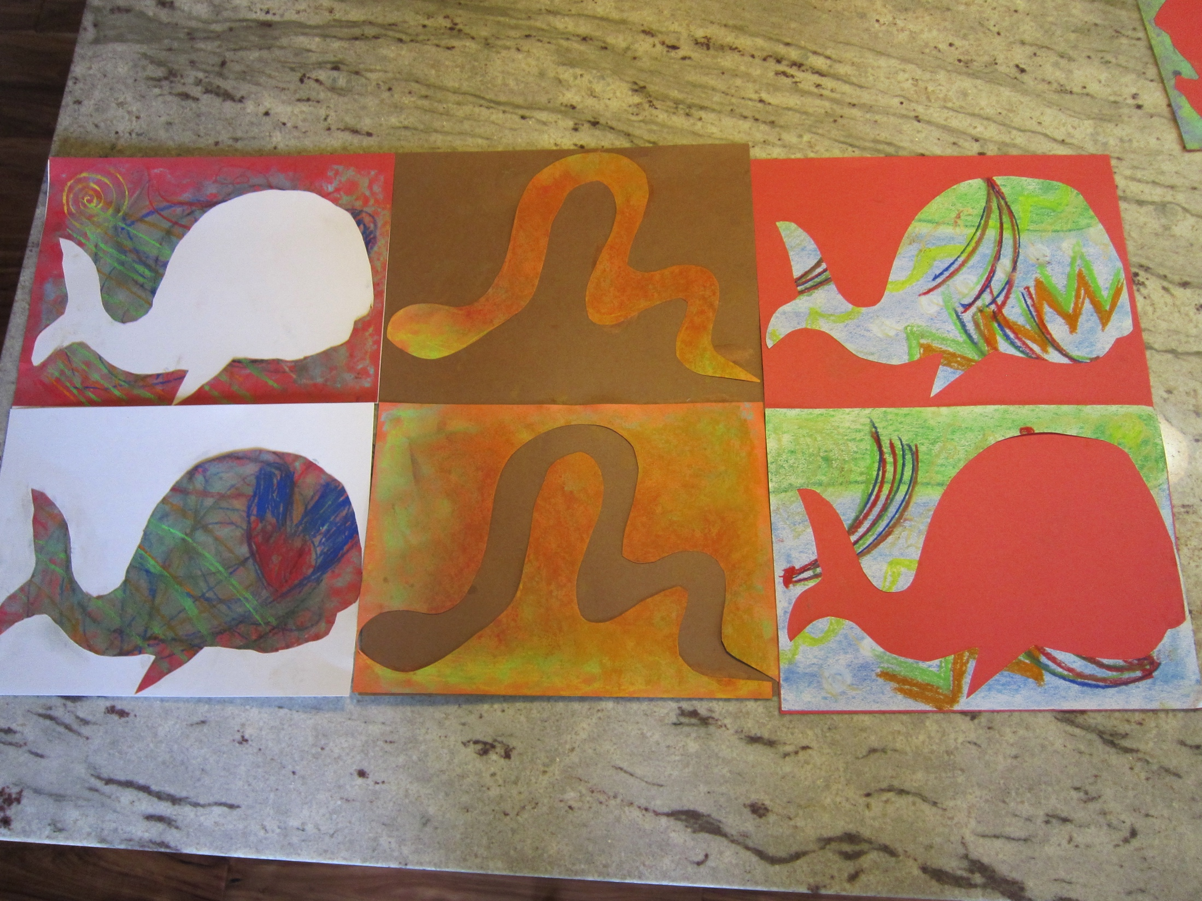
OUTSIDE IN!
INSIDE OUT!

