Slide 1
Portrait
A picture of a person
Self Portrait
A picture of yourself

Slide 2
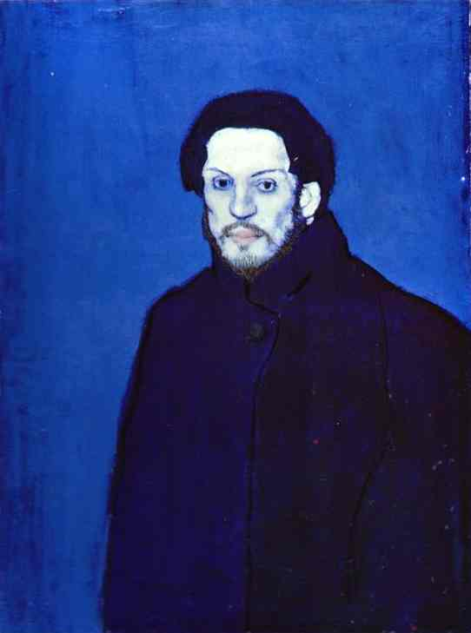
Why paint a picture of yourself?
Artists would paint portraits of themselves because they were the only ones who could paint not only the outside, but what the artist was like on the inside.
This is a painting of Picasso during his blue period. Can you guess why he is painted all blue. Think about the color blue. Singers sometimes say they are singing the blues when the are sad. Does his face look happy?

Slide 3
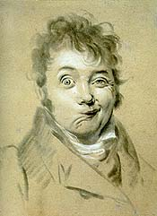
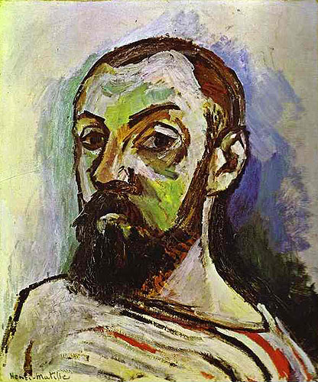
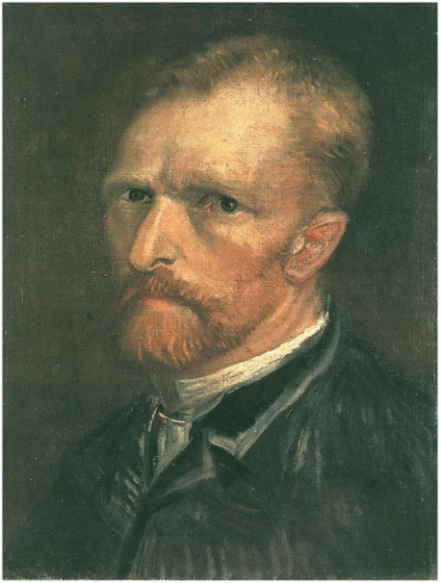
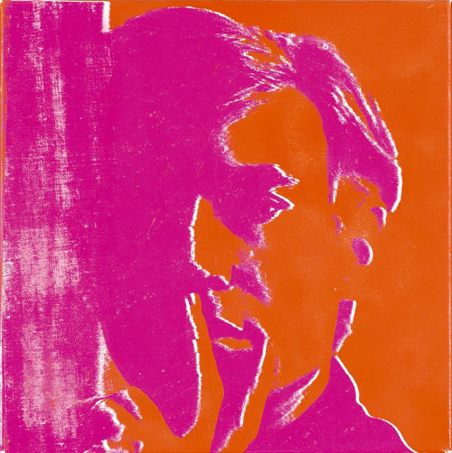
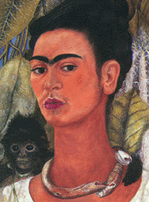
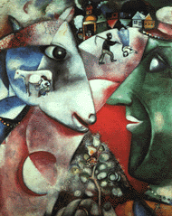
Frida Kahlo.
Frida Kahlo.
Other self-portraits.
What do you think?
Léopold Boilly
)
Vincent van Gogh
Henri Matisse
Andy Warhol
Frida Kahlo
Marc Chagall

Slide 4
Marc Chagall created this self-portrait about his memories of growing up in Russia. The artist did not use a mirror for this painting because it was all information he had in his memory.

Slide 5
Materials:
White construction paper
Water color paper
Paint brushes
  Large water color brushes
  Tempera brushes in different sizes
White oil pastels
Watercolor palettes
Cups for water to rinse brushes
Face templates
Tempera paint:
  Pre-mixed skin colors
  Various colors for lips, hair, eyes, clothing
Mirrors
Paper plates or palettes to put tempera paint on

Slide 6
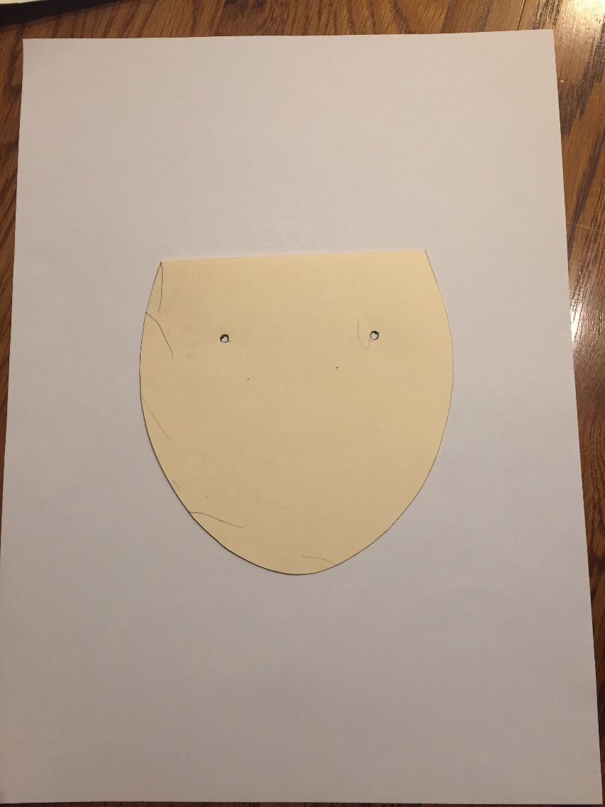
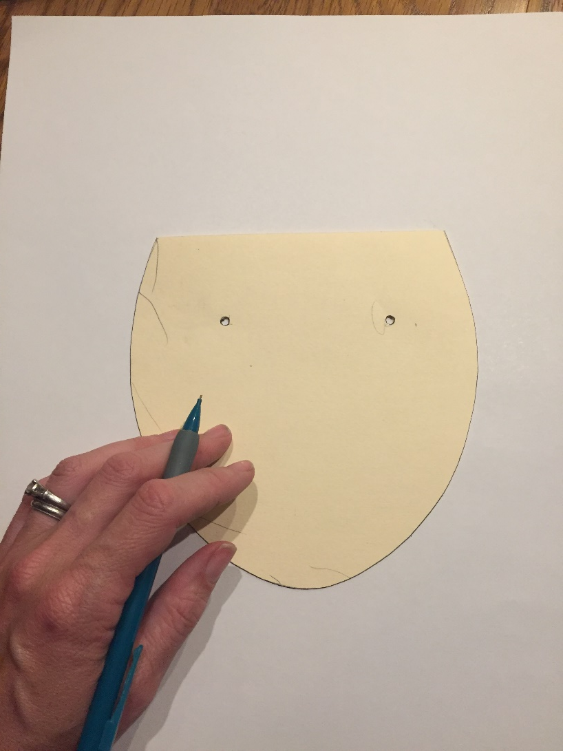
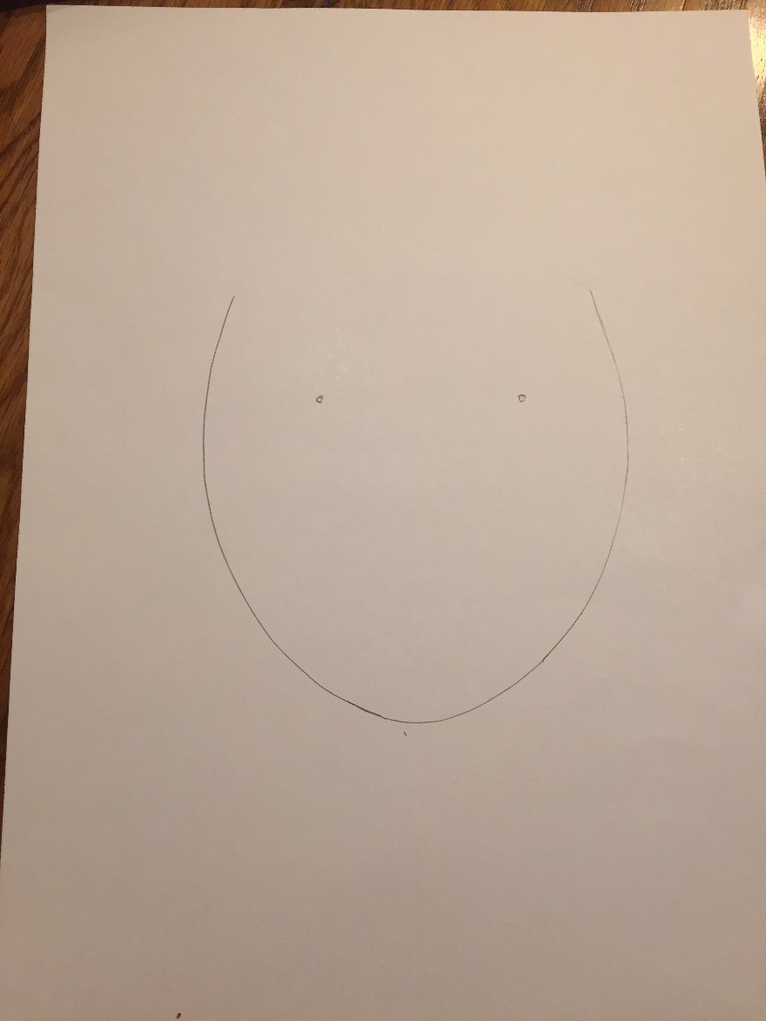
Let’s get started..
Have your white construction paper in front of you portrait style. (vertical)
Place face template in the middle of your paper.
Trace around just the curved U of the template.
4. Make dots where eyes will go.

Slide 7
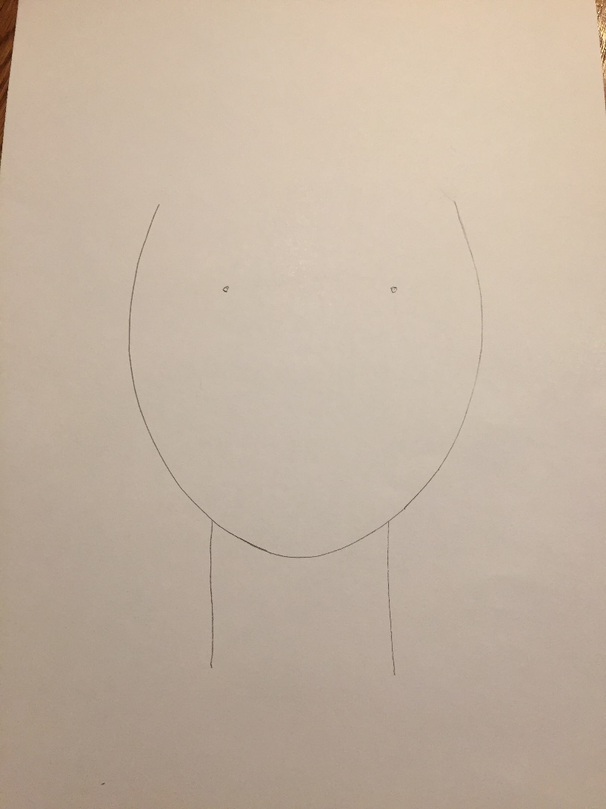
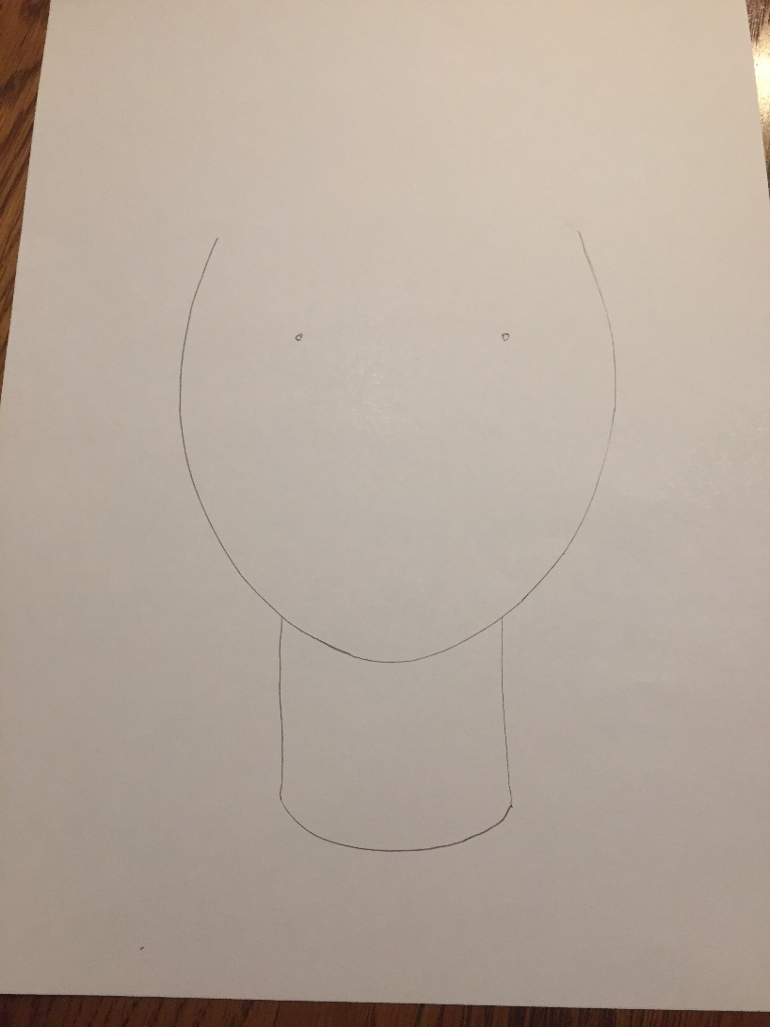
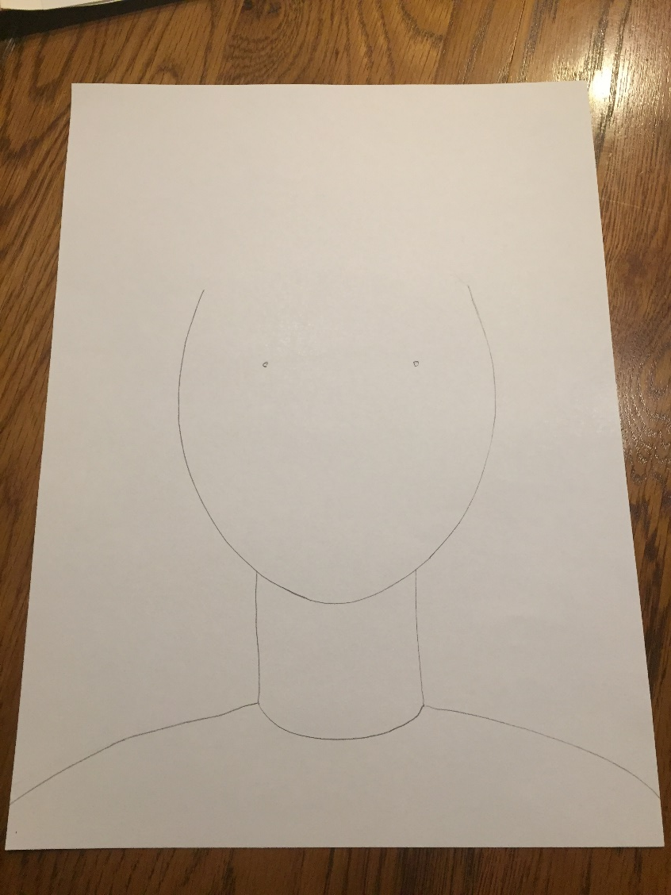
5. Add two vertical lines down for your neck
6. Add a curved line at the bottom of the lines to make the line of your shirt.
7. Add two lines out from the bottom of the neck to create the shoulders.

Slide 8
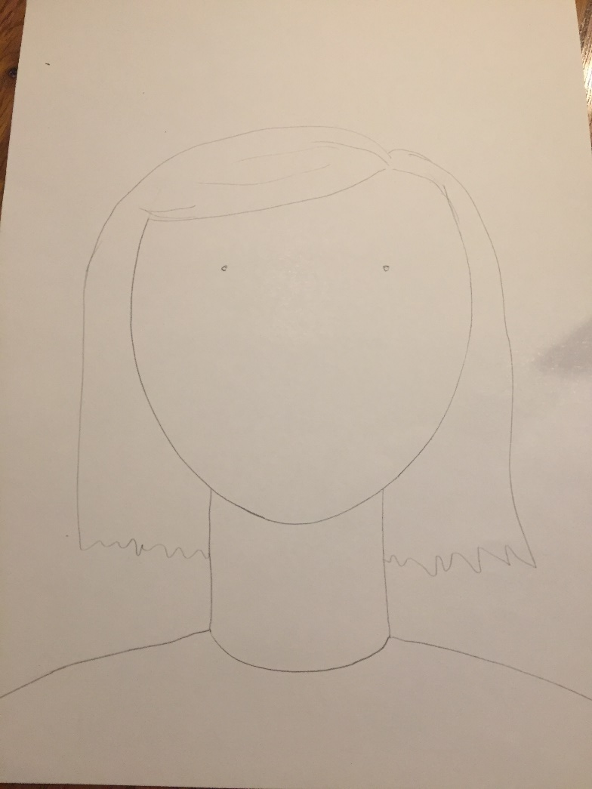
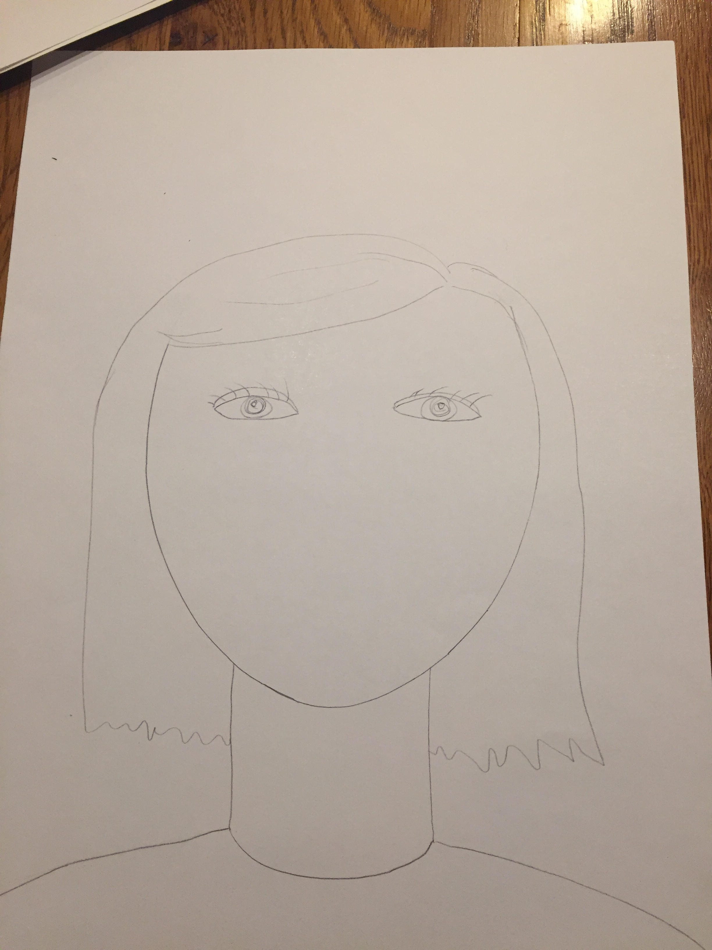
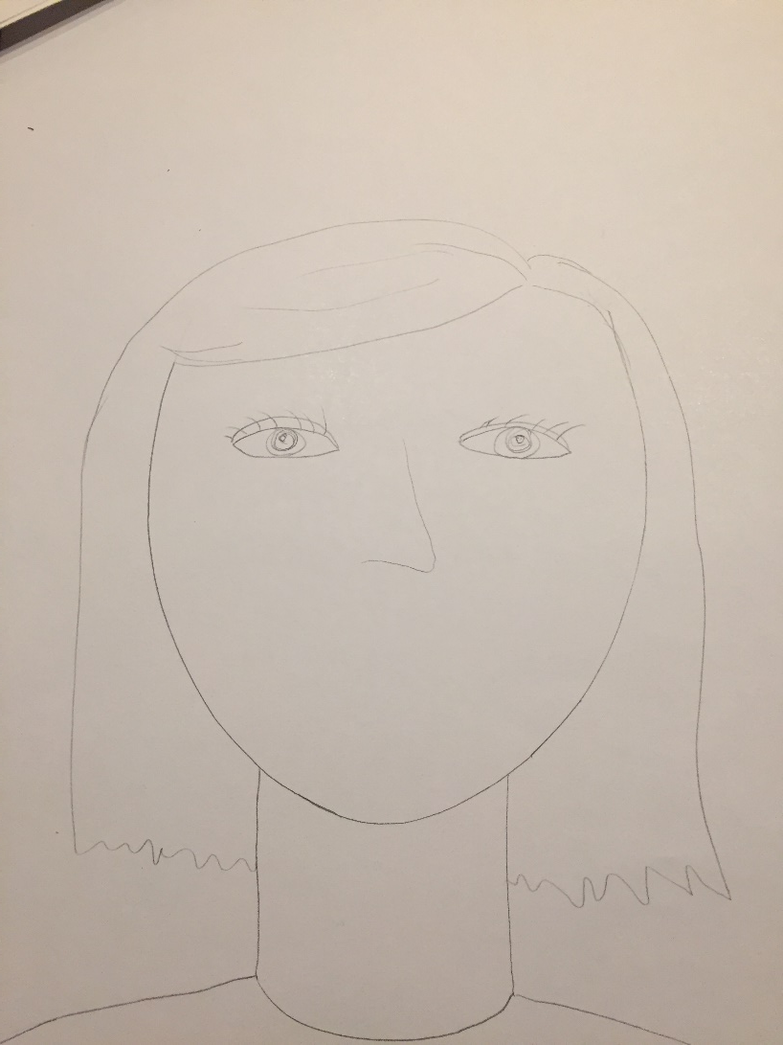
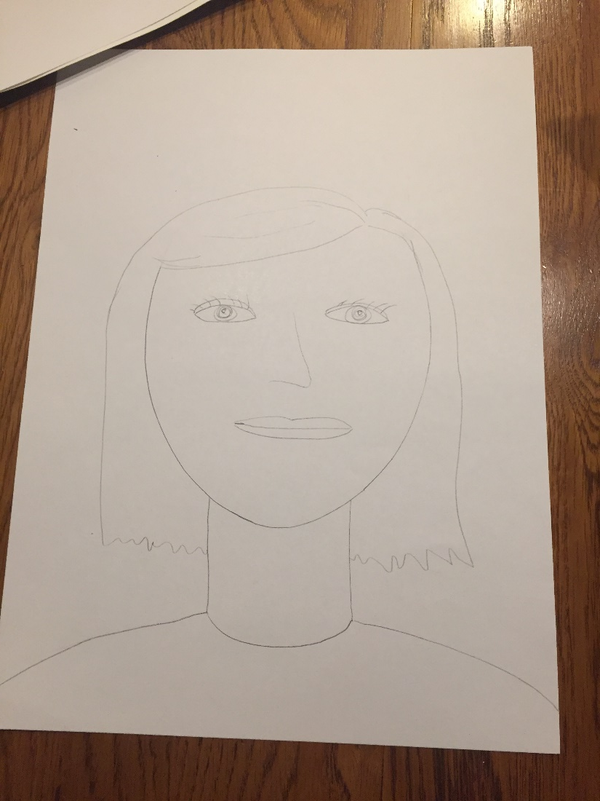
8. Draw hair.
9. Draw eyes.
10. Draw a nose.
11. Draw a mouth.

Slide 9
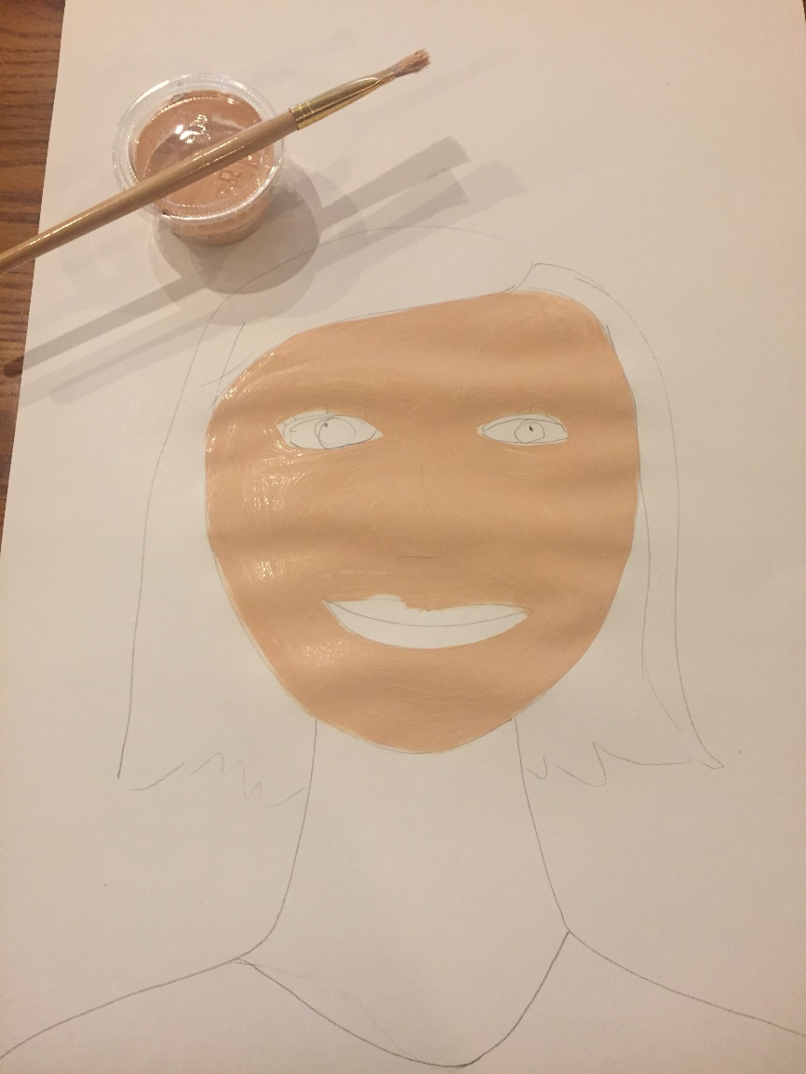
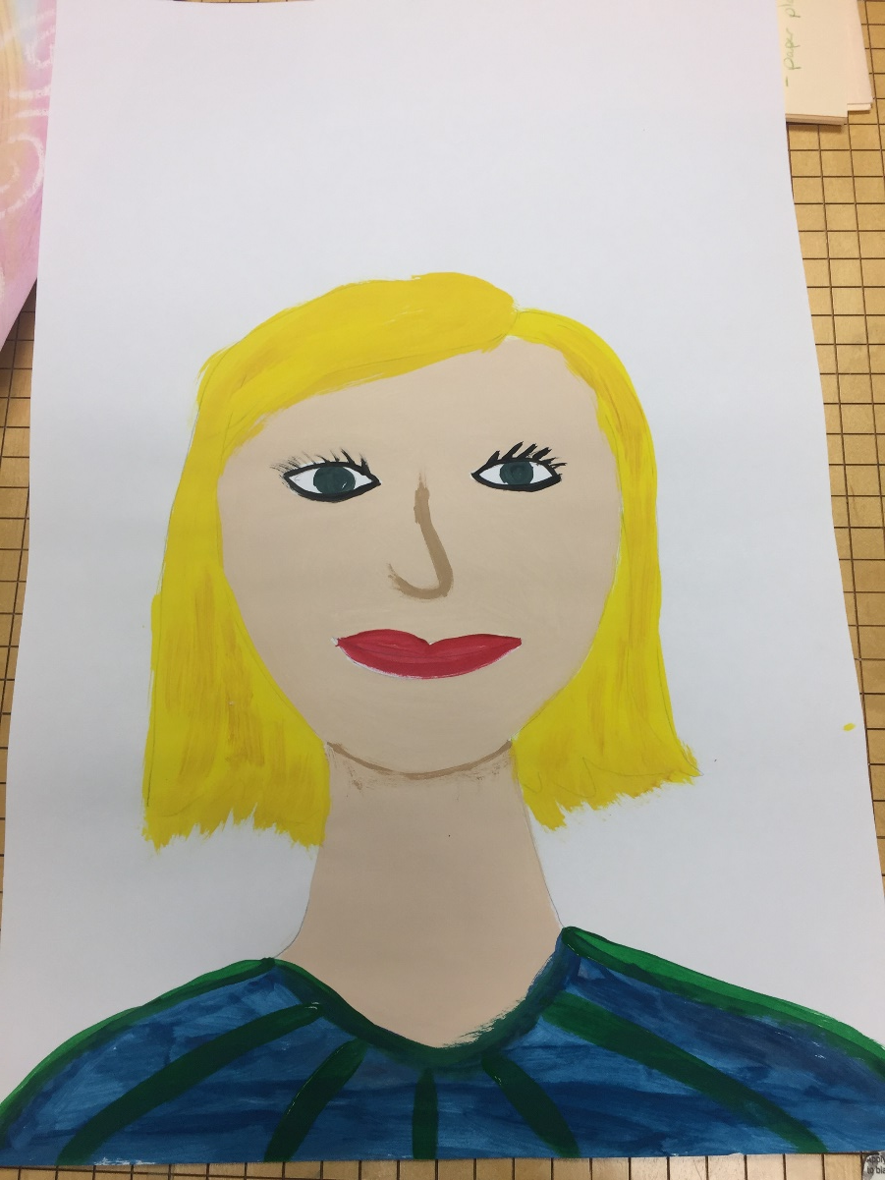
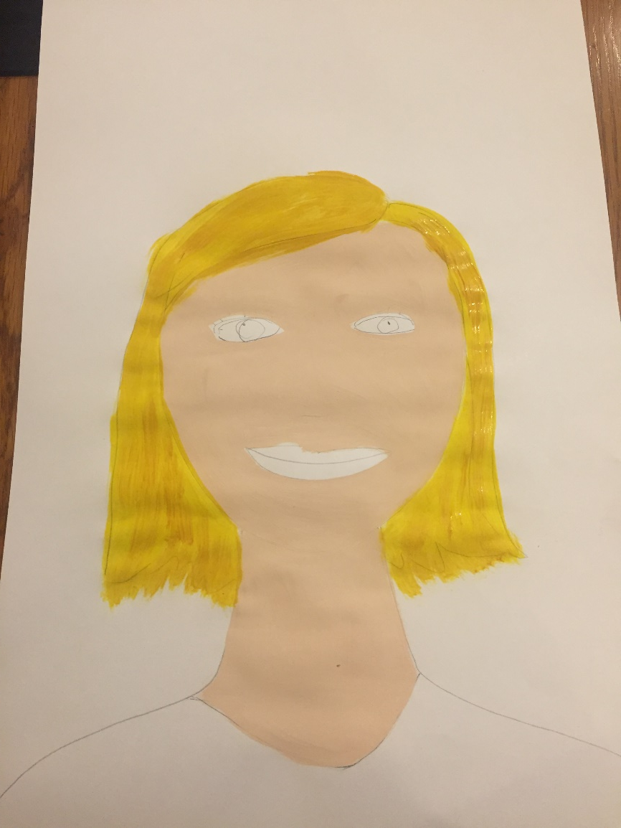
12. Choose a skin color and paint all skin.
13. Paint hair.
14. Paint eyes, nose, lips, and clothing. Use a slightly darker skin color for nose.
15. Set aside to dry.

Slide 10
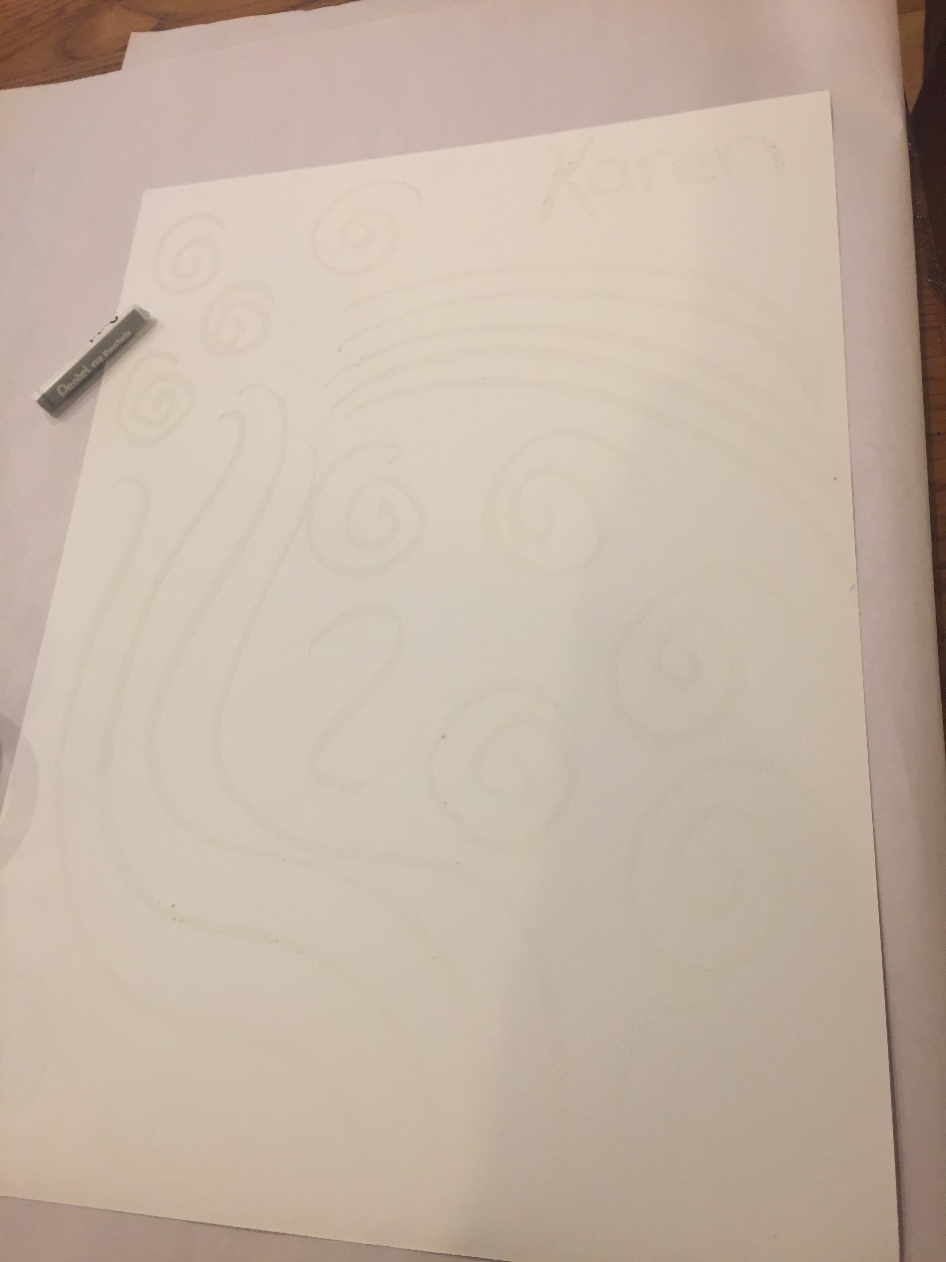
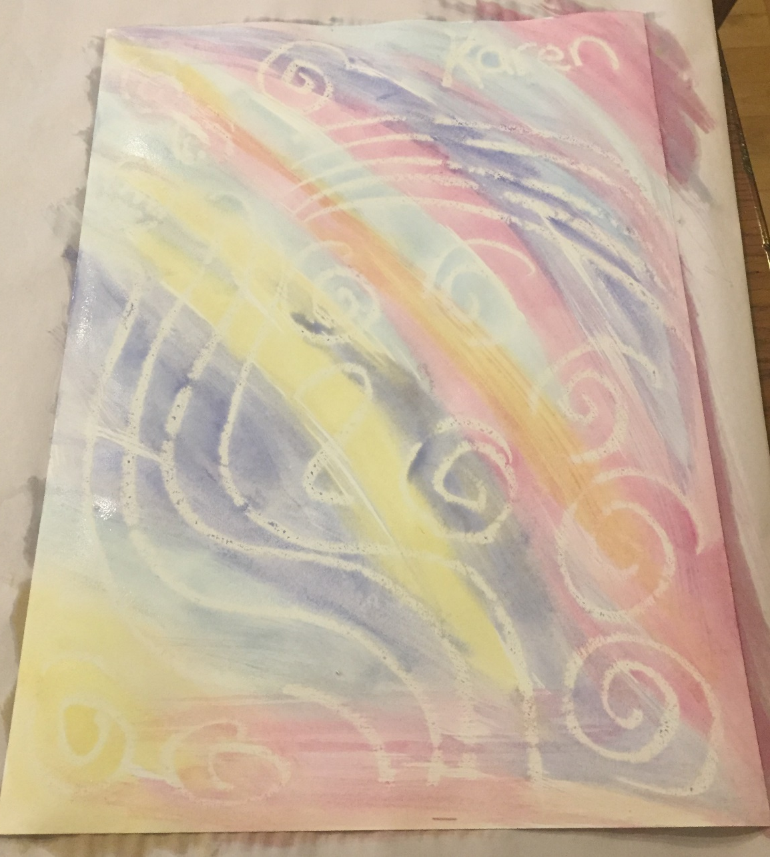
BACKGROUND:
Draw a design on watercolor paper with white oil pastel.
Paint with watercolor paint.
Let dry.

Slide 11
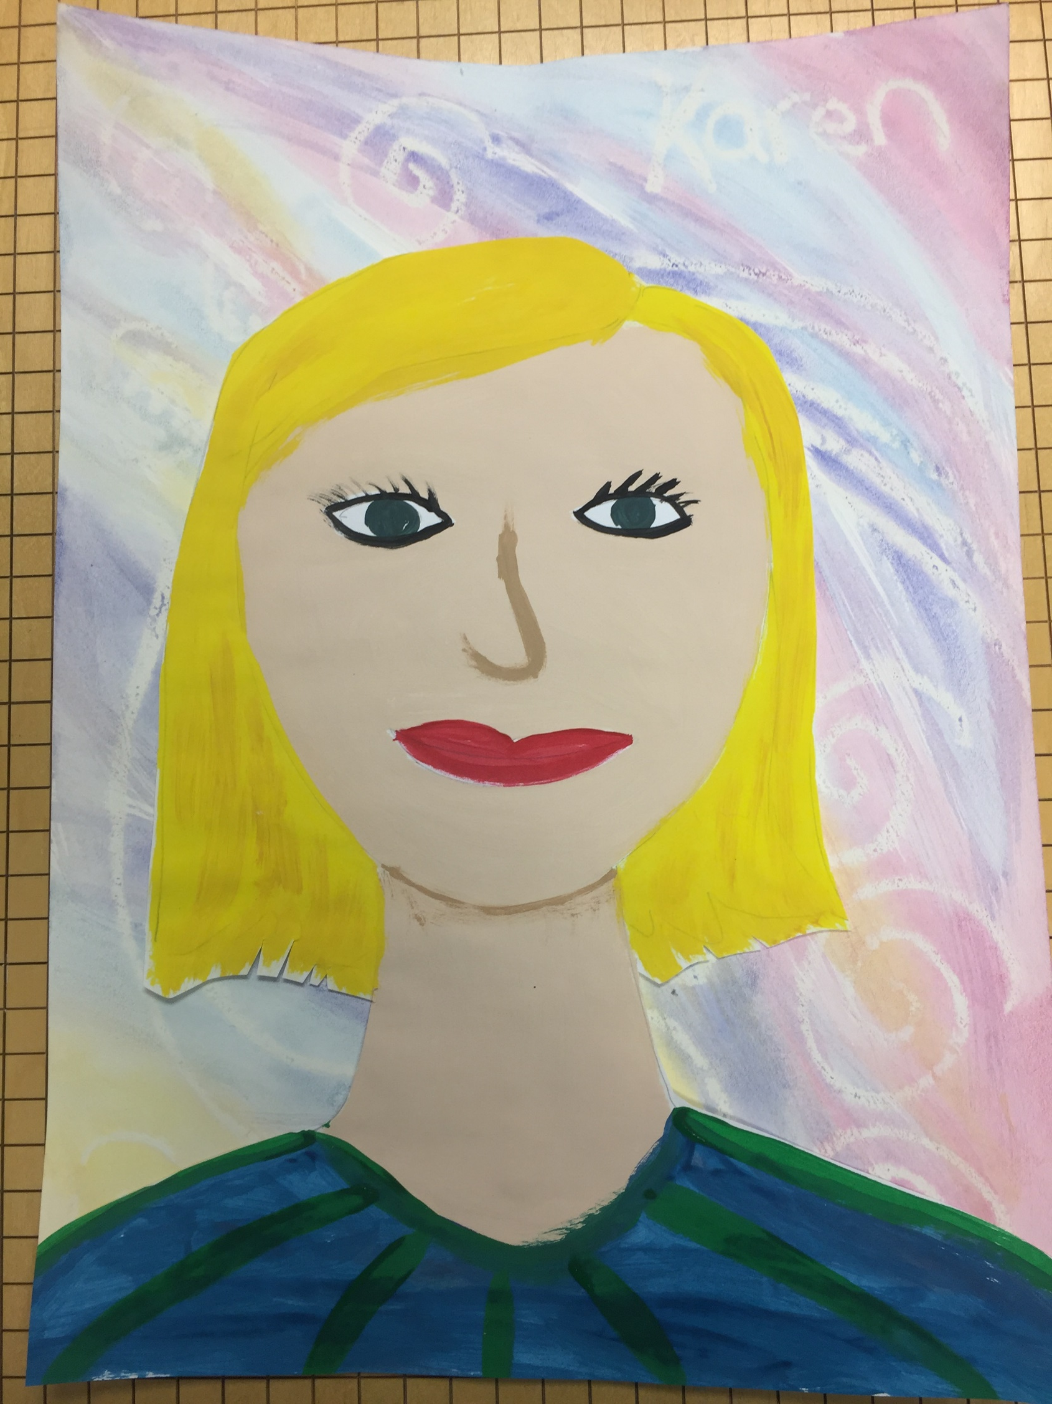
For Art Docent:
Cut out around each student’s portrait.
Glue portrait to background.

