Slide 1
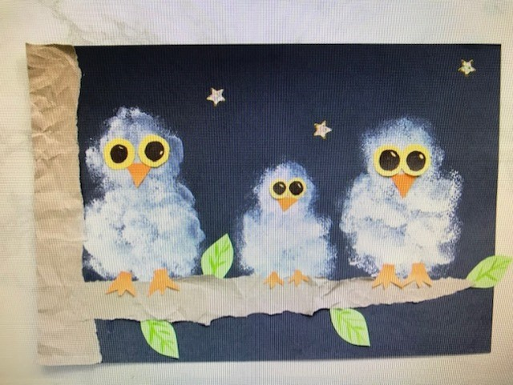
Snow Owl

Slide 2
Lesson in Texture and Shape
TEXTURE
Is the way an object feels to the touch or looks as it may feel if it were touched
SHAPE
There are 2 types of shapes
Geometric like square circle triangle
Organic are found freeform. Like a squiggle bubble and don’t have names. They are often found in nature like a cloud or a leaf

Slide 3
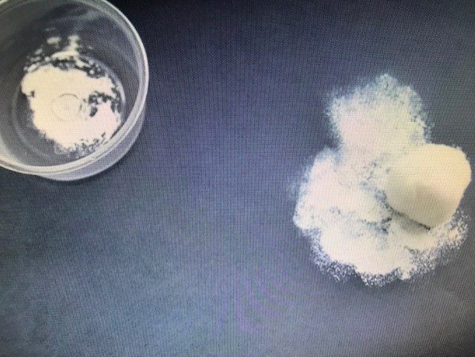
Step 1
Use your cotton ball to lightly dab white paint onto your paper to make a body and a head in the shape of an
8
Make sure to leave room at the bottom for your branch

Slide 4
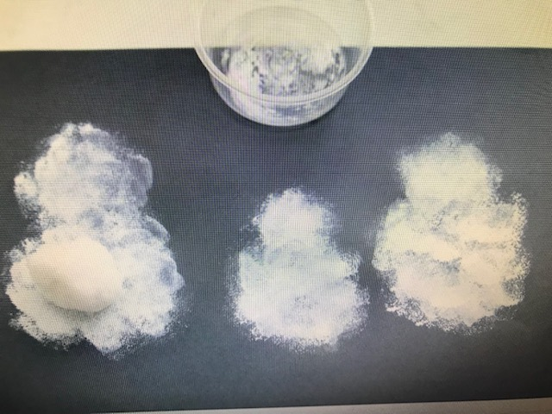
Step 2
Make 3 bodies

Slide 5
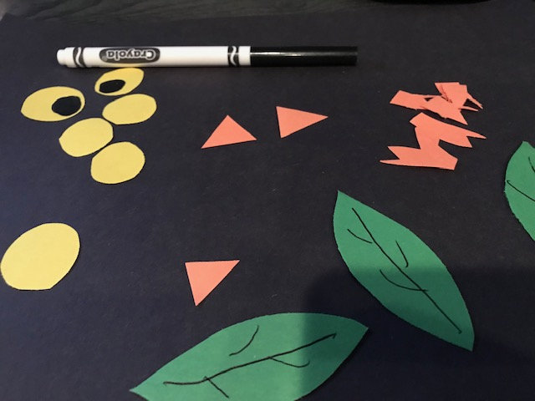
Step 3
Cut out eyes, beaks, claws, and leaves from papers.
Add details like the veins on the leaves & the iris with a marker.

Slide 6
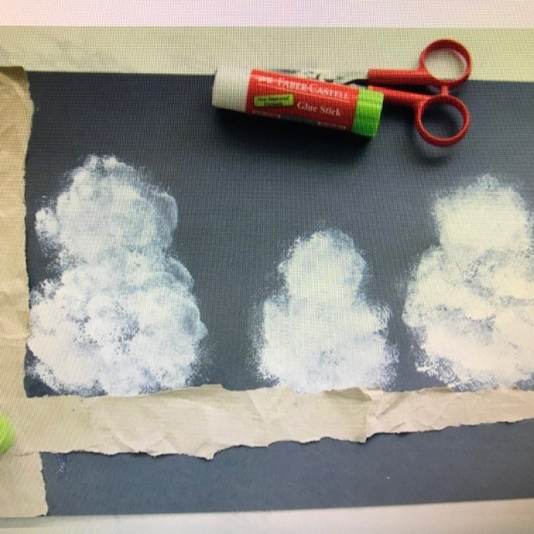
Step 4
Tear 1-2 branch like structures from brown paper.
Crumple the paper to give it texture.
Glue branch along one side and under the owls.

Slide 7
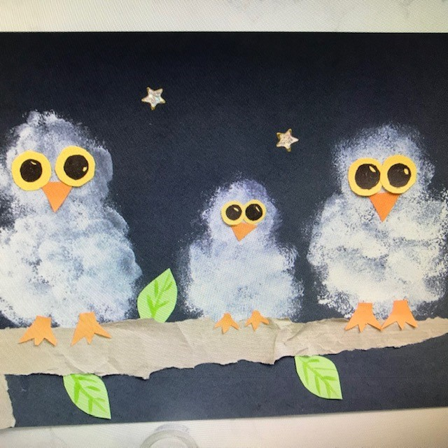
Step 5
Glue eyes, beaks, and claws to your owls.
Add a few sticky stars to the background.

Slide 8
Materials Needed for Stamped Snowy Owl
Cotton balls
White Paint
Black, Brown, Green, Yellow, Orange paper
Scissors
Markers
Glue stick
Star Stickers (optional)
Small Bowl or a paper plate to hold paint

Slide 9
Directions for Art Docent
Pour white paint in a small bowl. Dip a cotton ball in the paint and dab in an 8 shape at one end of the paper.
Dab 3 little owl figures on the paper and let dry.
While paint dries
Cut out eyes, beaks, claws and leaves from the construction paper. Use marker to add details like veins of the leaves and iris of the eyeballs
Once the stamp art is dry, tear a branch like structure from a brown paper bag. Join two or more pieces if your torn paper is too small.
Crumple the paper to add texture. Paste the brown paper at one end of the artwork in the shape of a branch.
Make sure there is one branch that is just below the owls. Encourage kids to create their own design. There is no “right” way here, so help them make it.

Slide 10
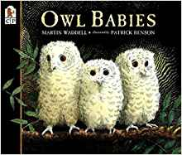
Optional book
Included in kinder bin

