Slide 1
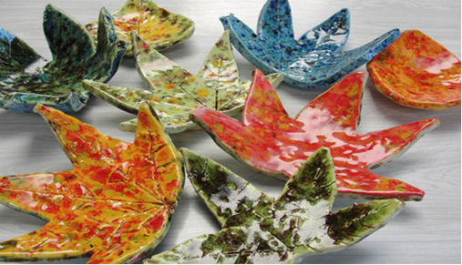
Clay Leaf Bowl

Slide 2
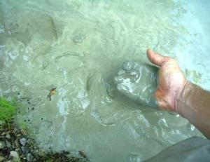
Clay Minerals from the earth: silica and alumina
Notes:
What is clay?
Minerals from the earth – specifically silica and alumina. Often clay is found near rivers where small particles of rock are carried down to a lower part and collect together to form clay.
Clay characteristics –
Clay is plastic when it’s wet –clay can be pushed, stretched, stamped, or impressed
Clay shrinks as it dries
Clay hardens as it dries – when wet it has no structural strength (can slump or distort if handled roughly) Bone dry clay, before heated, is quite brittle
Clay vitrifies when subjected to sufficient heat – clay becomes hard, durable, waterproof

Slide 3
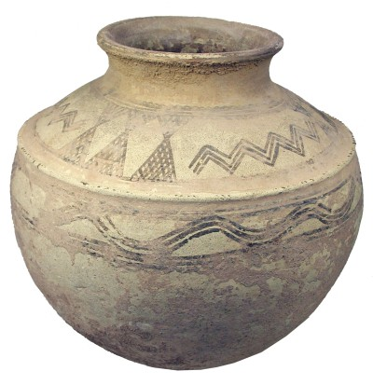
People have used clay for thousands of years to make items like pots.
Uses for clay
Notes:
How long have clay projects been around?
Clay pots have been found in current day Iran and China that date back to 5000 B.C. – that’s more than 6000 years ago! People around the world, including Native Americans in what is now the USA, used clay to make containers for food and to make bricks to build houses ( baked clay mixed with straw called adobe). Back then they used fire to cook and harden the clay.

Slide 4
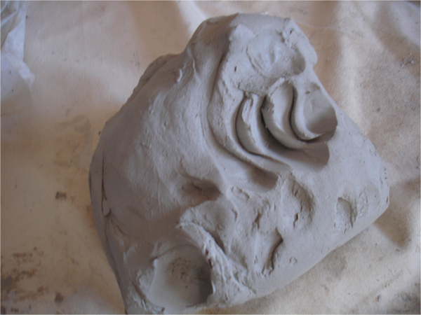
Plastic Stage
Workable
Moldable
Notes:
This is what the clay will look like that you have today. Your piece will be flat like a pancake though.

Slide 5
Greenware Stage
Wet, damp, soft leather-hard, leather-hard, stiff leather-hard, dry, and bone dry
Once it is dry and light gray it becomes very fragile
Notes:
These projects we make today will need to dry in the open air for a week or two (this is the greenware state-•Greenware (noun) is the term given to clay objects when they have been shaped but have not not yet been bisque fired, which converts them from clay to ceramic. Greenware may be in any of the stages of drying: wet, damp, soft leather-hard, leather-hard, stiff leather-hard, dry, and bone dry.)
When they are completely dry they will be fired in the kiln for the first time (bisque fired) and look like this when they are done (hold up a sample of bisque fired piece).
After that, I will come back and you will paint the projects with something called glaze which is a special liquid like a paint that’s made of bits of ground up glass. The piece will then be fired again in the kiln and will turn out like this (show a real glaze fired piece).
Getting started:
Students receive one canvas cloth on the desk, one slab of clay, fresh leaf about the size of an adult hand, dull pencil for writing name, paper clip for cutting clay, bowl for project drying, mini bowl with few drops of water for fingertip smoothing.

Slide 6
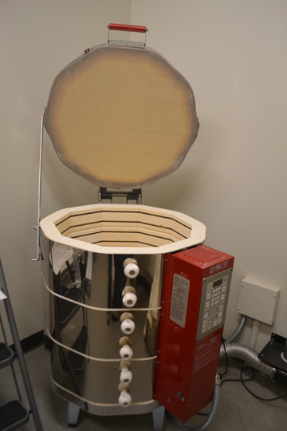
Electric Kiln
1800 -2000 degrees F
Notes:
People used to use fire to harden their clay. Today we use a special electric oven called a kiln to cook the clay. How hot does your kitchen oven at home reach when you are cooking food? 375 or 400 degrees F? Our kiln will cook your projects at about 1800 -2000 degrees F. (show photo of kiln)

Slide 7
Bisqueware Stage
After Fired in the kiln
Notes:
Cooking in a kiln is called firing. This is important because it makes the clay stronger and more waterproof. Clay that has been kiln fired would not return to a soft state even if it were in water for a long time. That is because the extreme heat causes permanent physical and chemical changes to occur. These reactions, among other changes, cause the clay to be converted into a ceramic material.
If you put wet clay in a tub of water it would turn mushy and lose it’s shape but clay that has been kiln fired and turned to bisqueware will retain it’s shape even if it were put in a tub of water. For example, the pitchers above would not turn back to soft lumps of clay if you poured water into it.

Slide 8
Next time…
We will paint the projects with something called GLAZE which is a special liquid like a paint that’s made of bits of ground up glass. Then they will be fired in the kiln again.

Slide 9
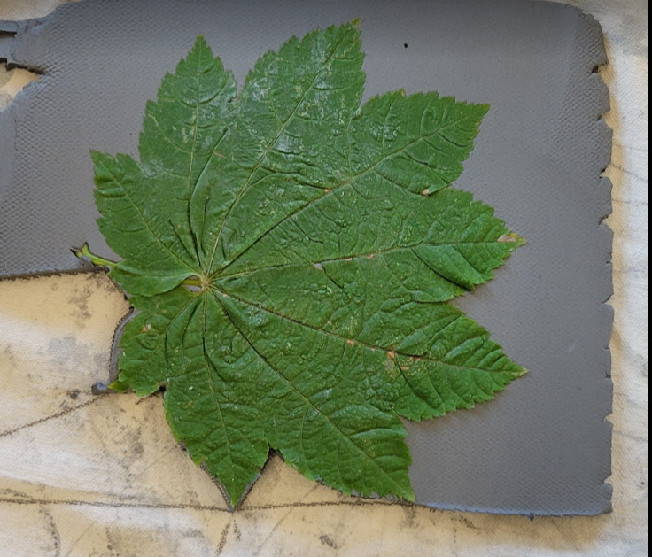
Student Steps:
Each leaf will be placed on the table with the slab clay it will fit. Find your seat by locating the leaf shape you would like to use.
Place the leaf (vein side down) on the clay slab.
Use a rolling pin to push leaf firmly into the clay to make an impression.
Trace around the perimeter of the leaf using the bamboo skewer in an upright manner (adults may need to help).
Flip over clay to scratch student’s name on back with a dull pencil.
Remove leaf by lifting stem.
Place clay leaf in Styrofoam or coated paper bowl and slump by pressing gently to achieve bowl shape with clay leaf.
Use a moist finger to smooth all the edges so they won’t be jagged or sharp once fired.
Set the bowl aside to dry for 7-14 days until ready to fire in the kiln.
Clean up!
Rinse your hands in the bucket of fresh water before you wash your hands in the sink with soap and water.

Slide 10
End of Student Presentation

Slide 11
Preparing Clay Slabs for Grade Level
Prior to Rolling Day - gather fresh leaves approx. 6-8” in diameter (maple leaves, hydrangea leaves, etc)
Supplies for using clay slab roller:
3 pieces of roller fit together
Rubber mat to use under roller to prevent from sliding on table
Canvas for roller
Table top (often at the end of the classroom hallway)
Clay
Wire cutter
Plastic tub and garbage bags or plastic wrap to store slabs (one per classroom)
Leaf to see how big to make clay slab (fresh leaves)

Slide 12
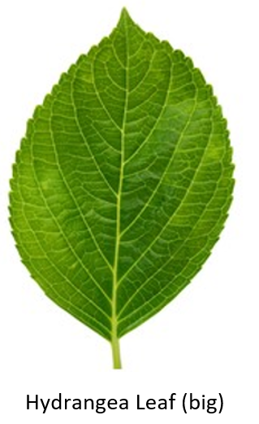
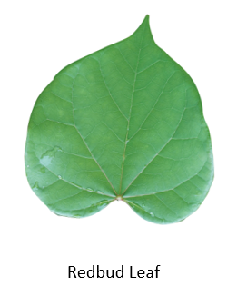
What Leaves to use: (large enough to fit slumped into a 16-20oz bowl without too much hanging over the edges) – the size of an adult’s hand should be good

Slide 13
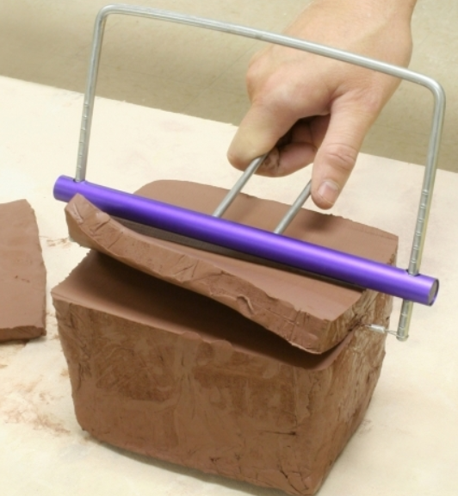
Rolling & Preparing Clay for Whole Grade
Using Clay Slicer – cut the short end ¾” thick. Should be able to get 14-15slabs per block of clay. (14-15 student leaf bowls)
Using the Slab Roller – roll the clay 2-3 times to make a square shape slab that fits the leaf sizes you will be using. (adjust to the size of the leaves you will be using, as needed)
Works best with 4-5 helpers for doing a whole grade level.
You will roll the clay twice at two different thicknesses.
1st roll – at 1/2” thick
2nd roll – rotate clay slab a quarter turn and roll again at slightly more than ¼” thick (between 3/8” and ¼” thick)
Test size against your largest leaf to make sure it fits

Slide 14
Docent Prep for Class Day 1
Supplies to take to class for clay lesson:
Cart to carry items (resides in Kiln room)
Clay or previously pre-rolled clay slabs in plastic tubs
Canvas piece for each student
Rolling pins for rolling leaves into clay
Small dishes for SMALL amount of water for student use (or wet sponge in dish)
Skewer sticks for cutting around leaves in clay
Dull pencils for writing names on back of project
Bowls/plates to slump leaf
Fresh leaves to trace
Bisque sample to show students
Finished glazed sample to show students
Lesson plan in hard copy and if desired Powerpoint (on a jump drive or emailed to teacher)
Bucket with water to wash hands and tools before using sink
Wet sponges/towels for clean up

Slide 15
Prep Your Teacher
Send an email to the teacher a few days before your first clay lesson.
Remind them to send an email to the student’s families to remind the parents to make sure they don’t wear clothes they don’t want to get “dirty” on Art Day. Clay is completely washable. So not to fret if it does get on their clothes.
Ask the teacher to make space inside their classroom where you can store 18+ paper bowls with the leaves in them. A place where they won’t get touched. (a good place is above the coat racks on the top shelf. If you use this space, you might need to bring the step ladder from the copier room to help place up that high)
The day before your Bisque fire schedule, please bring the bowls with leaves to the Kiln room to be ready to be fired. You will need to schedule the time with the teacher that works best for not interrupting their students while you remove the project from their room.

Slide 16
Student’s workspace – Day 1
4-5 students per table
Prior to class, prepare each student’s workspace with:
Canvas cloth
1 clay slab
1 leaf that fits THAT slab
1 water cup to share with those who can reach it
1 skewer stick (for tracing the leaf in the clay)
1 rolling pin
1 dull pencil
1 16 – 20 oz bowl
Give the PowerPoint introduction presentation in the classroom.
When time to go to the clay tables, tell the students to find a seat with the leaf shape they want.
Does not need to be next to their friend.

Slide 17
Clean up – Day 1
Brush mats over buckets or garbage cans to remove most of the clay fragments. Wet mats are harder to clean so scrape them with rulers to get the bulk of clay.
Soak all plastic tools in buckets. Remove all traces of clay from the texture tools, wooden rolling pins, knives, etc. CLAY CLOGS DRAINS. Clay water can be dumped outside onto dirt areas.
Put away all tools and canvas on cart for next class to use.

Slide 18
Prep the Teacher #2
Send an email a couple days before glazing day to remind them to send an email home to the student’s families.
Don’t wear anything that you don’t want to get dirty on Art Day.
Glaze is washable.
Long sleeves could get in the way.

Slide 19
Docent Prep for Class Day 2 (Glaze)
Choose 3-4 glaze colors (Yellows, Oranges, Sassy Orange, Reds, Greens)
Glazes that have bursts of glass colors look the best (in my opinion)
Pour glaze into 2-3 oz To Go cups that have lids. Label each cup with glaze name.
Have enough cups of each color to allow students to choose their single color to use at the table they are seated.
Place example glazed tiles next to each cup of glaze to show what the glaze will look like after firing.
Supplies to take to the class lesson:
Sponges and water in bowls to wipe dust off project prior to glaze
Sample tiles of glaze colors for your project
Glaze (in To Go cups)
Glaze paint brushes
Butcher paper to cover whole table
Paper Plates with Student’s name on them. (so student can find their own leaf)
Set the child’s leaf bowl on the plate to glaze their project
Smocks reusable cloth ones that are used for one child and washed between uses
Finished glazed project samples

Slide 20
Student instructions for Glazing
Find your leaf by looking for your name on the plate or written on the table.
Use ONLY 1 color for your Leaf (look at tile sample to see final color after firing)
Student can use two colors if docent feels they can manage it.
Apply 1 coat of glaze and allow to dry. Looks chalky and doesn’t come off if you touch it.
Apply 2 more coats of glaze, allowing to dry between each coat.
DO NOT glaze the bottom of the leaf bowl (the part that touches the table)
Wipe off with wet sponge if it gets on the bottom
DO NOT mix colors. 1 brush per color.
Colors do NOT Blend. Last coat of glaze will be the color of your project.
Tip: Turn leaf upside down (bottom of leaf pointing up) to glaze the backsides of the leaves.
Remember, DO NOT glaze the part of the bowl that touches the table when it is right side up.
Notes:
Do not need to use PPT on Day 2 of glazing. You can give instructions to student in their classroom first. Then walk them to their art tables in the hallway and tell them to find their name next to their leaf and wait for further instructions before starting to apply first coat.

Slide 21
A tip for glazing….
3 Coats of glaze (dry between each coat)
Use the medium brushes (one brush per color).
Make sure they fill in all the deep grooves in their texture and all edges. Including the backside of the leaves.
Glaze is not blend-able. Don’t try to mix colors. It won’t come out as you expect it to.
Docent/helpers need to check the bottoms of every project to ensure all glaze is removed from areas that will touch the kiln shelf.
Notes:
Return the newly glazed projects to the kiln room and put on the shelf and add Teacher’s name to the shelf.

Slide 22
Clean up – Day 2 (after glazing)
If smocks were used, please take home and wash with low fragrant laundry detergent. Fold and bring back for next class.
Please wash the brushes until the water runs clear from the brushes. Any glaze left on the bristles will harden and make using the brushes harder (stiffer) for the next class.
Store washed brushes with bristles facing up.
If more classes are going after yours, please refill all the To Go cups for the next Docent. If you are the last class, please scrape any remaining glaze back into its’ original bottle (only if it has not been contaminated by other colors).
The last class should put all tools, brushes, and glazes back on the shelves in the Kiln room. Cart should be empty.

