Slide 1
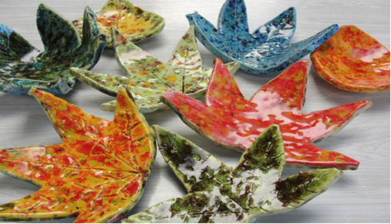
Clay Leaf Bowl

Slide 2
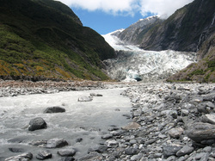
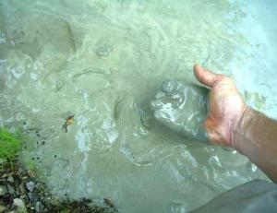
Clay Minerals from the earth: silica and alumina
Notes:
What is clay?
Minerals from the earth – specifically silica and alumina. Often clay is found near rivers where small particles of rock are carried down to a lower part and collect together to form clay.
Clay characteristics –
Clay is plastic when it’s wet –clay can be pushed, stretched, stamped, or impressed
Clay shrinks as it dries
Clay hardens as it dries – when wet it has no structural strength (can slump or distort if handled roughly) Bone dry clay, before heated, is quite brittle
Clay vitrifies when subjected to sufficient heat – clay becomes hard, durable, waterproof

Slide 3
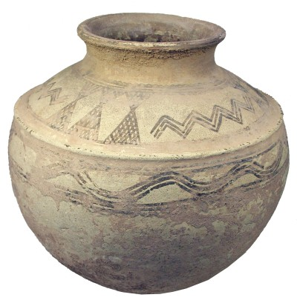
People have used clay for thousands of years to make items like pots.
Uses for clay
Notes:
How long have clay projects been around?
Clay pots have been found in current day Iran and China that date back to 5000 B.C. – that’s more than 6000 years ago! People around the world, including Native Americans in what is now the USA, used clay to make containers for food and to make bricks to build houses ( baked clay mixed with straw called adobe). Back then they used fire to cook and harden the clay.

Slide 4
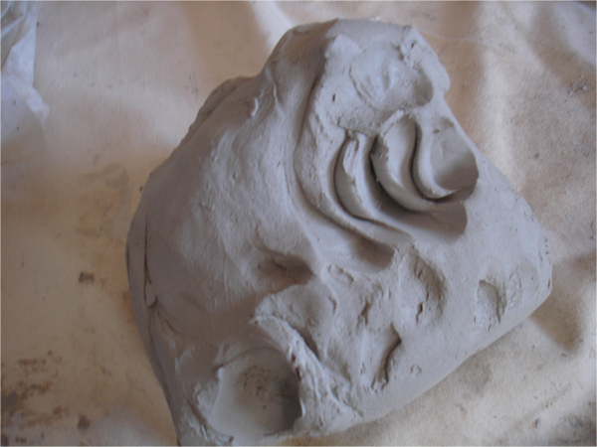
Plastic Stage
Workable
Moldable
Notes:
This is what the clay will look like that you have today. Your piece will be flat like a pancake though.

Slide 5
Greenware Stage
Wet, damp, soft leather-hard, leather-hard, stiff leather-hard, dry, and bone dry
Once it is dry and light gray it becomes very fragile
Notes:
These projects we make today will need to dry in the open air for a week or two (this is the greenware state-•Greenware (noun) is the term given to clay objects when they have been shaped but have not not yet been bisque fired, which converts them from clay to ceramic. Greenware may be in any of the stages of drying: wet, damp, soft leather-hard, leather-hard, stiff leather-hard, dry, and bone dry.)
When they are completely dry they will be fired in the kiln for the first time (bisque fired) and look like this when they are done (hold up a sample of bisque fired piece).
After that, I will come back and you will paint the projects with something called glaze which is a special liquid like a paint that’s made of bits of ground up glass. The piece will then be fired again in the kiln and will turn out like this (show a real glaze fired piece).
Getting started:
Students receive one canvas cloth on the desk, one slab of clay, fresh leaf about the size of an adult hand, dull pencil for writing name, paper clip for cutting clay, bowl for project drying, mini bowl with few drops of water for fingertip smoothing.

Slide 6
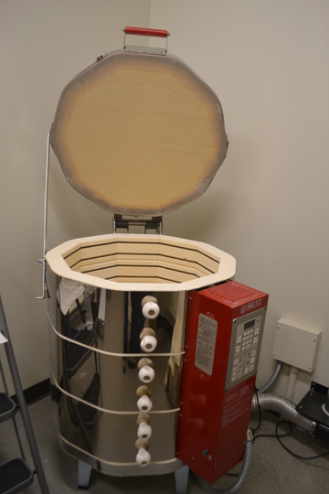
Electric Kiln
1800 -2000 degrees F
Notes:
People used to use fire to harden their clay. Today we use a special electric oven called a kiln to cook the clay. How hot does your kitchen oven at home reach when you are cooking food? 375 or 400 degrees F? Our kiln will cook your projects at about 1800 -2000 degrees F. (show photo of kiln)

Slide 7
Bisqueware Stage
After Fired in the kiln
Notes:
Cooking in a kiln is called firing. This is important because it makes the clay stronger and more waterproof. Clay that has been kiln fired would not return to a soft state even if it were in water for a long time. That is because the extreme heat causes permanent physical and chemical changes to occur. These reactions, among other changes, cause the clay to be converted into a ceramic material.
If you put wet clay in a tub of water it would turn mushy and lose it’s shape but clay that has been kiln fired and turned to bisqueware will retain it’s shape even if it were put in a tub of water. For example, the pitchers above would not turn back to soft lumps of clay if you poured water into it.

Slide 8
Next time…
We will paint the projects with something called GLAZE which is a special liquid like a paint that’s made of bits of ground up glass. Then they will be fired in the kiln again.

Slide 9
Steps:
Place the leaf (vein side down) on the clay slab.
Use a rolling pin to push leaf firmly into the clay to make an impression.
Trace around the perimeter of the leaf using the paper clip in an upright manner (adults may need to help).
Flip over clay to scratch student’s name on back with a dull pencil.
Remove leaf by lifting stem.
Place clay leaf in styrofoam or coated paper bowl and slump by pressing gently to achieve bowl shape with clay leaf.
Use a moist finger to smooth all the edges so they won’t be jagged or sharp once fired.
Set the bowl aside to dry for 1-2 weeks until ready to fire in the kiln.
Clean up!

